Slide 1
Efficient Catalog Matching with Dropout Detection
Dongwei Fan

Slide 2
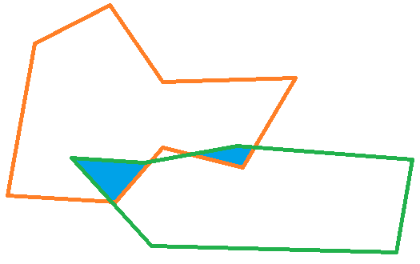
Motivation
Zones Algorithm is one of the fastest crossmatching methods
Blind to catalogs’ sky coverage information
The goal is to include the sky coverage info and make it faster

Slide 3
Outline
Crossmatch with Footprints/Sky Coverage information
Introduction
How to do
Dropout Detection
Crossmatch in Arbitrary region

Slide 4
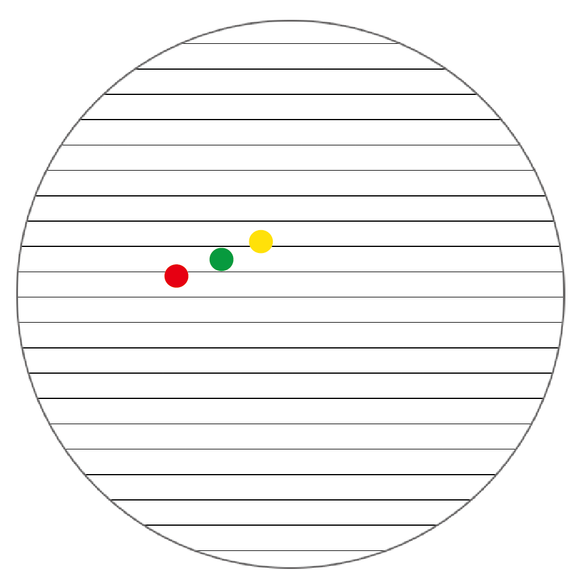
Crossmatching with Zones
Celestial Sphere was mapped to zones by Declination.
Every object and every zone has a ZoneID
$ZoneID=\left\lfloor \frac{δ+90°}{h}\right\rfloor ,$ $δ$ is Dec., h is height of zone
Every catalog will be indexed by the ZoneID and R.A.
Crossmatching only happens among the objects in nearby zones -- why Zones Algorithm so fast

Slide 5
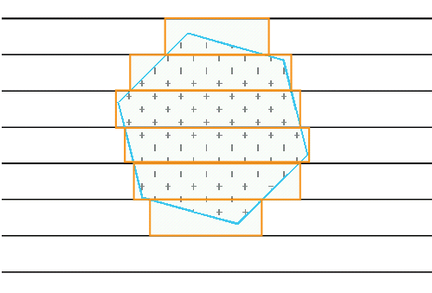
How to show footprint on Zones
Use intervals to approximate the footprint
Save intervals in Datatable
Zones are narrow. i.e. 7.1 arcsec height. So the approximation is very closed to the footprint.
This will take longer, but it is one time operation.

Slide 6
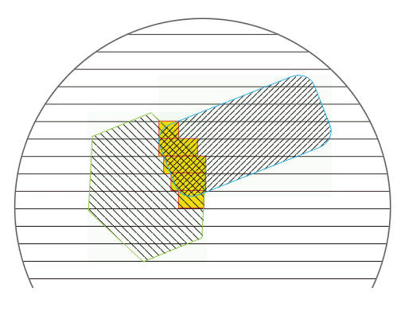
Intersect footprint by their intervals
Intersection intervals are also stored in an interval data table This step have to do for every pair of catalogs. It is very fast to complete in database.

Slide 7
Outline
Crossmatch with Footprints/Sky Coverage information
Introduction
How to do
Dropout Detection
Crossmatch in Arbitrary region

Slide 8
Step by Step
Step 1: Zones Definition
Step 2: Approximate Footprint by intervals
Step 3: Footprint Intersection
Step 4: Index Catalogs & create ZoneZone
Step 5: Crossmatch with sky coverage intersection

Slide 9
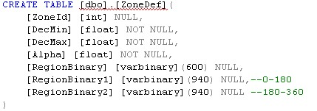
Step 1: Zone Definition
Create Table ZoneDef (Dec -90°- 0°,0°-90°)
Calculate the Alpha for each Zone
Calculate BinaryRegion for all zones
Cut each Zone to two parts(RA 0°-180°, 180°-360°)
After Step 1 we get a ZoneDef Table

Slide 10
Handle the wrap around problem
From Spherical Library, the boundary points are easy to calculated, but we cannot determine which is at the left
Two ranges in figure could be $(30, 330)$ or $(330, 360)∪(0, 30)$
Select Min(Ra),Max(Ra): both return $(30, 330)$
Which one is the real range?
If it is (30, 330) - the purple line, that is OK
But if (330,360)∪(0,30)?
So cut the zone to (0,180),(180,360) then intersect with the region separately
Then select Min(Ra), Max(Ra):
For purple line return (30,180),(180,330) -- could be merged
For blue line return (330,360),(0,30)

Slide 11
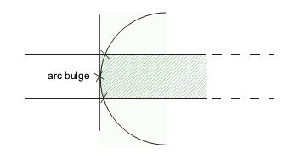
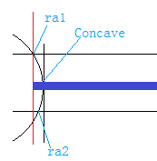
Step 2: Approximate Footprint
Get the Footprint of a catalog
Make Regions Intersection between Footprint and Zones
Calculate the Outline and get the intervals in zones – be careful of the buldge
Merge intervals in the same zone, if they have intersection

Slide 12
How to calculate the outline

Slide 13
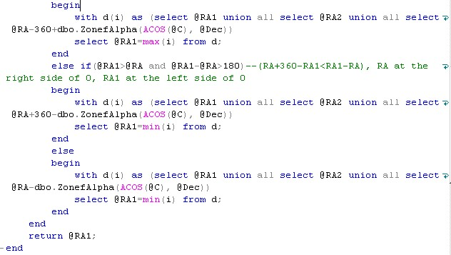
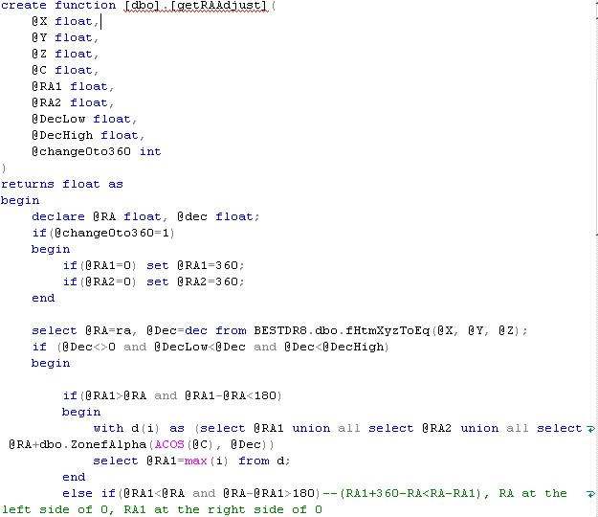
How to get the outline with bulge

Slide 14
How to merge intervals in a zone
Structure of Table

Slide 15
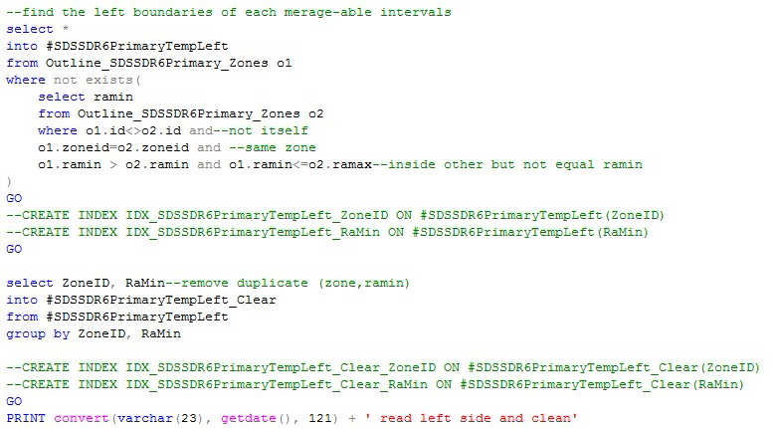
T-SQL to merge intervals -1

Slide 16
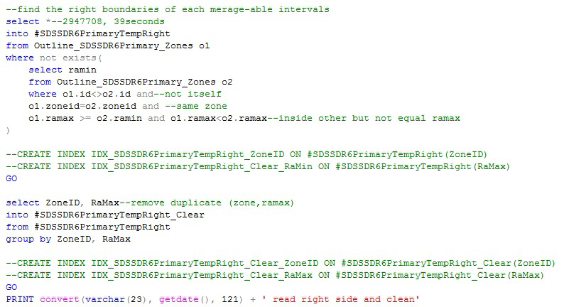
T-SQL to merge intervals -2

Slide 17
T-SQL to merge intervals -3

Slide 18
Step 3: Intersect Footprint
Intersect footprints’ intervals approximation
Assume: GALEX Intervals approximation (Red)
SDSS Intervals approximation (Black)
Handle wrap around problem, if RaMax+Alpha>360 insert (RaMin-360, RaMax-360)
After Step 3 we get what we want: the new common sky coverage of two catalogs
dbo.OutlineIntr(
ZoneId int,
RaMin float,
RaMax float,
primary key(ZoneId, RaMin, RaMax)
)

Slide 19
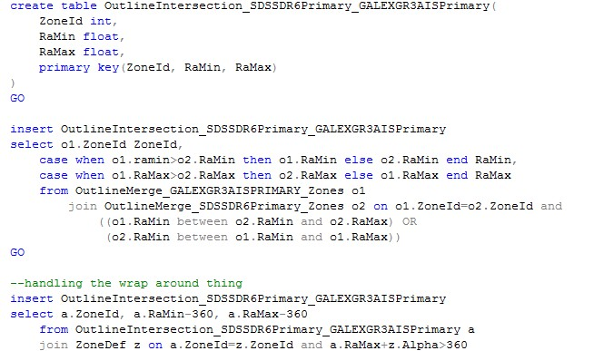
How to intersect intervals

Slide 20
Step 4: Index Catalogs
Totally the same as Zones Algorithm
Create ZoneID for each object and create an index on (zoneid, ra, objid)
Create a ZoneZone table to indicate database to only search objects in nearby zones – by Jim Gray
Create ZoneZone( zone1 int,--current object’s zoneid zone2 int,--which zones should be scanned alpha float, primary key(zone1, zone2) )

Slide 21
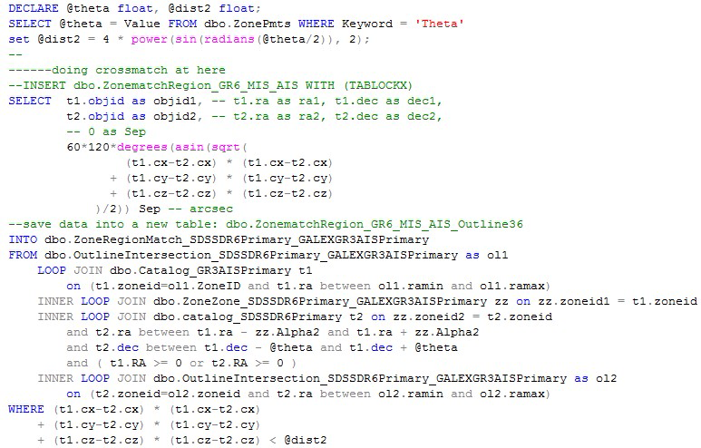
Step 5: Crossmatch with sky coverage intersection

Slide 22
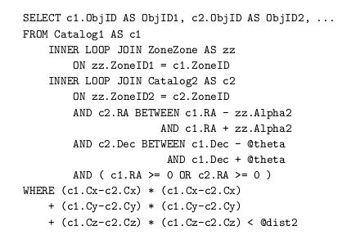
SQL Implementation
Original Zone Match

Slide 23
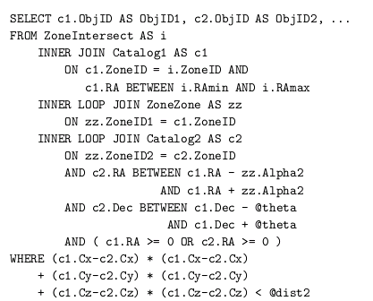
SQL Implementation
Original Zone Match
Zone Match in footprint intersection

Slide 24
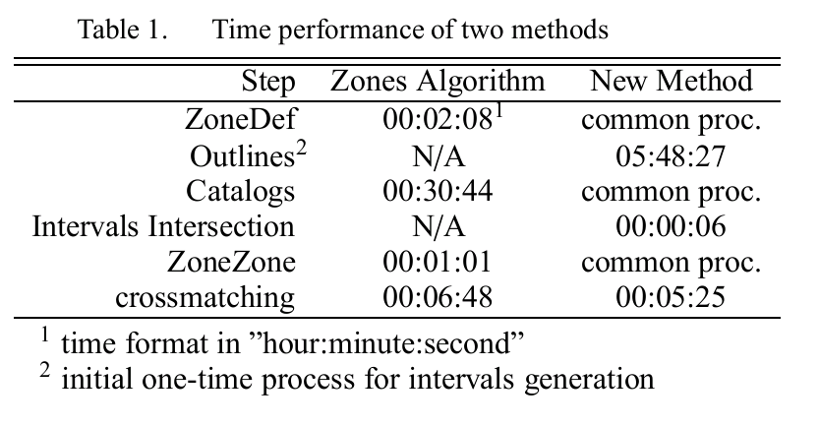
Performance
Tested on thumper.pha.jhu.edu, with SDSS DR6 (230.4m objects) and GALEX GR3 AIS (54.9m objects) catalogs. Their overlap on the sky is 3689 Square degrees.

Slide 25
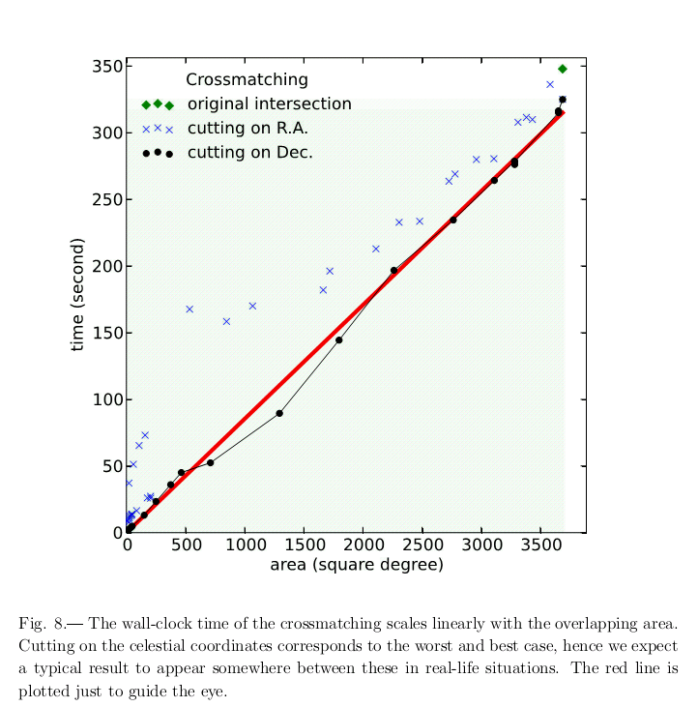

Slide 26
Outline
Zone Match in two (or more) Footprints/Sky Coverage
Introduction
How to do
Dropout Detection
Crossmatch in Arbitrary region

Slide 27
Dropout identification
For a catalog (C1), we could know
1. which objects are inside the intersection (I)
2. which objects were matched(M) with the other catalog (C2)
C1 >= I >= M
I - M = IM: Objects inside the intersection but do not be matched
IM could be the objects which cannot be found by C2.
IM are the dropouts of C2. That would mean some objects in C2 is fainter than C1.

Slide 28
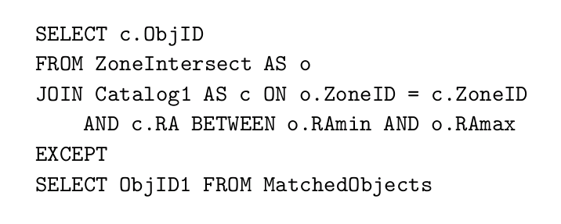
Code

Slide 29
Performance
A total of 4.2 million SDSS’s dropouts from GALEX,
which are inside the SDSS coverage but do not have associated counterparts,
were found in just 29 seconds.

Slide 30
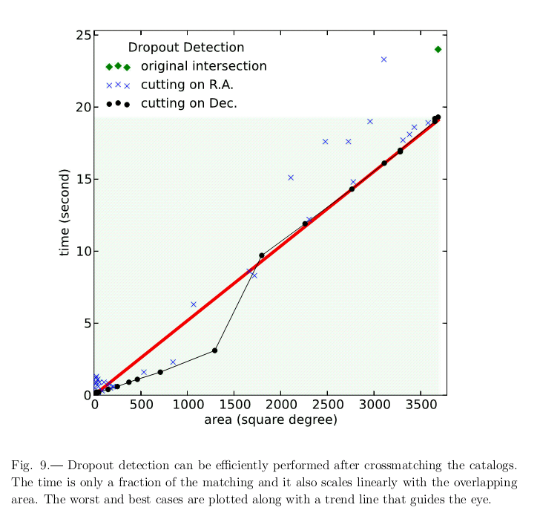

Slide 31
Outline
Zone Match in two (or more) Footprints/Sky Coverage
Introduction
How to do
Dropout Detection
Crossmatch in Arbitrary region

Slide 32
Crossmatch in Arbitrary Region
Step 1: create the Arbitrary Region we want
Step 2: approximate the region by intervals
Then, we could
Select objects in the region – will be implemented as a plugin on my software - FITS Manager
Even crossmatch objects in the intervals

Slide 33
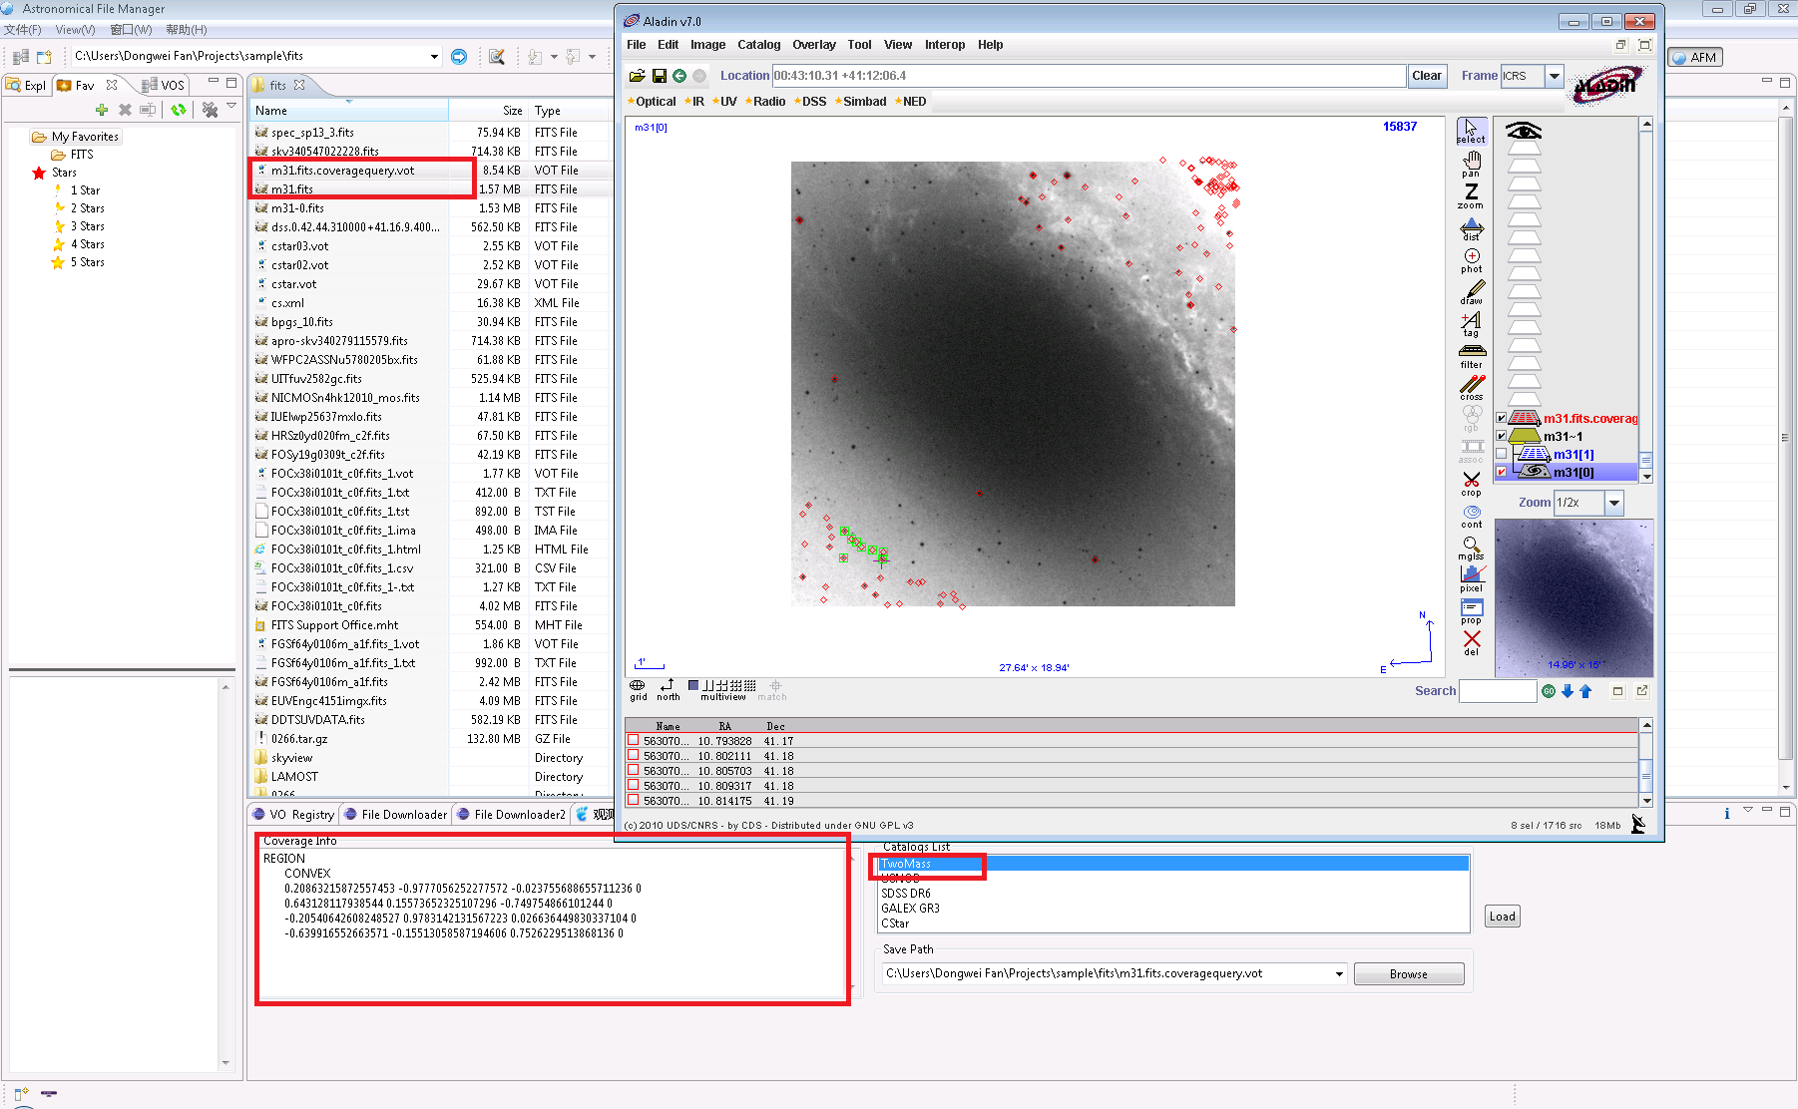

Slide 34
Summary
Matching is fast with the Zones Algorithm
But it is blind to sky coverage
Sky coverage typically done separately
Needs separate indices: yields slow combination
Here we combine the two using the same index
Faster matching for partial overlaps
Increased performance for the on-the-fly runs
This will be part of the SkyQuery

Slide 35
News
A big project from China-VO was approved.
The total amount will be about 1.5M US$ from two founding.
It is an Astronomical Resource Planning platform for the telescopes in China.
Tasks: observation time application, proposal review, data archiving, data release and sharing, scientific discovery collection, will be (or demanded) done on the platform. The platform will provide proposal submission, data access, limited data processing and data mining, and maybe more functions, to astronomers.
Achievements from the IVOA and VO partners will be adopted heavily by the platform.

Slide 36
Thanks

