Slide 1
Deep Spectroscopy of Planetary Nebulae
in the Substructures of M31
Xuan Fang
The University of Hong Kong
With thanks to:
Xiaowei Liu (PKU, China)
Yong Zhang (HKU, China)
Haibo Yuan (BNU, China)
Martín A. Guerrero (IAA, Spain)
Rubén García-Benito (IAA, Spain)
Antonio Cabrera-Lavers (GTC, Spain)
Yunnan University, Feb. 19th 2017

Slide 2
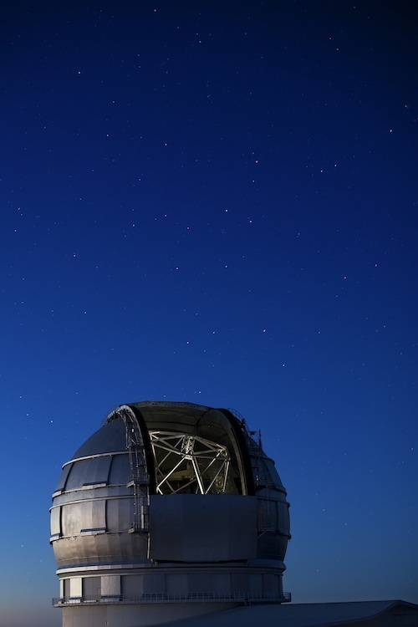
Outline
Background
GTC observations and results
Summary

Slide 3
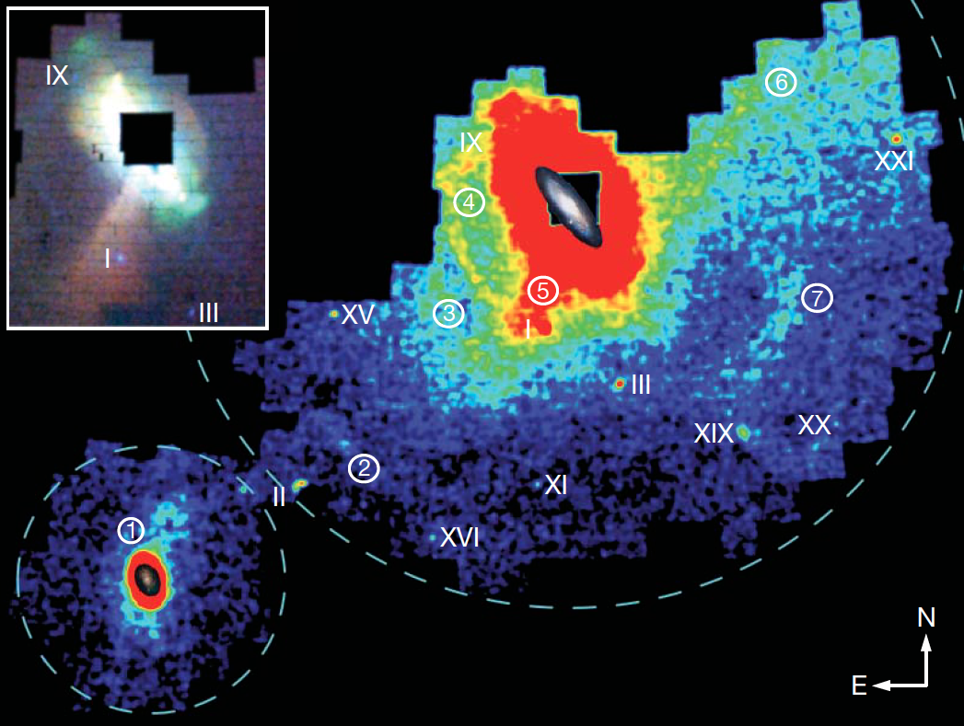
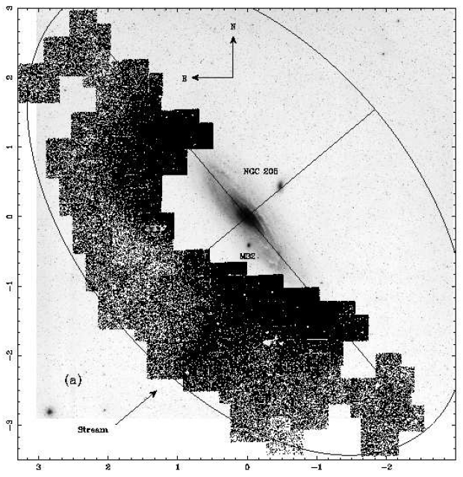
Stellar density map of M31-M33
from PAndAS survey
Figure adopted from McConnachie et al. (2009)
Ibata et al. (2001)
M33 structure
125-kpc stream A
stream C
eastern arc (stream D)
Giant Stellar Stream
northwest minor axis stream
southwest could
Giant Stream

Slide 4
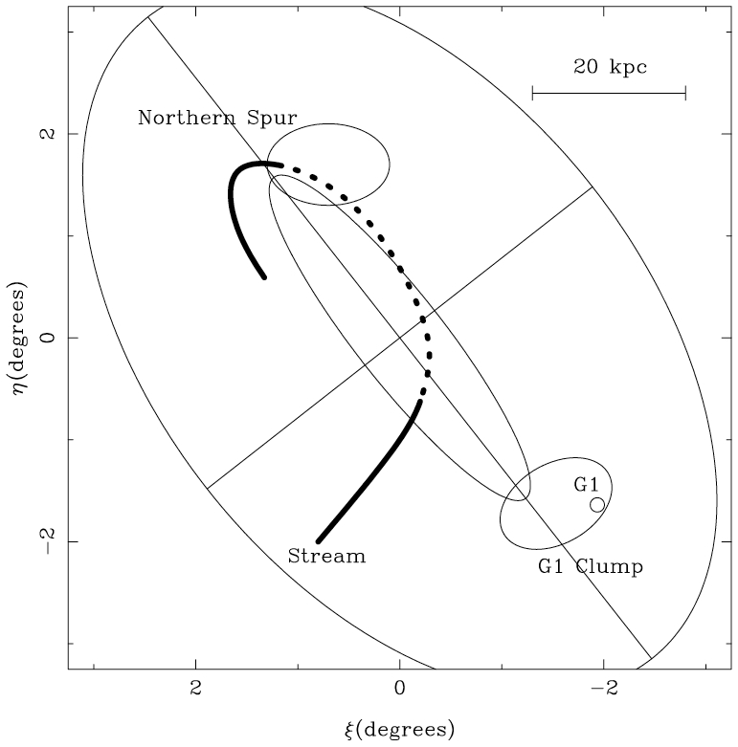
Stellar density map of M31-M33
from PAndAS survey
Figure adopted from McConnachie et al. (2009)
Ferguson et al. (2002)
M33 structure
125-kpc stream A
stream C
eastern arc (stream D)
Giant Stellar Stream
northwest minor axis stream
southwest could

Slide 5
The low-resolution (R~1000) optical spectrum of a planetary nebula (PN)
PNe can provide accurate velocity and abundance measurements;
PNe are excellent tracers of chemistry, kinematics and stellar populations of galaxies;
PNe can be detected in galaxies at large distances.

Slide 6
M31
Planetary Nebulae in M31
1°
0°.75
M31 is the nearest (780 kpc) spiral system and an excellent candidate to study galaxy formation;
~3000 planetary nebulae have been identified in M31 (Merrett et al. 2006).
NGC205
1) PNe in the M31 disk have been observed since 1970s to derive abundance gradients.
2) Spectra of PNe in the substructures of M31 are lacking.
M32

Slide 7
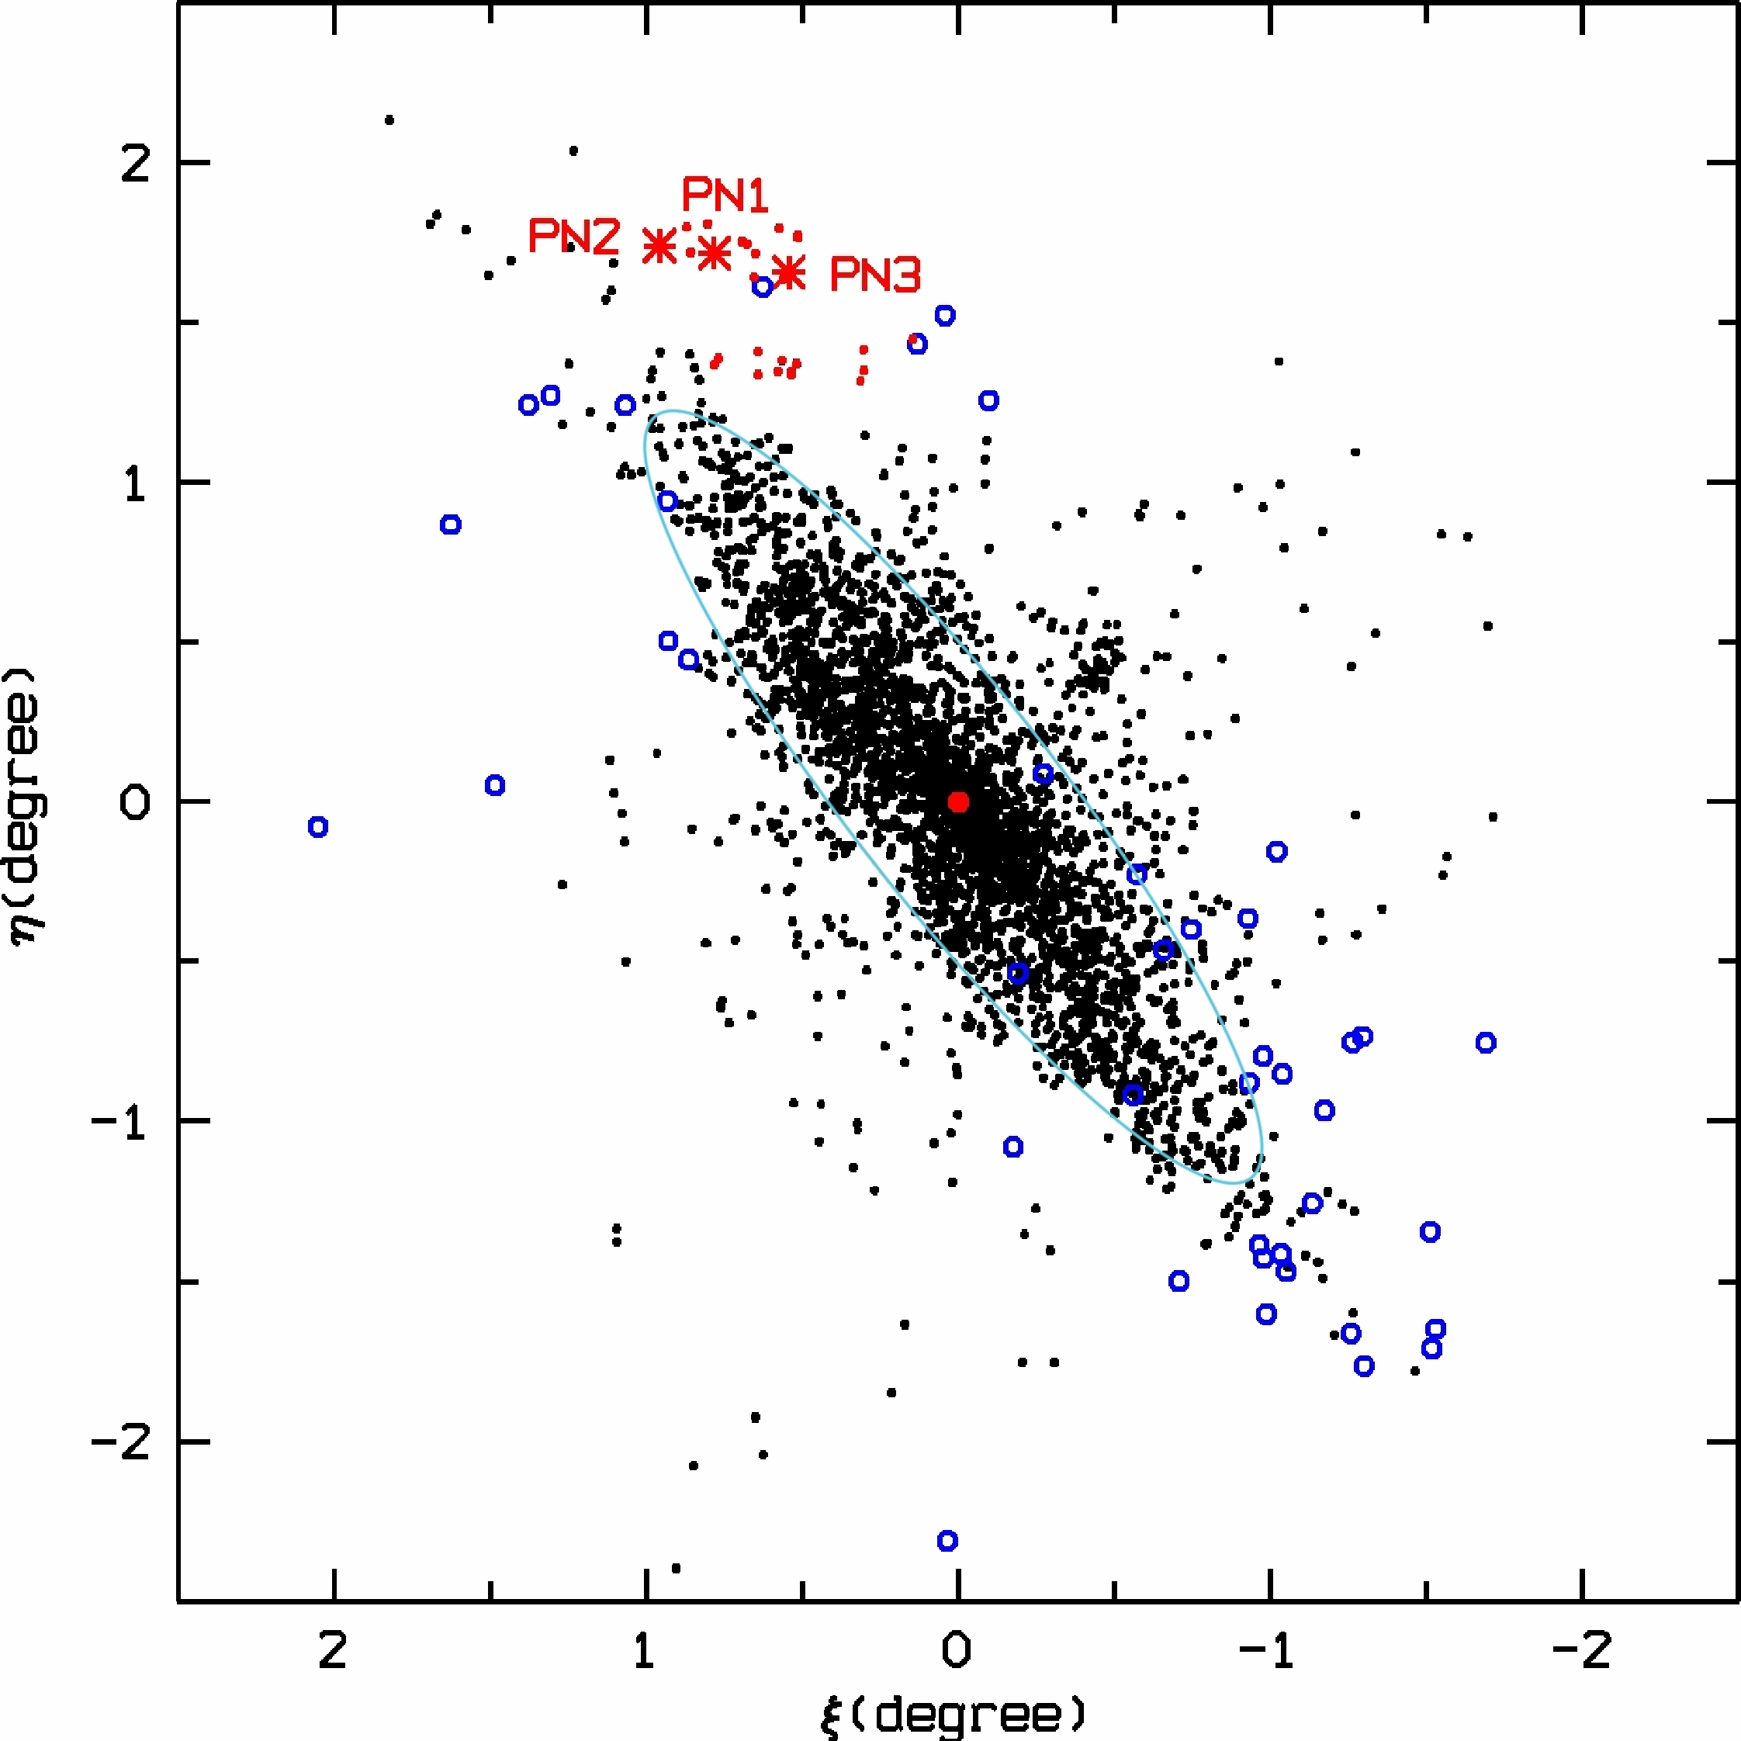
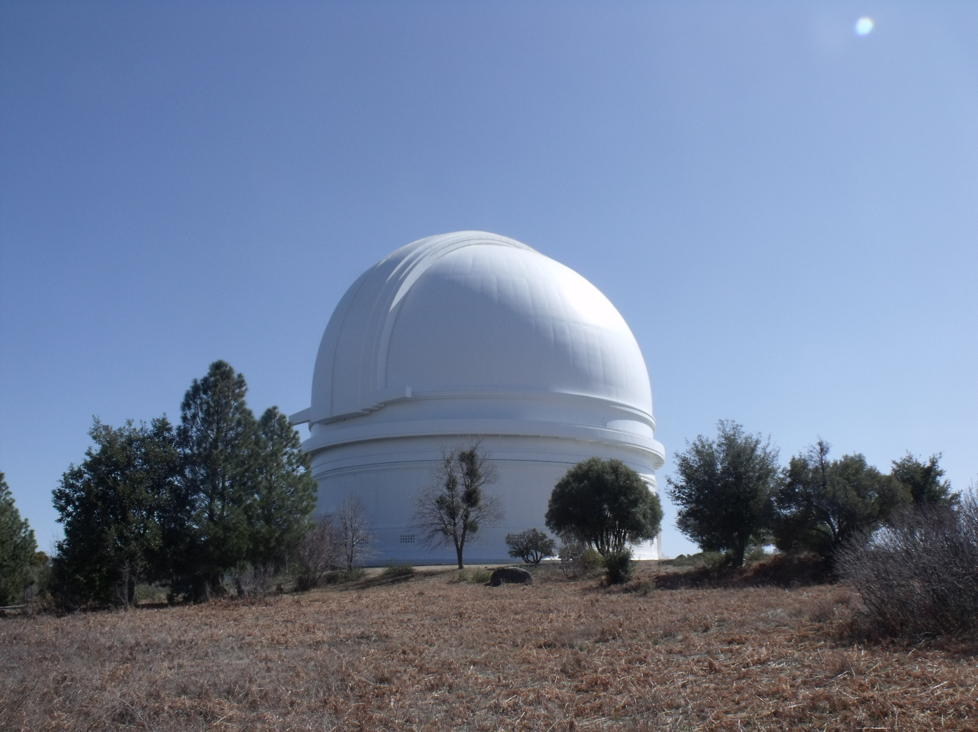
Spectroscopy of PNe in the Northern Spur substructure of M31
(Fang et al. 2013, ApJ, 774, 138)
m₅₀₀₇ ~20.61–20.84
Black dots: Merrett et al. (2006)
Blue open circles: Yuan et al. (2010)
Red asterisks: Palomar sample
Supported by the Telescope Access Program (TAP).
The first chemical study of PNe in a substructure of M31.
Instrument:
Double Spectrograph (DBSP) on the 5.1m Hale Telescope (P200).
Hale 5.1m, Palomar, CA.
Sept. 22-23, 2011

Slide 8
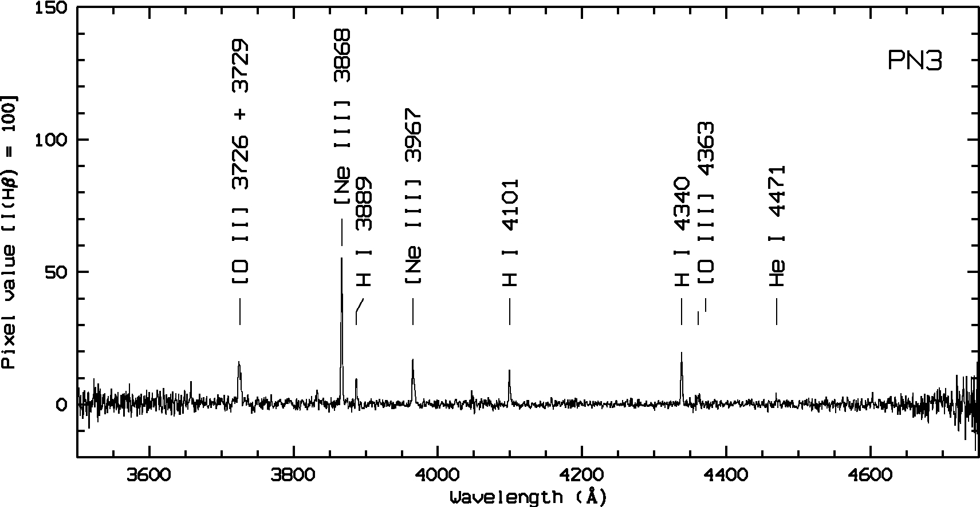
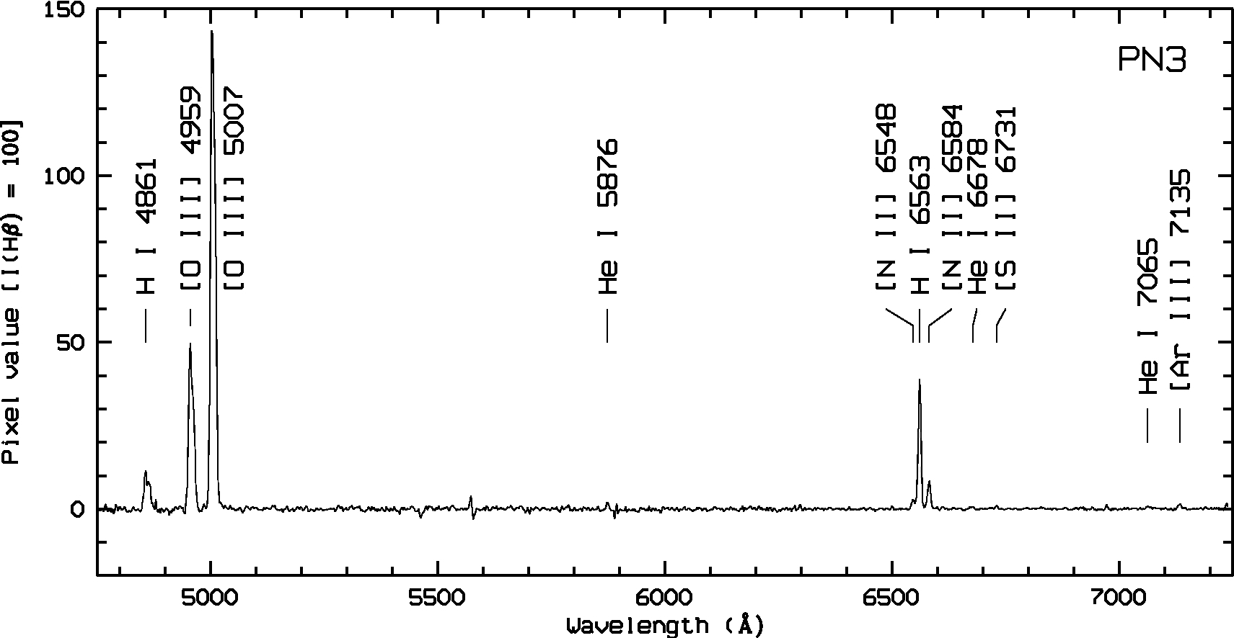
Exposure: 6×1800s
DBSP blue spectrum of PN3:
Larger telescopes are needed!
Exposure: 6×1800s
DBSP red spectrum of PN3:
Fang et al. 2013, ApJ, 774, 138

Slide 9
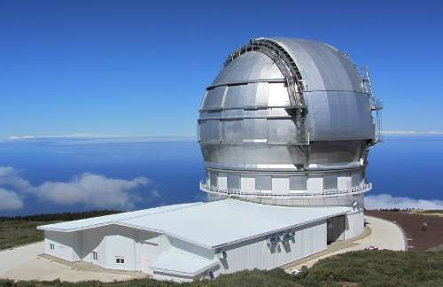
GTC observations (#GTC55-14B)
GTC OSIRIS spectroscopy (2014 Aug. 23–29)
15 hours awarded for seven targets
Dark moon; seeing ~0.6”–0.8”; 1” wide long slit
Two CCDs, 2k×4k each; 0.127”/pixel
Grism R1000B (3620–7780 Å)
FWHM ~ 6 Å (2.06 Å/pixel)
10.4m Gran Telescopio Canarias
La Palma
ID | R.A. (J2000) | Decl. (J2000) | m₅₀₀₇ | V_{helio} (km/s) | R_{gal} (kpc) | Location | GTC exposure
PN1 | 00:45:52.8 | +42:36:52.9 | 20.65 | -149 | 20.1 | Northern Spur | 4 × 1250s
PN2 | 00:46:59.3 | +42:37:58.2 | 20.81 | -81 | 21.6 | Northern Spur | 4 × 1250s
PN3 | 00:46:26.5 | +43:00:43.0 | 20.48 | -420 | 25.7 | Northern Spur | 4 × 1250s
PN4 | 00:43:32.3 | +41:58:42.5 | 20.99 | -579 | 9.93 | Giant Stream | 4 × 1200s
PN5 | 00:43:07.9 | +41:28:45.5 | 20.82 | -713 | 3.05 | Giant Stream | 4 × 1200s
PN6 | 00:42:40.3 | +41:19:07.4 | 21.23 | -766 | 0.70 | Giant Stream | 4 × 1200s
PN7 LAMOST | 00:49:29.0 | +37:50:45.4 | 21.51 | -203 | 50.2 | Giant Stream | 4 × 2400s 1 × 1200s
Fang et al. 2015, ApJ, 815, 69

Slide 10
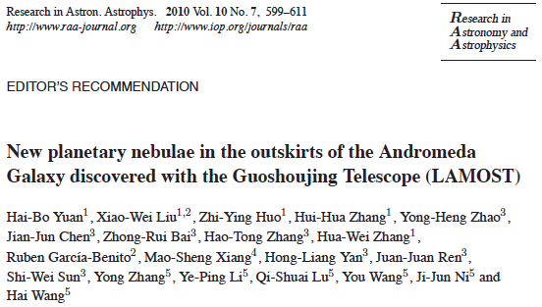
Targets were selected from the catalogues:

Slide 11
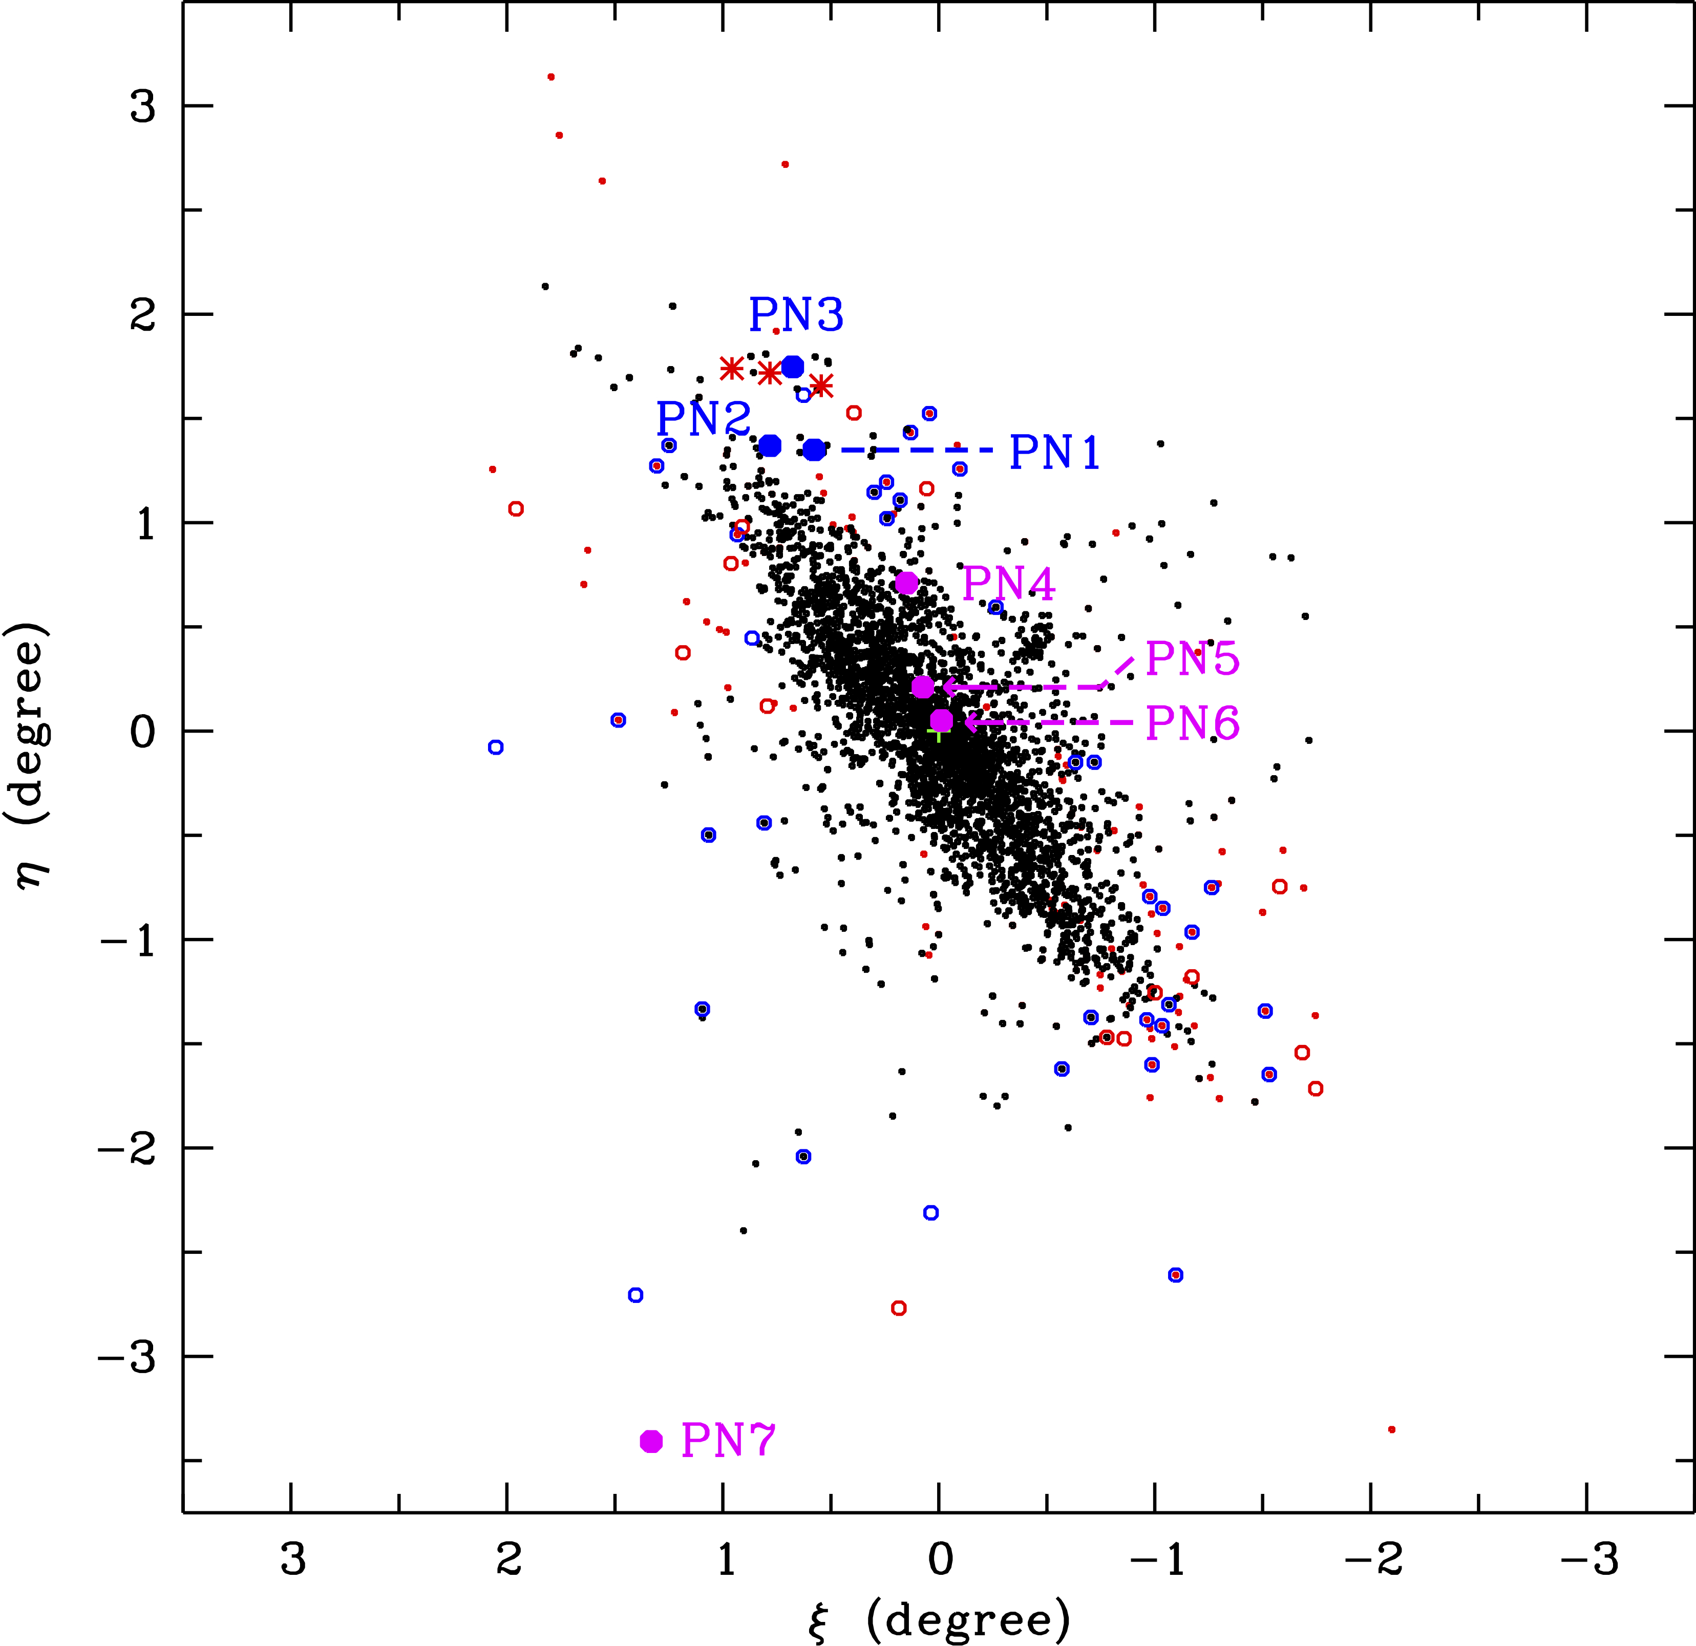
GTC spectroscopy of PNe in the Northern Spur and the Giant Stream of M31.
Red asterisks: Fang et al. (2013)
Blue and magenta filled circles: GTC targets of Fang et al. (2015)
Black dots: Merrett et al. (2006)
Blue open circles: Yuan et al. (2010)
Red open circles: LAMOST new
Purpose:
To derive accurate abundances using deep PNe spectra.
The 10.4m GTC
1) newly discovered by LAMOST;
2) in the outer stream of M31;
3) both spatially and kinematically related to the Giant Stream.

Slide 12
M31 Oxygen gradient exhibited by PNe and H II regions
Linear fit of the disk sample of Kwitter et al. (2012)
The samples of Zurita et al. (2012) and Esteban et al. (2009) are H II regions; the others are PNe.
Our PNe have homogeneous oxygen abundances within the errors, <log(O/H) + 12> = 8.54 ± 0.12
Fang et al. 2016, IAUS. 323, in press

Slide 13
New GTC observations (#GTC25-16B)
GTC OSIRIS spectroscopy (2016 Sept. 2–11)
30 hours awarded for 11 targets
Clear nights, dark moon; seeing 0.7”–0.8”
Grisms R1000B (3630–7850 Å) and R1000R (5080–10370 Å); slit width 1.0”
ID | RA | Dec | m₅₀₀₇ | Location | Exposure
PN8 | 00:47:25.9 | +42:58:59.7 | 21.32 | Northern Spur | 2 × 2400s
PN9 | 00:46:13.8 | +42:40:28.5 | 20.88 | Northern Spur | 4 × 1200s
PN10 (LAMOST) | 00:44:03.1 | +42:27:46.6 | 20.74 | Northern Spur | 4 × 1200s
PN11 | 00:47:30.3 | +43:03:41.1 | 20.69 | Giant Stream | 4 × 1200s
PN12 | 00:49:08.0 | +42:28:44.5 | 21.96 | Giant Stream | 4 × 2400s
PN13 (LAMOST) | 00:49:55.2 | +38:32:49.0 | 21.91 | Outer Halo | 4 × 2400s
PN14 | 00:48:27.2 | +39:55:33.8 | 21.43 | Giant Stream | 4 × 2400s
PN15 | 00:45:58.5 | +39:13:25.4 | 21.10 | Outer Halo | 8 × 1200s
PN16 | 00:42:42.2 | +40:51:39.8 | 20.78 | M32 | 6 × 1000s
PN17 (LAMOST) | 00:53:38.6 | +41:09:32.3 | 21.15 | Outer Halo | 5 × 2100s
PN18 | 00:42:42.3 | +40:51:49.5 | 20.13 | M32 | 6 × 1000s
Note: PN18 is too close to the center of M32, and no emission lines were detected.

Slide 14
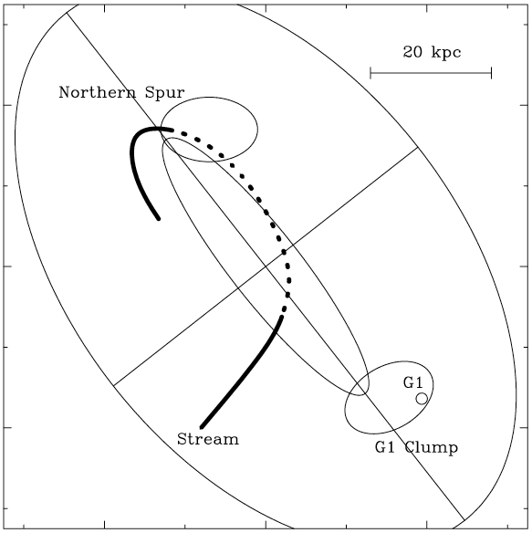
New GTC observations
(#GTC25-16B)
Blue: PNe in the Northern Spur
Red: PNe associat. with the Giant Stream
Green: PNe in the outer halo of M31
Magenta: the PN in M32
Target positions in M31:
Fang et al. in preparation

Slide 15
Kinematics of the Target PNe
The line-of-sight velocity with respect to M31, V_{los}, versus the distance along the major axis:
Blue: PNe in the Northern Spur
Red: PNe associat. with the Giant Stream
Green: PNe in the outer halo of M31
Magenta: the PN in M32
PN14
PN8
PN7
PN10
PN15
PN11
PN12
PN13
PN17
Most of the PNe in our GTC sample kinematically deviate from the exodisk of M31.

Slide 16
GTC OSIRIS spectrum of target PN17 (m₅₀₀₇ = 21.15)
obtained from the R1000B grism
Raw:
Reduced:

Slide 17
GTC OSIRIS spectrum of target PN17 (m₅₀₀₇ = 21.15)
R1000B (5 × 35 min) + R1000R (2 × 30 min)

Slide 18
M31 Oxygen Gradient (including the new observations)
Linear fit of the disk sample of Kwitter et al. (2012)
(M32 PN)
The outer-halo PNe (PN13 and PN15) have solar O/H ratios.
The halo target PN17 discovered by LAMOST probably belongs to some substructure.
The substructure PNe seem to have lower O/H ratios than the outer-halo objects.

Slide 19
Abundance correlations: N/O vs. He and O
N/O vs. He/H
N/O vs. O/H
Red filled circles – All our GTC samples (Fang et al. 2015, 2017)
Red open circles – PNe sample observed by Fang et al. (2013) using P200
Black filled circles – M31 disk PNe of Kwitter et al. (2012)
Black filled diamonds – M31 outer disk PNe of Balick et al. (2013) and Corradi et al. (2015)
Black open circles – M31 bulge PNe of Jacoby & Ciardullo (1999)
Black open triangles: the Galactic Type I PNe of Milingo et al. (2010)
Fang et al., in preparation

Slide 20
Abundance correlations: N/O vs. He and O
N/O vs. He/H
M32 PN
N/O vs. O/H
M32 PN
Red filled circles – All our GTC samples (Fang et al. 2015, 2017)
Red open circles – PNe sample observed by Fang et al. (2013) using P200
Black filled circles – M31 disk PNe of Kwitter et al. (2012)
Black filled diamonds – M31 outer disk PNe of Balick et al. (2013) and Corradi et al. (2015)
Black open circles – M31 bulge PNe of Jacoby & Ciardullo (1999)
Black open triangles: the Galactic Type I PNe of Milingo et al. (2010)
Fang et al., in preparation

Slide 21
Summary
We have obtained deep GTC spectra of 17 extragalactic PNe.
13 in the substructures (the Northern Spur and the Giant Stream) of M31
3 in the extended disk of M31
1 in M32
The most interesting targets were selected from the LAMOST catalogue.
Yuan et al. (2010, RAA, 7, 599)
Abundance analysis of our sample shows:
Our M31 targets are all Type II PNe; the M32 seems to be Type I.
The Northern Spur and the Giant Stream PNe have close O/H ratios.
The outer-disk PNe, as far as ~180 kpc from the M31 center, have solar O/H ratio.
The substructure PNe have lower O/H ratios than the outer-disk targets.
Possible origin of the Northern Spur and the Giant Stream substructures:
The spatial and kinematical information and the consistency in abundances indicate they might have the same origin.
The M32 PN belongs to a different population from the PNe of the two substructures.
Who is responsible for the two substructures? Probably some other satellite(s) …

Slide 22
Backup slide

Slide 23
The spatial and kinematical distribution of the GTC sample
The Northern Spur and the Giant Stream seems to be well connected by the stellar orbit proposed by Merrett et al. (2003)
M32
This figure shows the spatial and kinematical distribution of PNe in M31.
Our PNe are kinematical different from the classical disc of M31.
Satellite M32 might be responsible for the origin?

