Slide 1
Spectral classification of galaxies of LAMOST DR3
Li-Li Wang
llwang@nao.cas.cn
National Astronomical Observatories
February 19, 2017

Slide 2
Aim
Make spectral classification of galaxies in the third data release of the Large Sky Area Multi-Object Fiber Spectroscopic Telescope(LAMOST) using spectral line features(Hβ, [OIII]λ5007, Hα and [NII]λ6585).
Compute average spectra for classes to understand the typical line features of different classes.

Slide 3
OUTLINES
1. Introduction
2. Data
3. Line measurements
4. Classification of galaxies
5. Average spectra
6. Summary

Slide 4
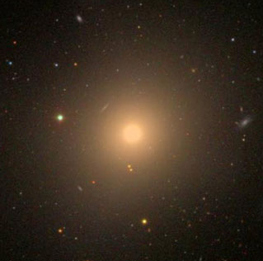
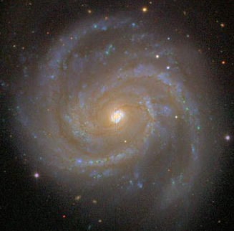
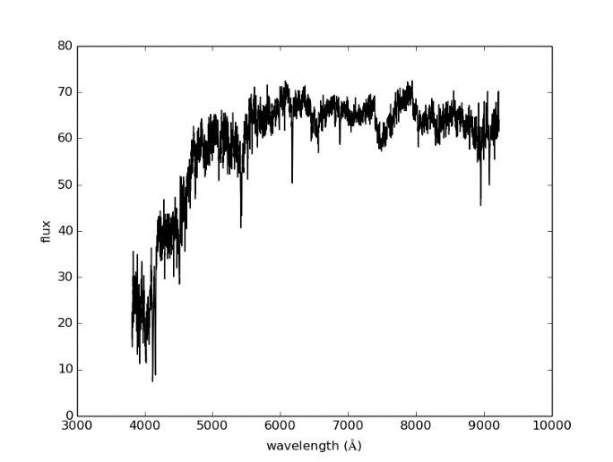
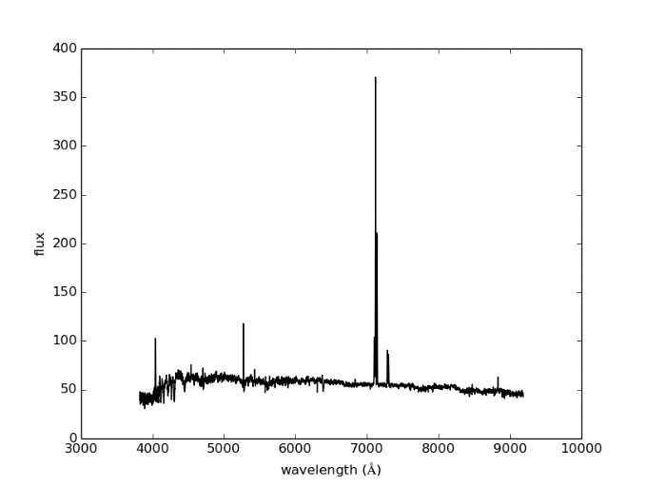
1. Introduction
One of the major goals of extragalactic astronomy is to comprehend the nature of the diverse galaxies.
The first step towards the goal is to classify them using some criteria and
compare their properties among the classes.

Slide 5
1. Introduction
In this work, we focus on:
make spectral classification of galaxies based on spectral line features;
preliminarily analyze the correlation of spectral classes with morphological types;
investigate typical spectral features of different classes through average spectra;
and present a galaxy catalog with classification and related information.

Slide 6
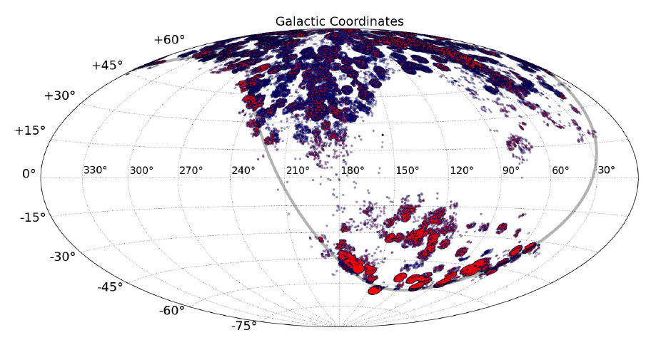
2. Data
Redshift: mean—0.093；
The median values of magnitude in g, r and i bands are located at 17.6, 16.9, and 16.4 respectively；
S/N in r band: median—10
The Galactic coordinates of all galaxies in LAMOST DR3
Data selection:
(1)redshift z<=0.3
(2)With cross-matches in the photometric catalog of SDSS
(3) S/N>=3 in r band
Pick out 51429 spectra of galaxies

Slide 7
3. Line intensity measurements
Precise line intensity measurement plays the key role in the following classification.
An observed spectrum
Subtract the stellar absorption features
Using stellar population synthesis to obtain a best-fitting stellar population model.
Gaussian fit
Flux re-calibration
requires accurate continua of galaxy spectra.
to correct the continuum of galaxy spectrum

Slide 8
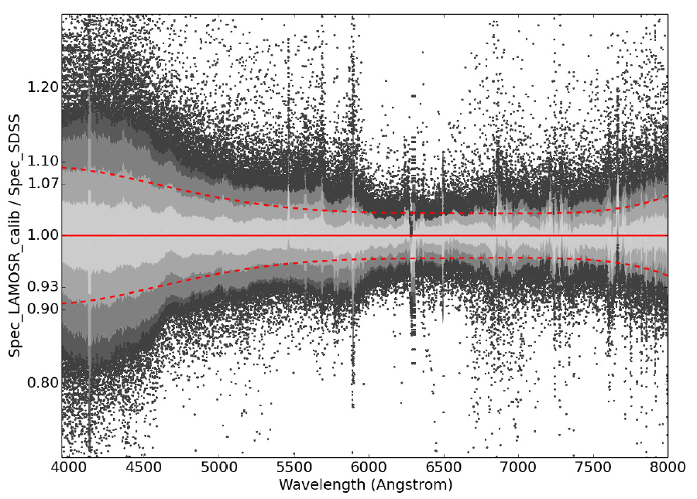
3. Line intensity measurements
Flux re-calibration
By cross-matching our sample with SDSS DR13 photometric catalog in 3 arcseconds radius, we re-calibrate LAMOST fluxes using the g, r, and i fiber magnitudes.
The original fluxes of LAMOST released spectra are corrected to the fluxes which are corresponding to photometric magnitudes by a low-order polynomial.
The standard deviation (red dash curve) is less than 7% in the wavelength range from 4,500 Å to 8,000 Å,
and increases to 9% in the band below 4,500 Å due to the rapid decline of the instrumental throughput.
Comparison between LAMOST re-calibrated spectra and the spectra of the same sources from SDSS

Slide 9
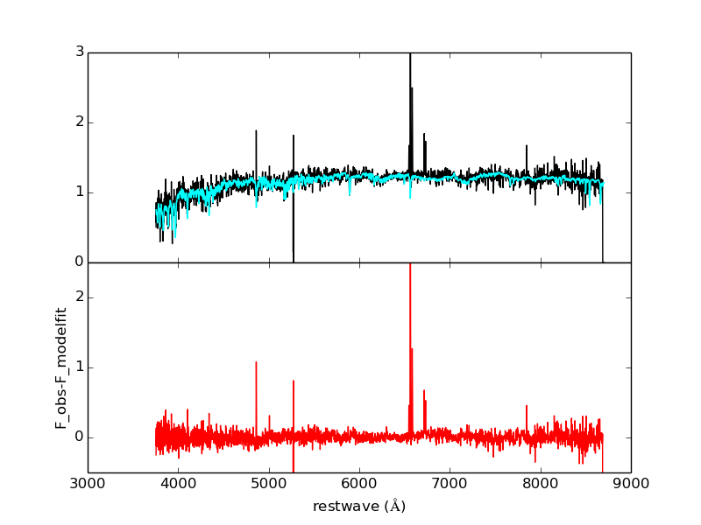
3. Line intensity measurements
an observed spectrum
best-fitting model spectrum
Hα
NII
Hβ
OIII
subtraction
An example of stellar population synthesis

Slide 10
4. Classification of galaxies
Classification schema
a spectrum
Hα emission is detected at greater than 3σ ?
non emission-line galaxy
passive
Hα_weak
emission-line galaxy
Star forming
composite
LINER
Seyfert
N
Y
Based on BPT diagram

Slide 11
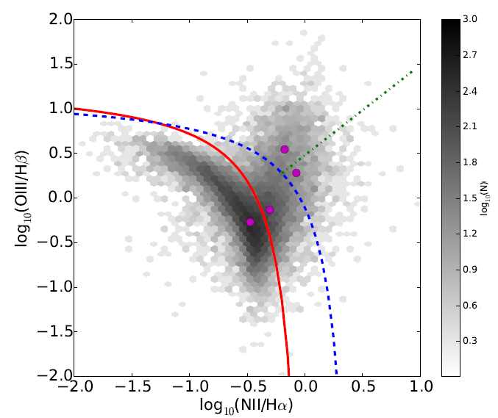
4. Classification of galaxies
red segregation curve：Kauffmann et al. 2003a
blue segregation curve：Kewley et al. 2001
green segregation curve：Cid Fernandes et al. 2010
BPT diagram for emission-line galaxies in our sample

Slide 12
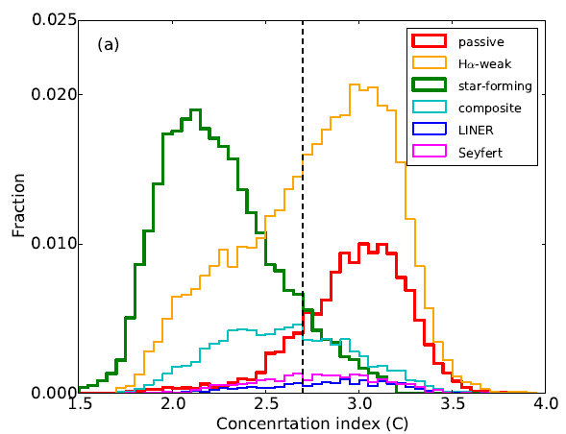
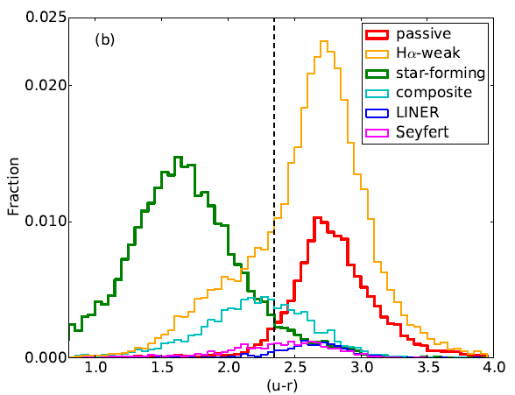
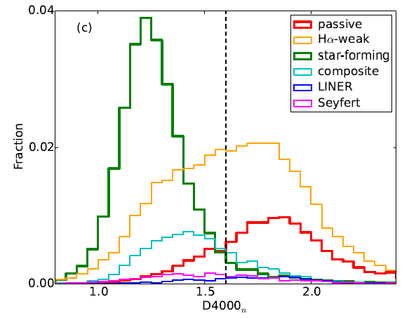
4. Classification of galaxies- Correlation with morphological class
morphological types：early type and late type
Some researches：C=2.6, u-r =2.22 to separate the early and late type;
D4000n is age indicator(D4000n=1.6)
Distribution of concentration index, (u - r) color, D4000n
We find that C = 2.7, (u - r ) =2.35 and D4000n=1.6 are the optimal separators among star-forming galaxies and passive galaxies

Slide 13
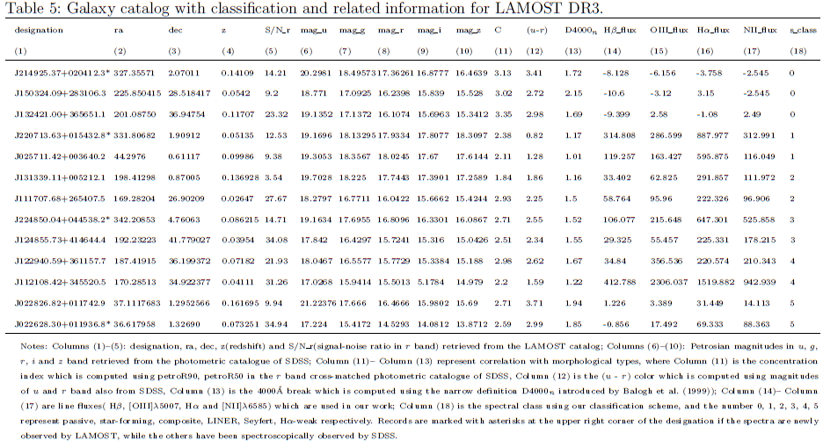
4. Classification of galaxies- Galaxy catalog
A catalog of LAMOST DR3 galaxies with classification and related information are provided, including 51,429 entries (47,871 targets), in which 16,112 spectra (14,369 targets) are newly observed while the others have been spectroscopically observed by SDSS.

Slide 14
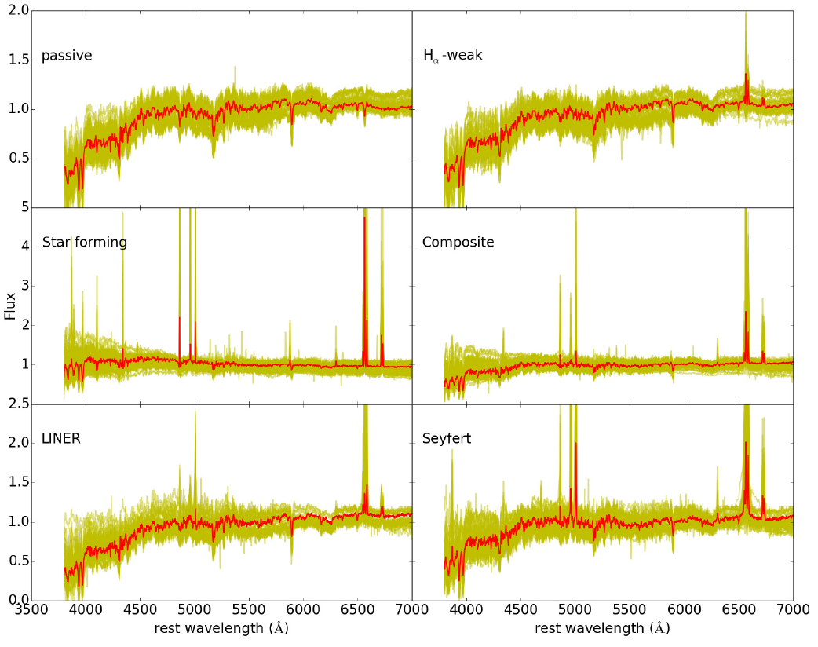
5. Average spectra
we calculate the average spectra of different classes to analyze the typical line features of different classes, and further explore what features are sensitive to different classes.
Average spectra of different classes in our galaxy sample

Slide 15
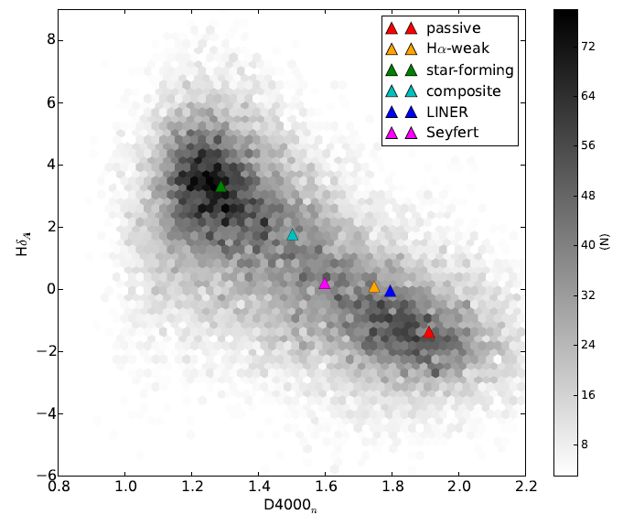
5. Average spectra
In D4000n –Hδ plane, Our average spectra clearly follow the previous research:
Kauffmann et al. 2003b,c
Galaxies are located along a straight line: low-mass star-forming galaxies are close to the top-left corner of the plot, while high-mass passive galaxies are in the bottom-right corner.
D4000n vs Hδ which display the recent star formation

Slide 16
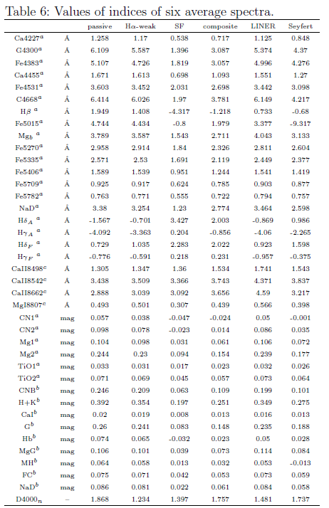
5. Average spectra- absorption-line indices
We calculate absorption-line indices of the average spectra, which are adopted from
Lick indices (Worthey et al. 1994; Worthey G. &Ottaviani D. L. 1997)
BH indices( Huchra et al. 1996)
DTT indices( Diaz et al. 1989)
D4000n( Balogh et al. 1999)

Slide 17
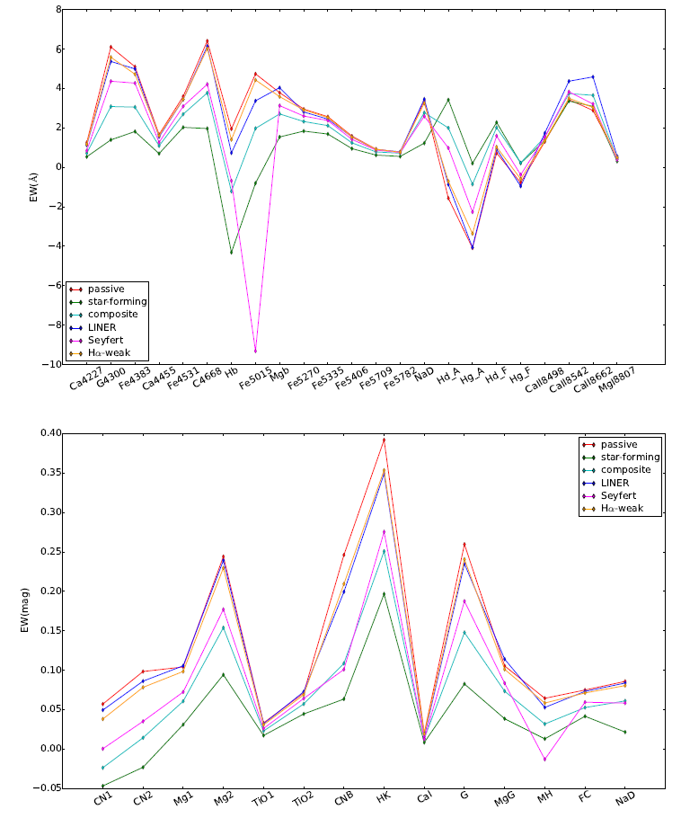
5. Average spectra- feature extraction
Extract some spectral features which are sensitive to the galaxy classes: G4300, Fe4383, Hβ, Fe5015, Mgb, Hδ_{A}, Hγ_{A}；
CN₁, CN₂, Mg₁, Mg₂, CNB, HK, G, MH。
these features are good class tracers so that they can be taken into account for spectral classification.
these features can be used for comprehending the physical parameters of different classes such as age and metallicity.
Fe5015, Mgb, Mg₁, Mg₂ are metal-sensitive in the definitions: [Mg₁Fe], [Mg₂Fe] and [MgFe]΄in Bruzual & Charlot (2003) and Thomas et al.(2003b).
metallicity: star forming<composite<Seyfert< LINER<Hα-weak<passive
Hβ, Hδ_{A}, Hγ_{A} are age-sensitive(Bruzual & Charlot2003,Gallazzi et al. 2003)
age: star forming<composite<Seyfert<LINER<
Hα-weak<passive
capability of line indices to differentiate the spectral class

Slide 18
6. Summary
One goal of this paper is to provide a spectral classification of galaxies in LAMOST DR3 according to spectral line features.
Flux re-calibration of galaxy spectra in order to overcome the error of population synthesis caused by the uncertainty of the continua
accurate measurement of emission line intensities subtracted the best-fitting stellar population model.
classify the galaxies into six classes: passive, H-weak, star-forming, composite, LINER and Seyfert.
correlation with morphological types by three parameters: concentration index, (u - r) color, D4000n index.
The other goal is to explore what spectral features are sensitive to different classes.
calculate the average spectra of the six classes in order to obtain the typical spectral features of each class.
From the absorption line indices of different average spectra, we extract features sensitive to classes such as Hβ, Fe5015, Hγ_{A}, HK, and Mg₂ band, and investigate the correlation of some features with age and metallicity of each class.
In this work, we have presented a glimpse of classification of galaxies by spectral lines, and following work will bring more insight to physical properties of these different classes.

Slide 19
END Thank you！

Slide 20
