Slide 1
Alpha-Abundance of the Halo stars from LAMOST red giant samples
孙天成
指导老师：崔文元 刘超
单位：河北师范大学

Slide 2
Outlines
The evolution of the Galaxy Halo
The evidence of the dual Halo
LAMOST DR2 K giants sample
Determination of the distance and alpha abundance
Result and Discussion

Slide 3
The formation and evolution of the Galaxy Halo
The Λ-Cold Dark Matter paradigm predicts that galaxies form hi- erarchically from mergers of lower mass subsystems. This theory have get been proved successful in large scale.
But, when compared with the property of our Galaxy and its nearest neighbors, there are many shortcomings, e .g . The missing satellites problem(Klypin et al. 1999; Moore et al. 1999).
It becomes clear that studies of the Galaxy and its components are crucial for a proper and complete understanding of galaxy evolution in the Universe.

Slide 4
The stellar halo is arguably the component that contains the most useful information about the evolutionary history of the Galaxy. This is because the most metal-poor stars in the Galaxy and possibly some of the oldest ones are found here. It therefore provides us with a picture of the Milky Way in its early stages of evolution.
The evolution of the chemical abundances in a galaxy is intimately connected with its star formation history (e.g., Tinsley 1979; Pagel 1998), among which one interesting tracer is [α/Fe].

Slide 5
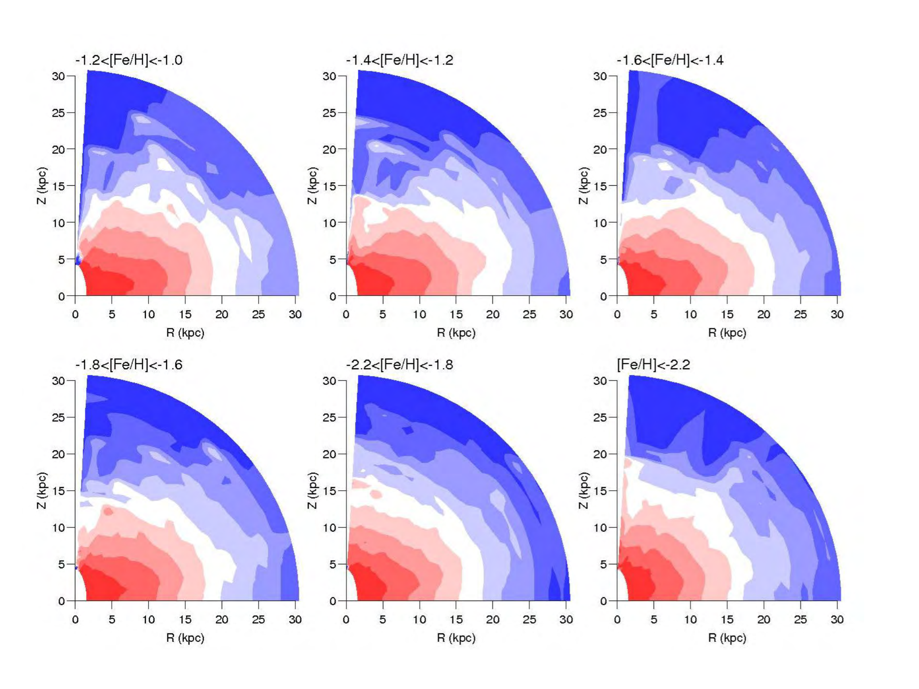
The evidence of the dual Halo
Carollo et al.2007 SDSS DR5
20,236 program stars explore distances up to 20 kpc from the Sun, only obtain useful estimates of the full space motions for the subset of 10,123 stars in a local volume.
They show the inner halo to be a population of stars that are non-spherically distributed about the centre of the Galaxy, with an inferred axial ratio on the order of ~ 0.6.
The outer halo, by contrast, comprises stars that exhibit a much more spherical spatial distribution, with an axial ratio ~ 0.9 to 1.0.

Slide 6
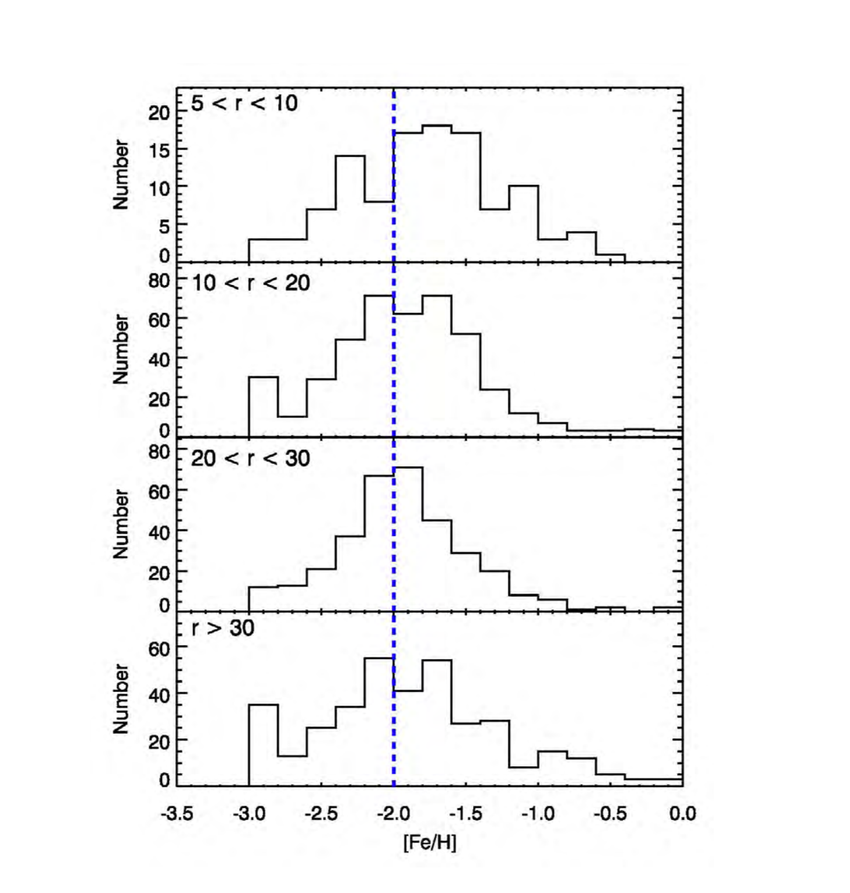
The distribution of metallicities for stars in the inner halo peaks at [Fe/H] = −1.6, with tails extending to higher and lower metallicities, the metallicity distribution function (MDF) of the outer halo peaks at lower metallicity than that of the inner halo, around [Fe/H] = −2.2.

Slide 7
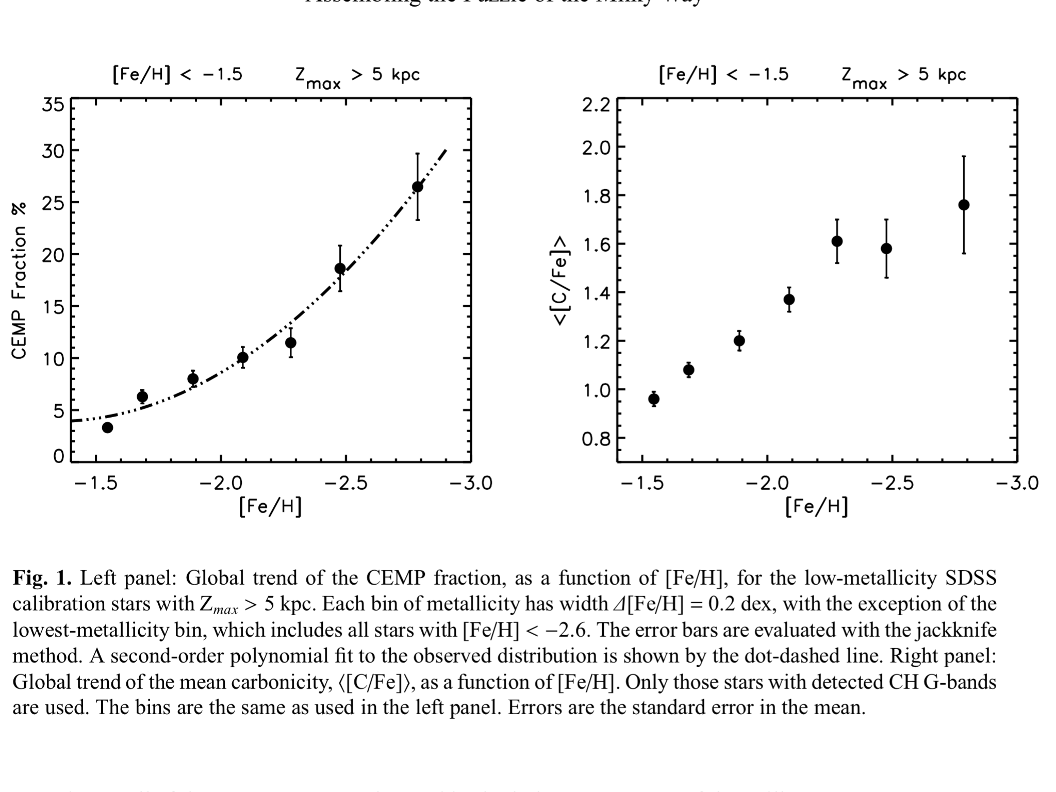
Beers, T.C. & Carollo, D. 2012

Slide 8
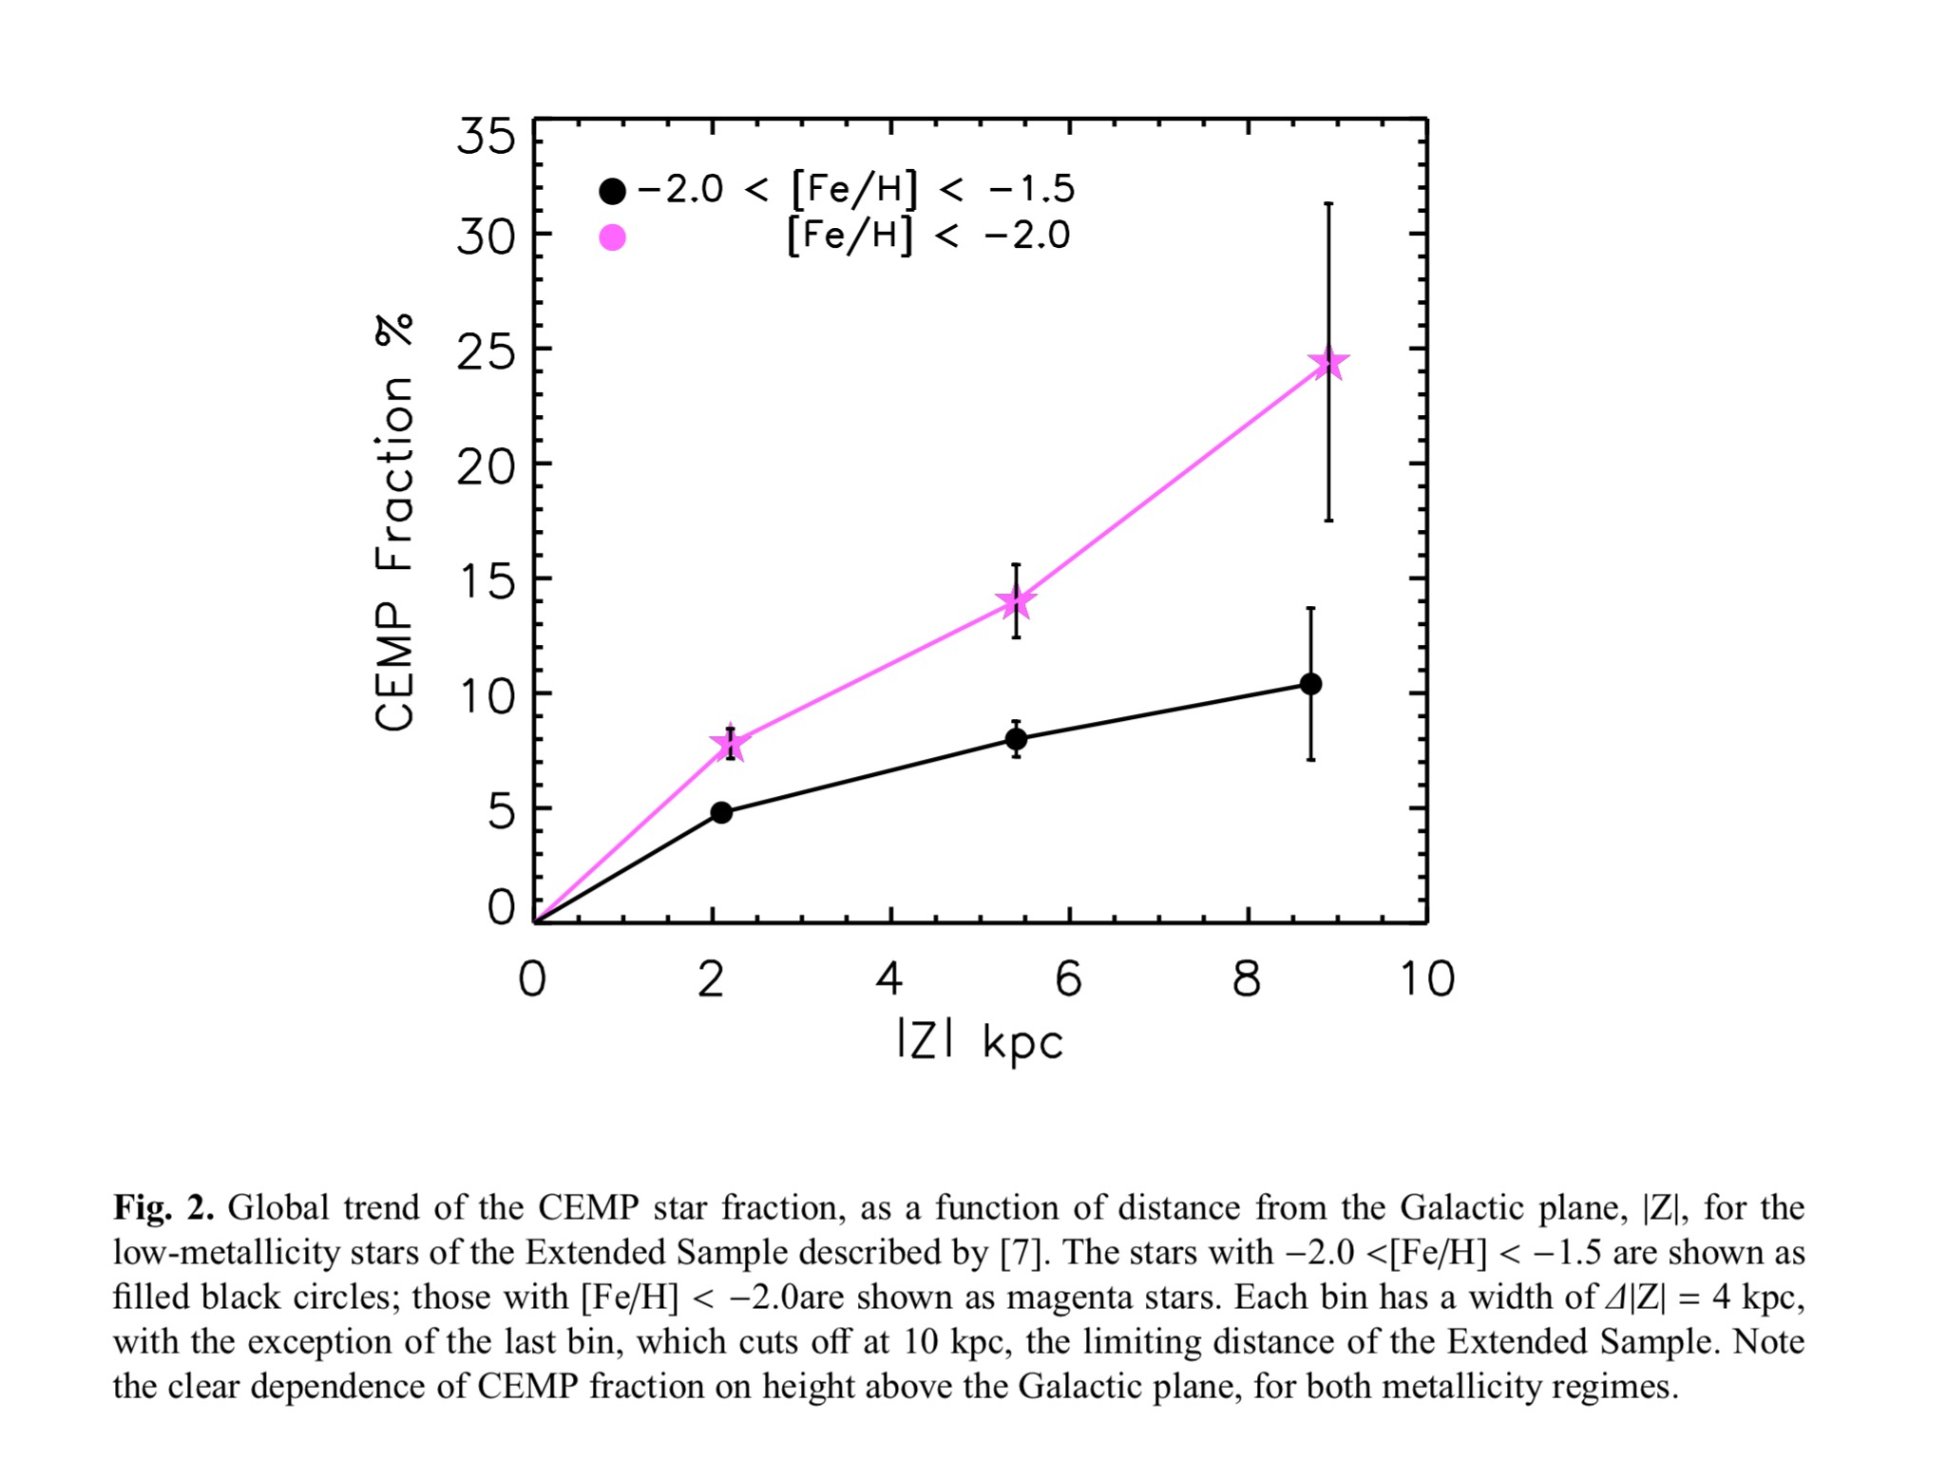
The observed contrast of CEMP star fractions in the inner- and outer-halo populations strengthen the picture that the halo components had different origins, and supports a scenario in which the outer-halo component has been assembled by the accretion of small subsystems.

Slide 9
recent observational studies have revealed the presence of α-poor stars in halo samples (Nissen & Schuster 2010; Schuster et al. 2012; Ramírez, Meléndez & Chanamé 2012; Sheffield et al. 2012; Bensby, Feltzing & Oey 2014; Jackson-Jones et al. 2014; Hawkins et al. 2014); These studies have shown that the α-poor sequence is distinct in kinematics, ages, and other chemical elements such as C, Na, and Ni compared to the α-rich sequence. It is thought that the α-poor sequence is assembled through the accretion of satellite galaxies.

Slide 10
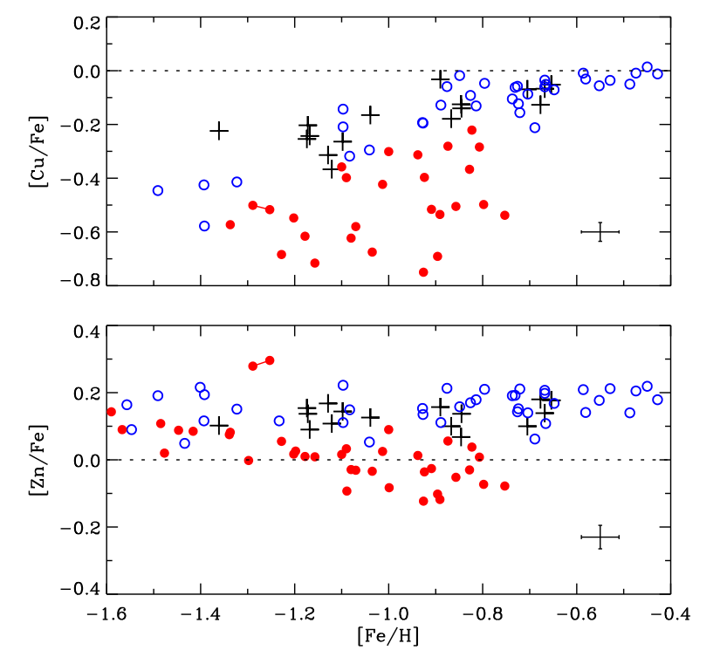
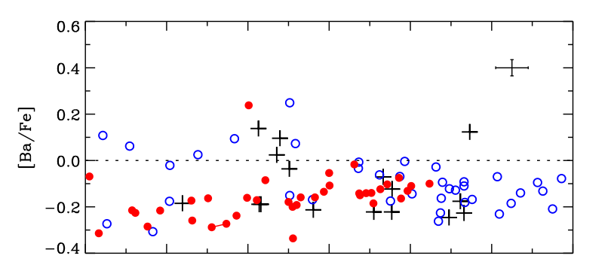
Nissen& Schuster(2011) solar neighborhood : halo kinematics.
The two populations, high- and low-α stars, that were found to have different ratios of [α/Fe], [Na/Fe], and [Ni/Fe] in their first paper (NS10) are also separated in [Cu/Fe], [Zn/Fe], and [Ba/Y]. high-α stars: high SFR massive stars and SNe II low-α stars: a slower chemical evolution, relatively metal-poor SNe Ia and low-mass AGB stars in addition to the contributions from massive stars and Type II SNe.

Slide 11
Another work corroborates the suggestion that stars with low [α/Fe] ratios are predominant at larger distances than stars with higher [α/Fe] ratios(Fernández-Alvar et al. 2016), in agreement with previous work that inferred the distances for the low-α and high-α populations based on their kinematical properties (Nissen & Schuster 2010, 2011; Ishigaki et al. 2010),they found the chemical trends inferred for stars ranging over distances from the Galactic center of 5 < r < 30 kpc, which suggest that, at r > 15 kpc, a stellar population begins to dominate which formed with a different chemical-enrichment history than stars at r < 10 kpc.

Slide 12
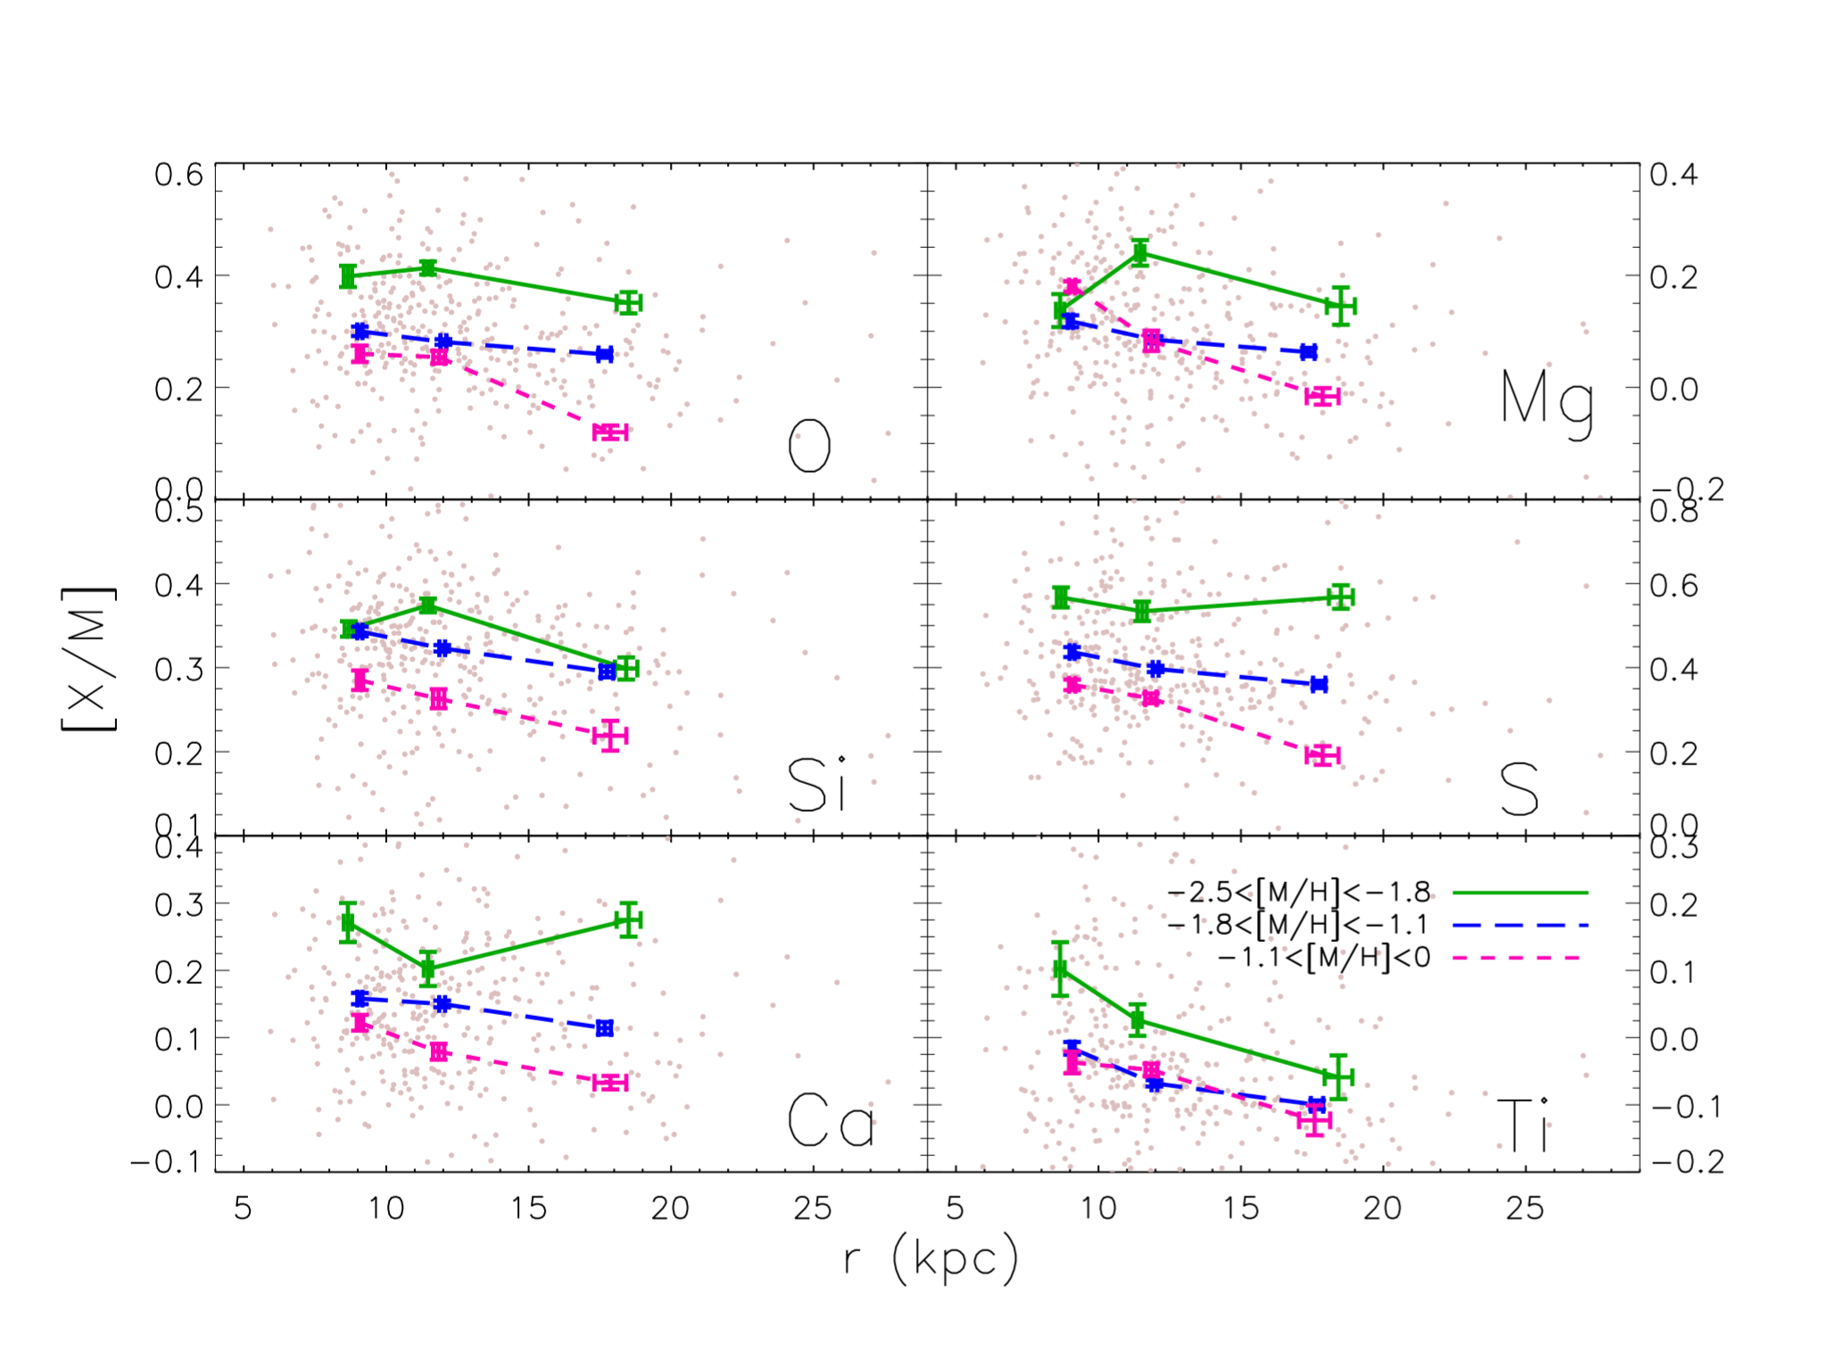
Fernández-Alvar et al. 2016

Slide 13
LAMOST DR2 K giants sample
Liu et al. (2014) presented a support vector machine classifier to identify the K giant stars from the LAMOST survey directly using their spectral line features. The completeness of the identification is about 75% for tests based on LAMOST stellar parameters. The contamination in the identified K giant sample is lower than 2.5%. Applying the classification method to about four million LAMOST spectra observed during the pilot survey and the first year survey, they select 454180 K giant candidates.
LAMOST has obtained spectra for over 4.1 million objects and measured three stellar labels (Teff, log g, [Fe/H]) for ∼2.2 million stars.

Slide 14
Determination of the distance and alpha abundance
Distance
Based on a Bayesian method, which compare measured stellar parameters to a grid of synthetic isochrones (Teff ,log g, and [Fe/H]), Carlin presented distances to stars contained by LAMOST DR2 catalogue (Carlin et al. 2015).Note that in this particular data-driven technique, to provide a unbiased distances so that we can use it to map the distribution of stellar populations and explore the kinematics and chemistry formation in the Milky Way, they avoid bringing in a priors hypothesis about perplexing property of the stellar populations.
20% overestimate ？

Slide 15
Alpha abundance
Ho et al. (2016) provide the [α/M] values derived from spectrum of giant sample in LAMOST DR2, which represents the largest catalog of [α/M] for giant stars to date. Cannon is a data-driven technique for measuring stellar labels from stellar spectra under the background of various of large spectroscopic surveys (Ness et al.2015).Using The Cannon method, based on the stellar spectra and labels of 9952 stars measured and analyzed common between LAMOST DR2 and APOGEE DR12, Ho et al. (2016) build a predictive model, obtained stellar labels(e.g. Teff, log g, [Fe/H], and [α/M]) for 454180 giant stars in LAMOST DR2 (approximately 20% of the total DR2 sample).

Slide 16
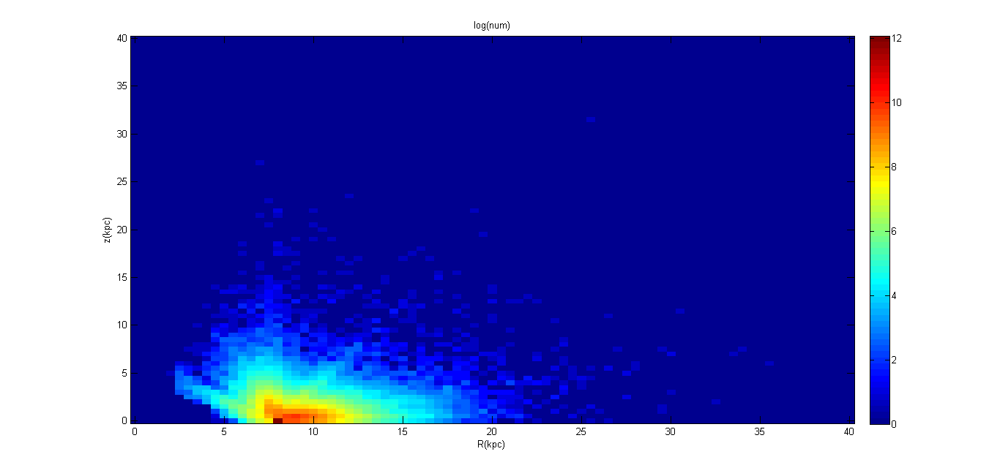

Slide 17
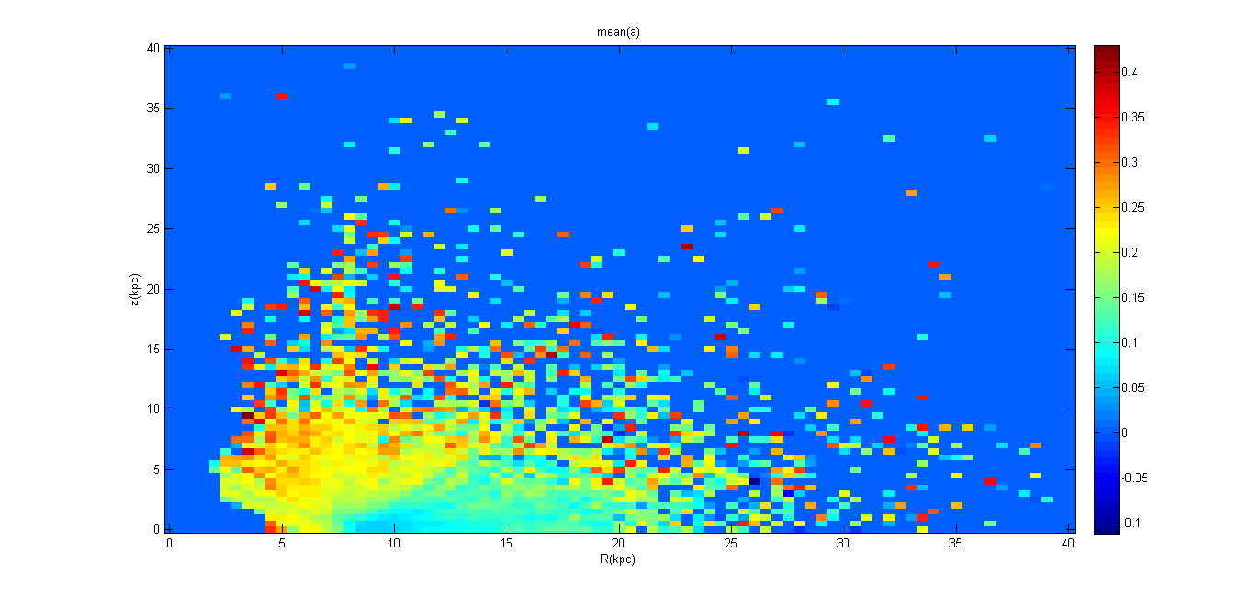

Slide 18
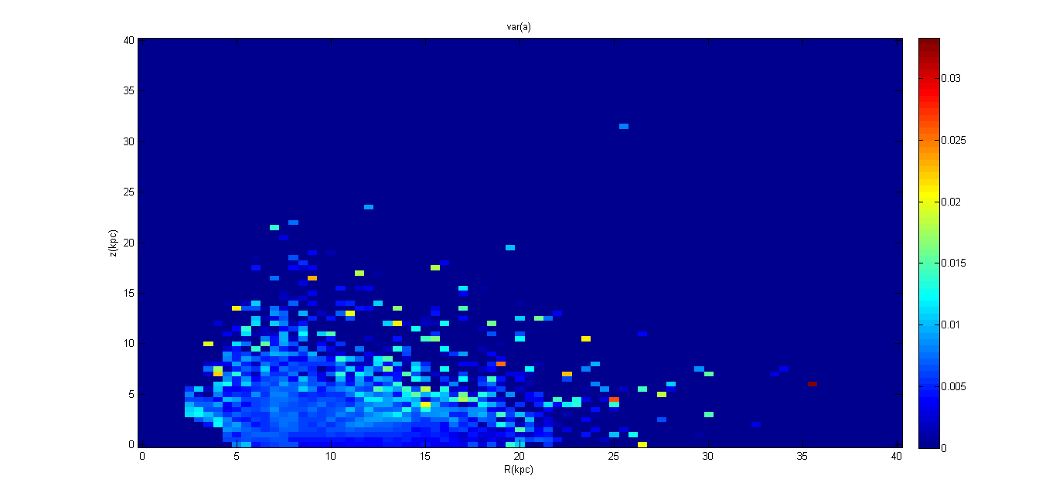

Slide 19
Result
To obtain a pure halo stars sample, we cull K giants with |z| < 5 kpc, leading to an ultimate sample of 3151 K giant stars.
5 ~ 55kpc
Splitting the sample into Galactocentric distance bins, we present results of the distribution of stars in the [α/Fe] vs. [Fe/H] plane

Slide 25
The ratio of low-α stars varies with the distance from the Galaxy center are as presented in the Figure.
Selection effect

Slide 26
The trend of the mean value of [α/Fe] ratios vary with distance from the Galactic center, shown in Figure , exhibit a decreasing trend. It is noted that we exclude the stars which have higher metalicity than -1, to eliminate the contamination of disk.

Slide 27
Stars in dwarf spheroidal galaxies, tend to have lower [α/Fe] at a given metallicity compared to the halo.

Slide 28
Discussion
Consistent with previous work in Fernández-Alvar et al. (2016), our result also reveals that at closer distant, high-α stars ([α/Fe]>0.2) dominate the Galactic halo, at farther distant, low-α stars ([α/Fe]<0.2) dominate the Galactic halo. As is illustrated in Figure 4, nearly r=15kpc is a clear boundary, which divide the halo stars into two different stellar populations, one is high-α stars, at r<15kpc, another is low-α stars, at r>15kpc, this story agree with the work mentioned above.
Distance: overestimate
Alpha abundance: Teff <4250.Their model in this regime is limited by the fact that ASPCAP labels are less reliable at these lower temperatures, so we urge caution when using labels for objects at lower temperatures. K giant：3500k~5000k
Sagittarius stream

Slide 29
Thank you!

