Slide 1
Density profile of the Galactic halo as probed by LAMOST K giants
Yan Xu, Chao Liu, Heidi Newberg, Jeff Carlin
Xiang-Xiang Xue, Qi-Ran Xia, Li-Cai Deng, Li Jing

Slide 2
Eggen et al.1962(ELS) rapid collapse of a monolithic gas cloud
Searle & Zinn 1978, the halo is formed by accrection
Probing the structure of the Galaxy has a history of 200yr.(Reid1993)
early studies
Single power law(SPL) with index, n=2.5-3.5, q=0.5-1 (Reid+1998,Gould+1998,Robin+2000,Siegel+2002)
Saha(1998), broken power law(BPL)
Preston(1991),SPL,q is variable
Notes:
The stellar halo was modeled as a smooth distribution of stars , fitted by a power law profile
SDSS, RAVE, LAMOST, GAIA
The structure, formation and evolution of the Milky Way.
Stellar quantities (distance, age, metallicity, kinematics,….) of large samples
Stellar Halo
The meaning of studying the density profile of the Milky Way
1.detect the shape of the dark matter halo
2.constrain the formation history of the Milky Way halo.

Slide 3
Reference origin tracer sample size distance(Kpc) model parameters
Xue+etal+2015 SEGUE2 K giants 1757 10<r_{GC}<80 BPL n_{in}=2.1, n_{out}=3.8, r_{break}=18, q=0.7
Einasto n=3.1, r_{reff}=15, q=0.7
SPL n=4.2, q=f(r_{GC}), q(10Kpc)=0.55,
q(30Kpc)=0.8
Pila-Diez+etal+2015 CFHTS near MSTO r_GC<60 SPL n=4.3, q=0.79
INT Triaxial n=4.28, q=0.77, w=0.87
BPL n_{in}=2.4, n_{out}=4.8,r_{break}=19,q=0.77
BPLq n_{in}=3.3,n_{out}=4.9,q_in=0.7,q_out=0.88
Faccioli+etal+2014 XuYi RRly 318 9<D<49 BPL
Deason+etal+2011 SDSS DR8 BS,BHB ~20000$ 4<D<40 BPL n_{in}=2.3, n_{out}=4.6, r_{break}=27, q=0.6
Deason+etal+2014 SDSS DR9 BS,BHB 10<D_{BS}<75 BPL n_{outer}=6-10, r_{break}=50
40<D_{BHB}<100
Sesar+etal+2010 Stripe82 RRly 483 5<r_{GC}<100 BPL n_{in}=3.2, n_{out}=2.2, r_{break}=30
Watkins+etal+2009 Stripe82 RRly 417 5<r_{GC}<117 BPL n_{in}=2.4, n_{out}=4.5, r_{break}=25
Sesar+etal+2011 CFHTLS near turnoff MS 27544 D<35 BPL n_{in}=2.62, n_{out}=3.8, r_{break}=28,
q=0.7
Juric+etal+2008 SDSS MS D<20 SPL n=-2.8, q=0.64
Bell+etal+2008 SDSS MS & 4 million D<40 SPL 2<n<4, 0.5<q<0.8$

Slide 4
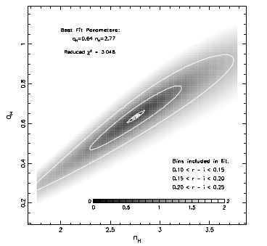
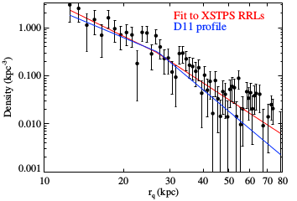
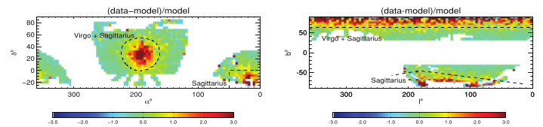
Faccioli et al.(2014)
Juric et al.(2008)
Deason et al.(2011)

Slide 5
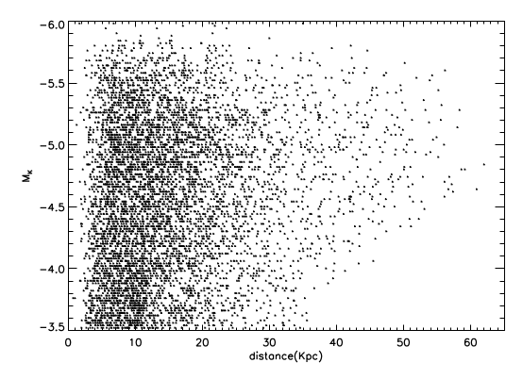
LAMOST DR3 K giants
Large sample
Better skycoverage
Nonparametric method
Model independent
Less influence of substructure
[Fe/H]<-1
M_K<-3.5

Slide 6
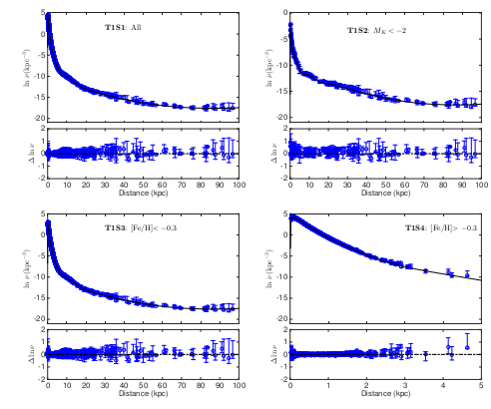
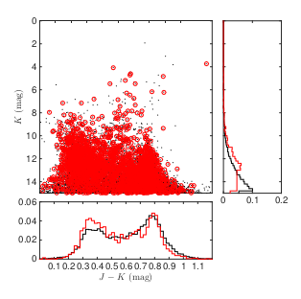
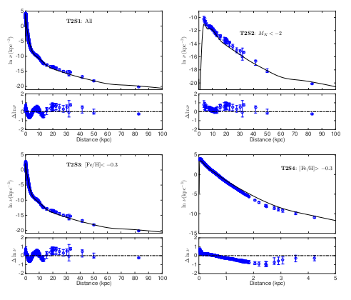
Selection Correction
Liu et al.(2017)
the selection function of the spectroscopic
survey is only based on color-magnitude diagram.
Density profile=density profile(spectroscopic) *
selection function

Slide 7
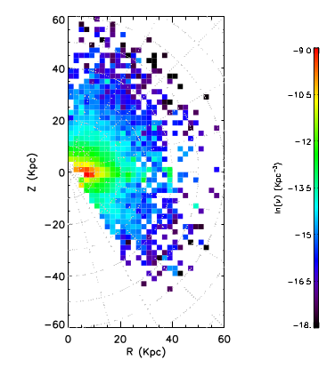
Stellar density map

Slide 8
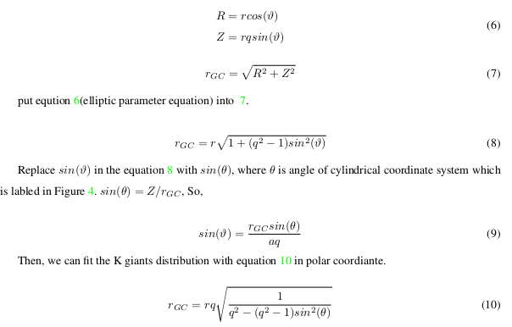
ν= r^{-n}
r²=R² + (Z/q)²
lnν=lnν₀-nr

Slide 9
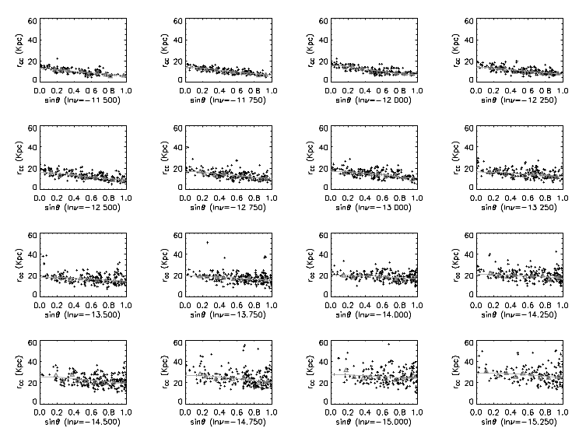

Slide 10
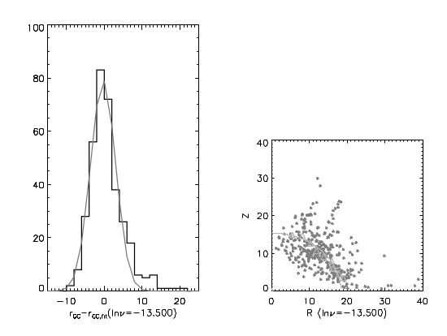
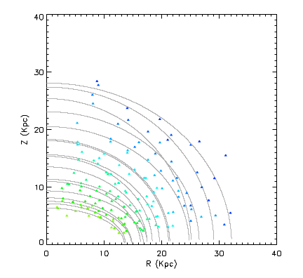

Slide 11
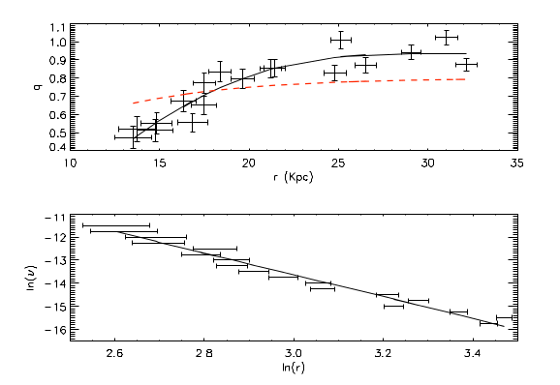

Slide 12
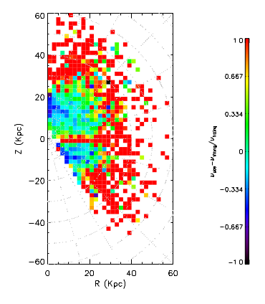
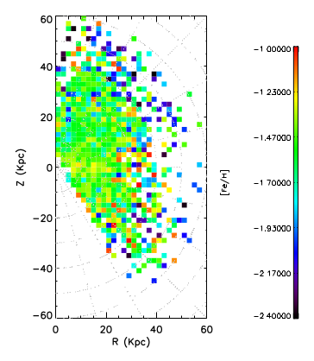

Slide 13
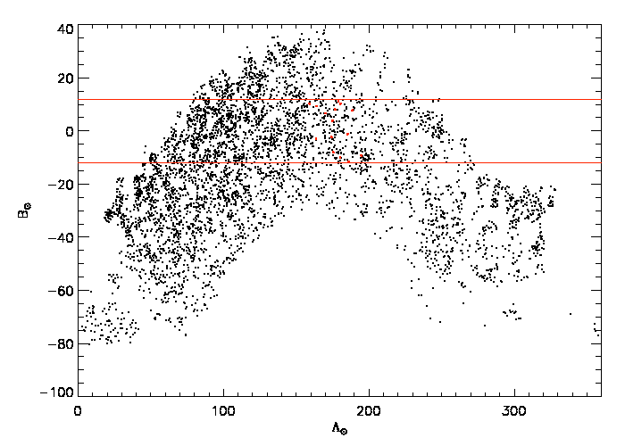

Slide 14
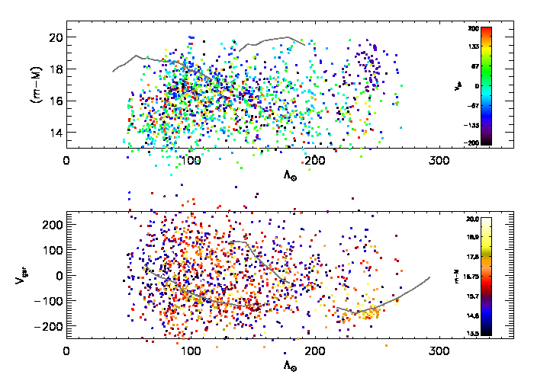

Slide 15
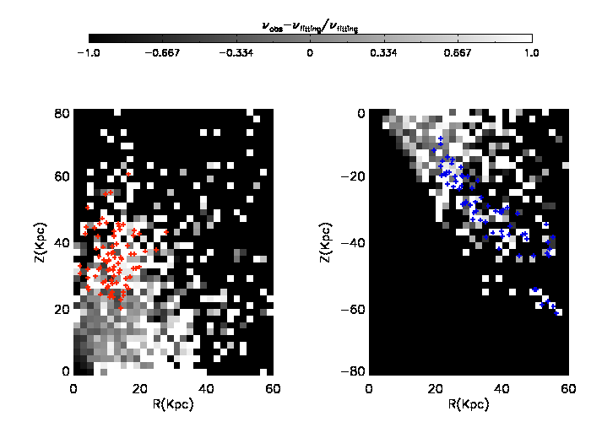

Slide 16
Conclusion:
Carollo(2007), inner halo, outter halo(15Kpc)
oblate
10Gyr more recently
part in situ main part composed by accrection
Deason et al. (2013) indicate that if there is break on power law index and the strength of the break depend on the accretion time and the size of the accretion debris, the location of the break depend on the average apocenter of the accretion strcture
SPL
n=4.7, no break
q vary with Galactic radii
Q(15Kpc)=0.55, q(20Kpc)=0.74 & q(60Kpc)=0.945
Notes:
16

Slide 17
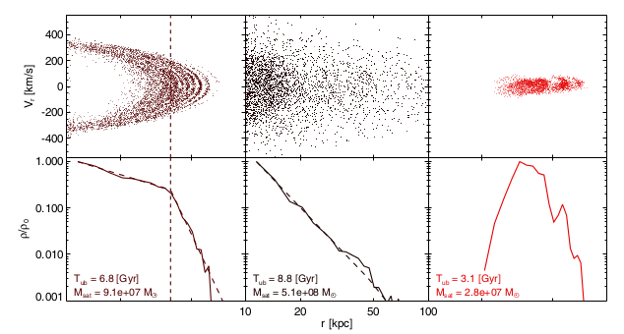
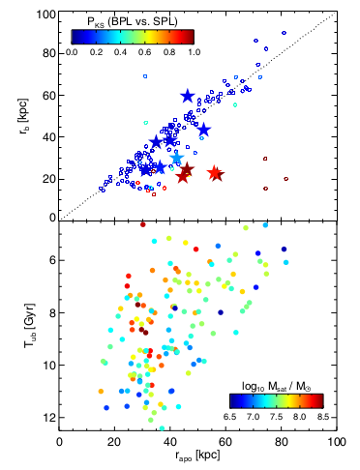
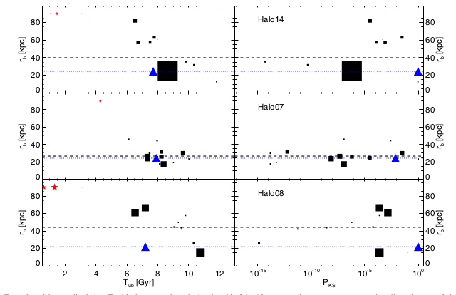
Deason et al.(2013)
Bullock & Johnston(2005)

