Slide 1
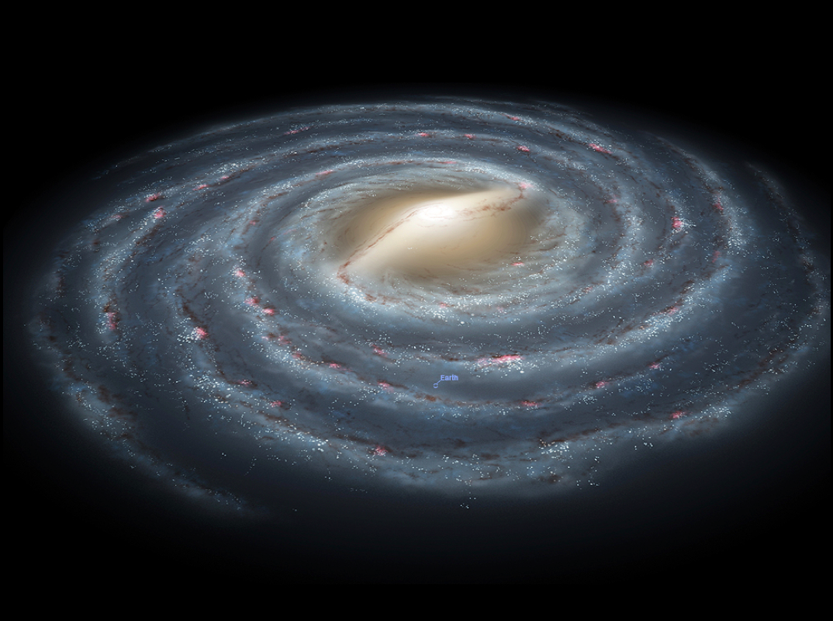
revisiting the Milky Way wobbly disk with lamost and tgas
李兆聿
上海天文台星系动力学团组
合作者：沈俊太、刘超、黄样、刘晓为

Slide 2
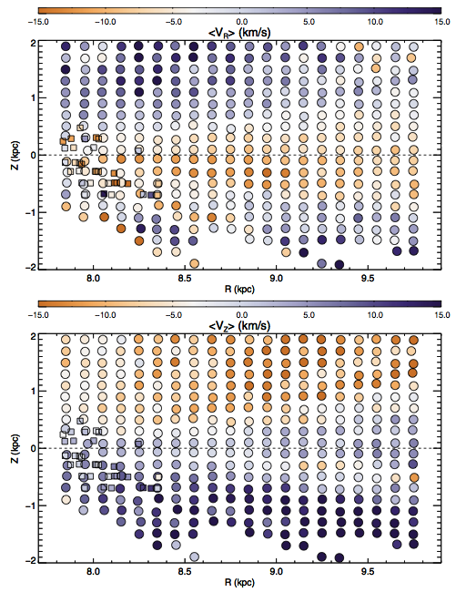
A Wobbly Disk
7.8 < R_{GC} < 9.8, -2.0 < Z < 2.0 kpc
Above the plane
positive <V_{R}> (outward) and negative <V_{Z}> (downward)
Below the plane
small or negative <V_{R}> (inward) and positive <V_{Z}> (upward)
RAVE data exhibit similar asymmetries to LAMOST between 8 < R_{GC} < 10 kpc.
Smaller variations in theta > 0 subsample
Vertical perturbation by external perturbations
Carlin et al. 2013
Notes:
380,000 F-type stars
距离是，首先得到一个标准的星的绝对星等（利用Hipparcos的三角视差法对一个子样本得出精确距离），然后根据lamost star与类型接近的标准星的比较来推测出它的绝对星等。

Slide 3
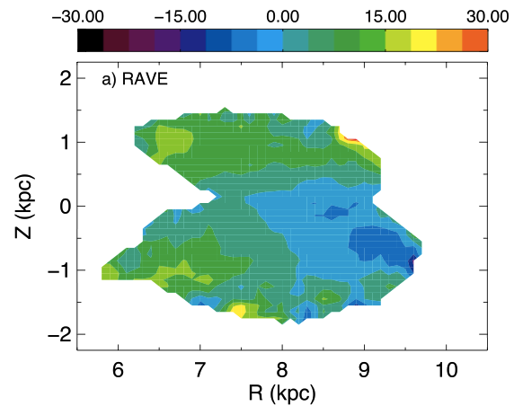
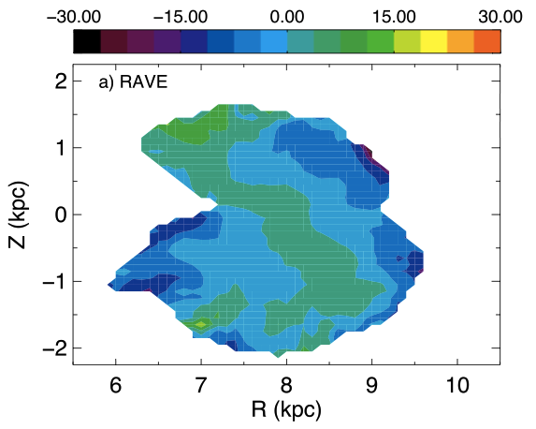
A Wobbly Disk
<V_{R}>
The further stars are from the plane, the more they are moving outwards.
Velocity gradient below the plane
(~ –7 km/s/kpc ) roughly consistent with Siebert et al. (2011)
Rarefaction within 8.5 kpc
Compression outside 8.5 kpc
<V_{Z}>
Williams et al. 2013
Notes:
RAdial Velocity Experiment (RAVE):
1.2 m UK Schmidt Telescope of the Australian Astronomical Observatory (AAO)
Multifiber spectroscopic survey of Milky Way stars
On Apr. 5, 2013, RAVE concluded data taking phase.
483, 330 individual stars observed
70,000 red clump stars, 6 < R < 10 kpc, -2 < Z < 2 kpc

Slide 4
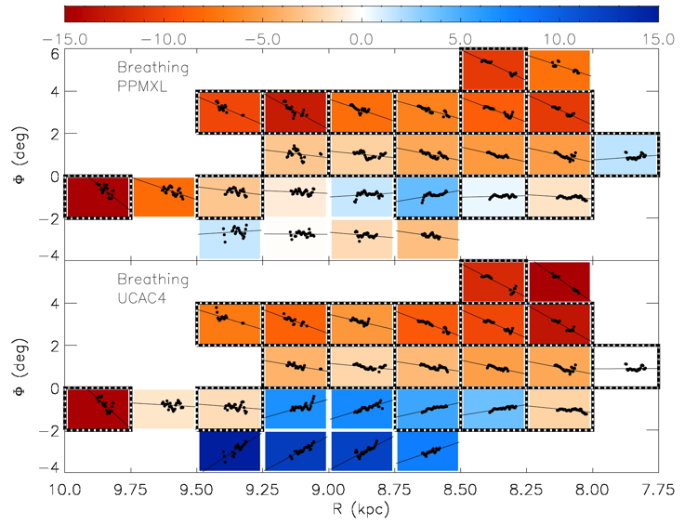
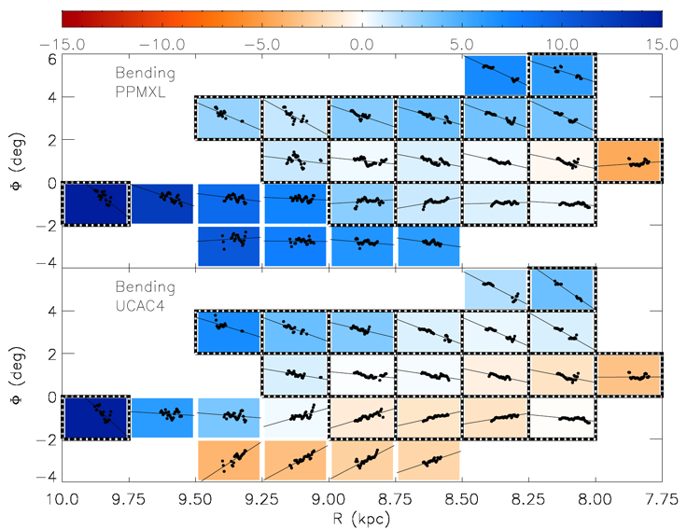
Bending & Breathing Modes
Bending & Breathing amplitudes:
A: Breathing amplitude (compression A<0, rarefaction A>0)
B: Bending amplitude (upward B<0, downward B>0)
A
B
Sun et al. 2015
Notes:
A (left), B (right)

Slide 5
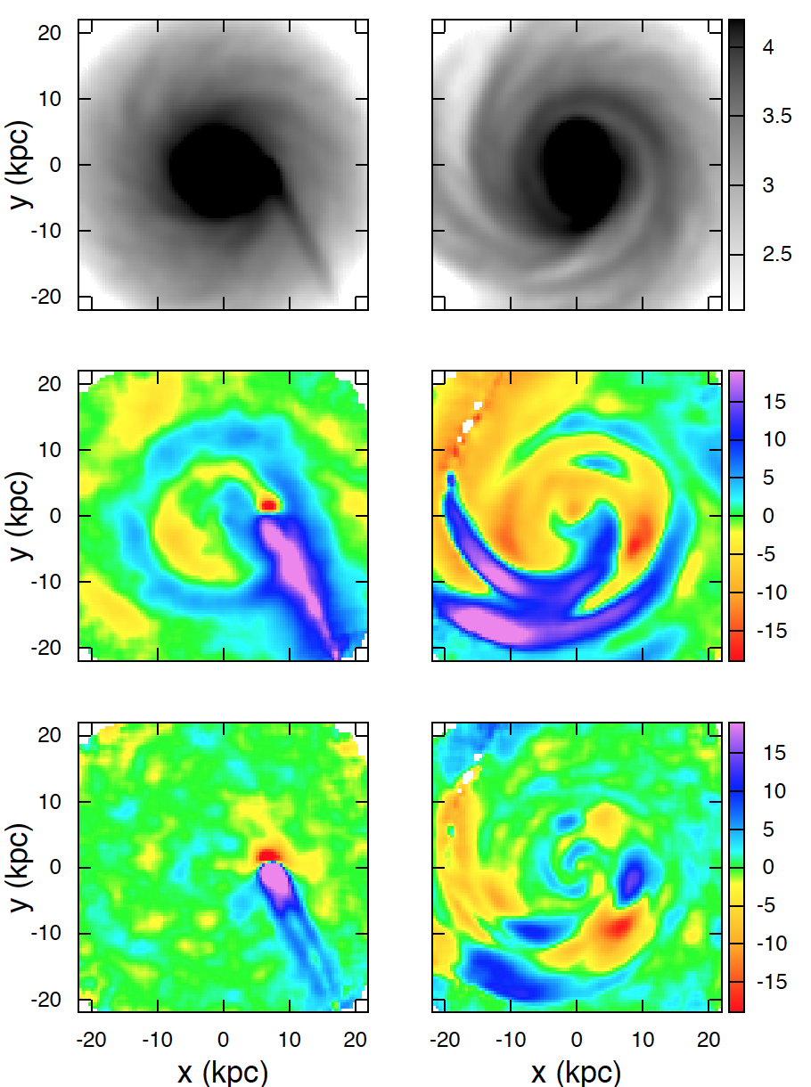
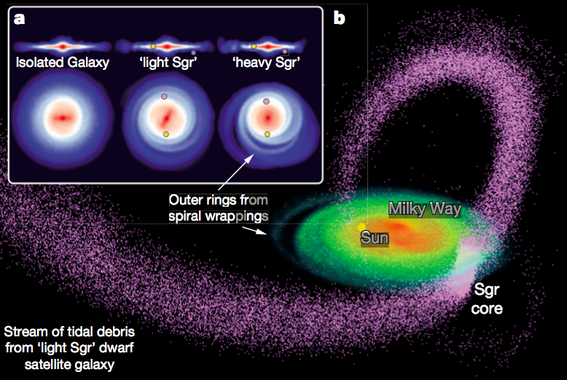
External Perturber: Sagittarius dwarf?
Scenario: vertical density waves were induced by the Sagittarius dwarf galaxy as it plunged through the Galaxy.
Purcell et al. 2011
Widrow et al. 2014
Notes:
Possible! The monoceros ring may have such an external origin.
Host Galaxy M_{vir} = 10¹² M_{O}, disk mass 3.59 x 10¹⁰M_{O}
Light Sgr progenitor M_{vir} = 10^{10.5} M_{O}
Heavy Sgr progenitor M_{vir} = 10¹¹ M_{O}
NFW halo profiel with scale length 4.9 kpc for light Sgr (6.5 kpc for heavy Sgr)
King profile for the stellar component (core radius 1.5 kpc, tidal radius 4 kpc, central velocity dispersion 23 km/s)
Satellite launched 80 kpc from GC in the MW plane, travelling vertically at 80 km/s towards the North Galactic Pole.
It has an external perturbation, influence the central bar and generate the outer spiral arms and flared disk.
The Sgr is moving up towards the plane with two tidal arms resulting from its advanced stage of tidal disruption.
The disk perturbation is still influenced by the internal structures (arms & bars), which may be triggered by external satellite galaxies.

Slide 6
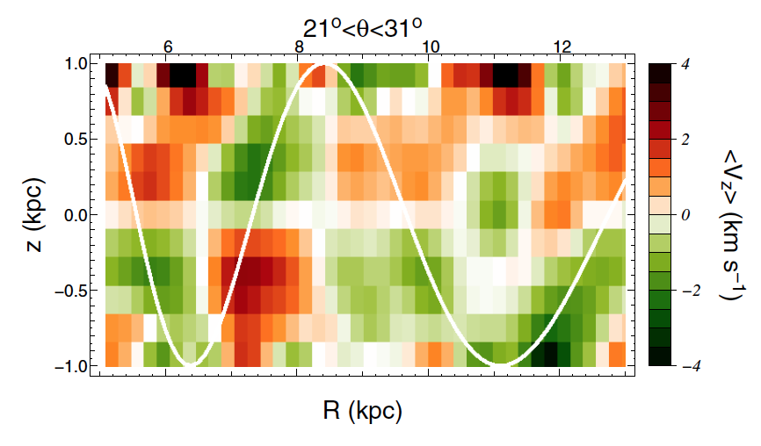
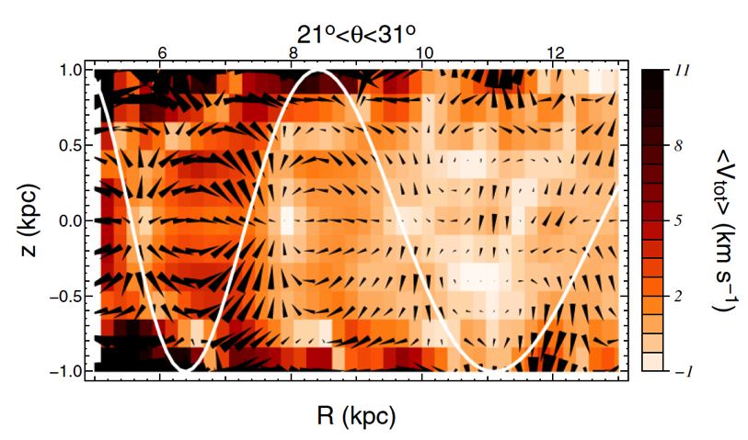
Local Structure Perturbation
Vertical breathing mode in the disk (Faure et al. 2014)
“Sink” point & “Source” point at different part of the spiral arm potential
Resonances from the spiral arms and bar generate rich substructures in the solar neighborhood (Monari et al. 2014; Debattista 2015).
Corotation resonance of the spiral arms
Outer Lindblad Resonance of the bar
Faure et al. 2014
Notes:
A 3D test-particle simulation is used to show the global stellar response to a spiral perturbation in both radial and vertical directions.
Inside/outside CR, the VR behaviour is different
4, 5, 6, 6.5 Gyr evolution

Slide 7
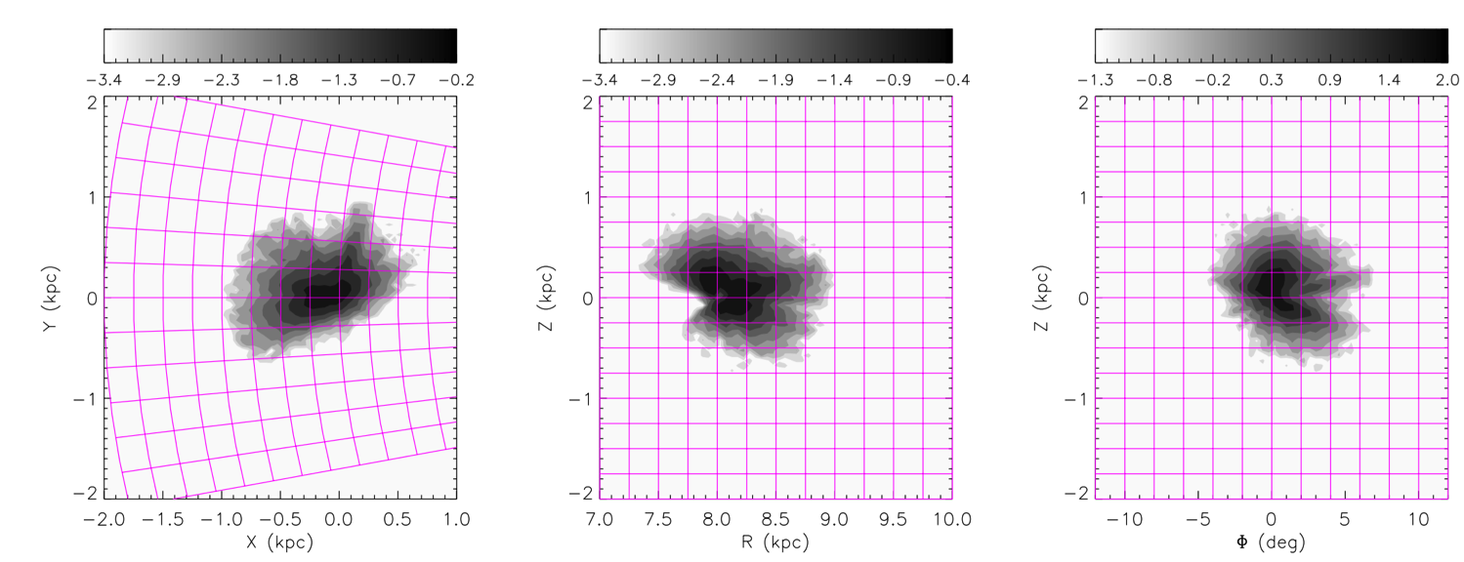
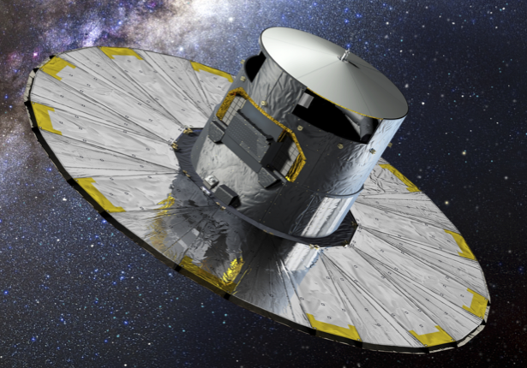
TGAS_LAMOST Sample
Gaia data published first data release on Sept. 14, 2016, including new parallax and proper motion estimates with accuracy of ~ 1 mas/yr for 2 million bright stars.
The TGAS-LAMOST (DR3) survey contains ~190,000 stars with accurate 6D information!
We selected FGK dwarf stars within 1 kpc distance from the Sun (~87000 stars)
Notes:
Color change

Slide 8
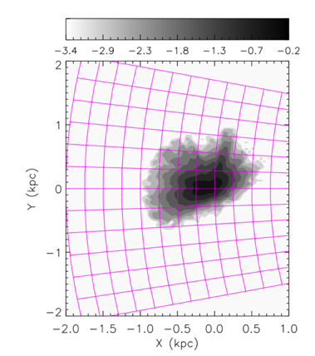
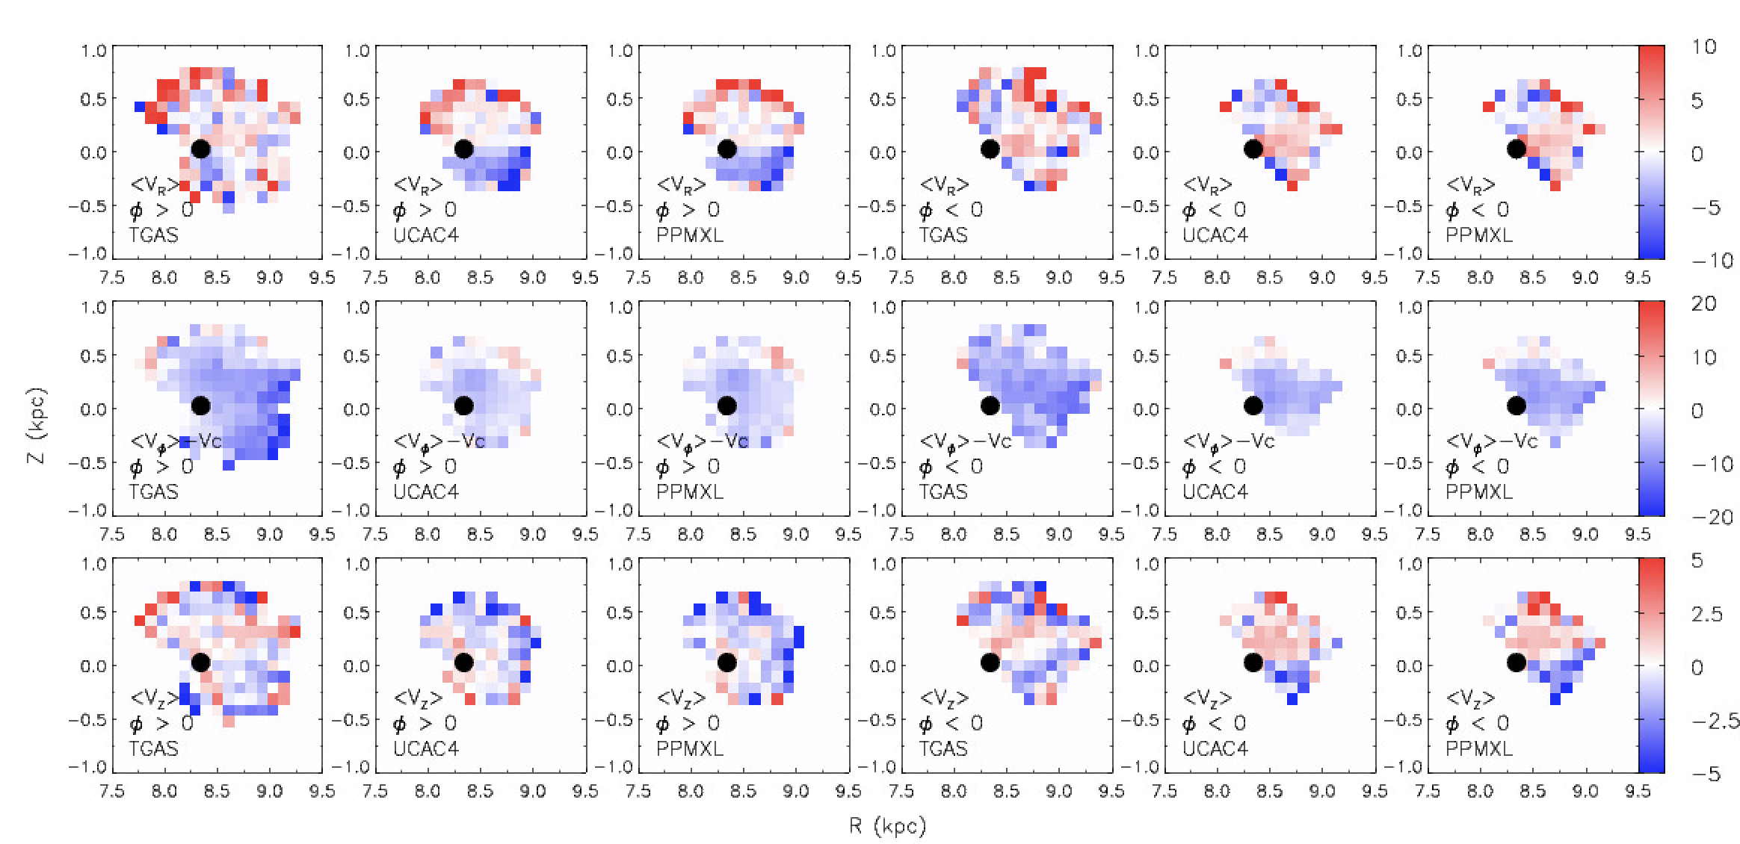
TGAS LAMOST Sample Results
ϕ>0
Bulk motion maps derived from TGAS vs. UCAC4/PPMXL (both use LAMOST RV)
Maps are not consistent with each other.
No clear pattern in <V_{R}> , <V_{Z}> for TGAS data
GC
ϕ<0

Slide 9
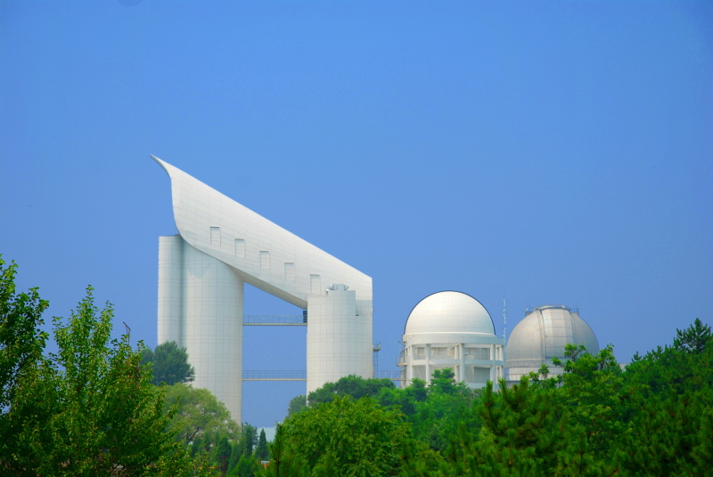
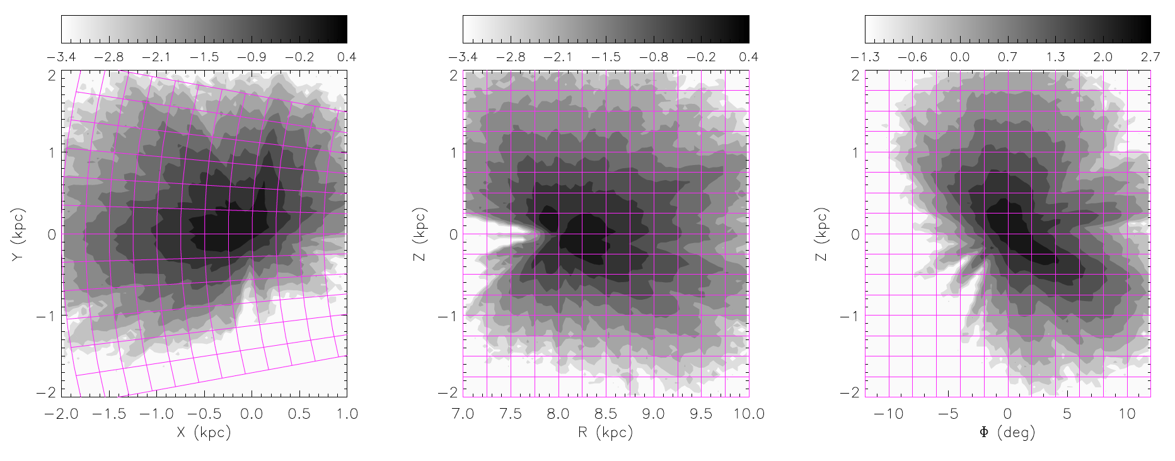
LSS-GAC DR3
LAMOST spectroscopic survey of the Galactic Anti-center (LSS-GAC) DR3
2.5 million FGK dwarf stars, with proper motion from UCAC4 and PPMXL.
Radial velocity uncertainties ~ 10 km/s, distance accurate to 20%.

Slide 10
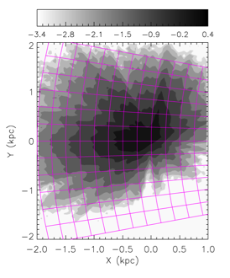
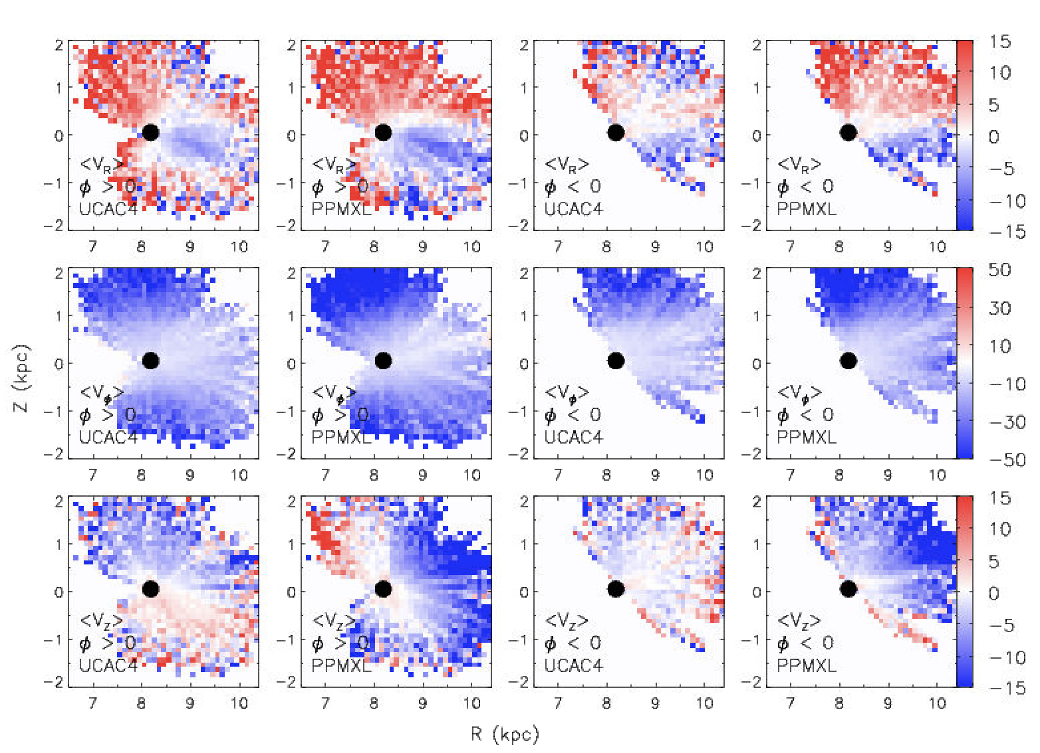
LSS-GAC DR3 Results
ϕ>0
Bulk motions derived from UCAC4/PPMXL + LSS-GAC
GC
ϕ<0

Slide 11
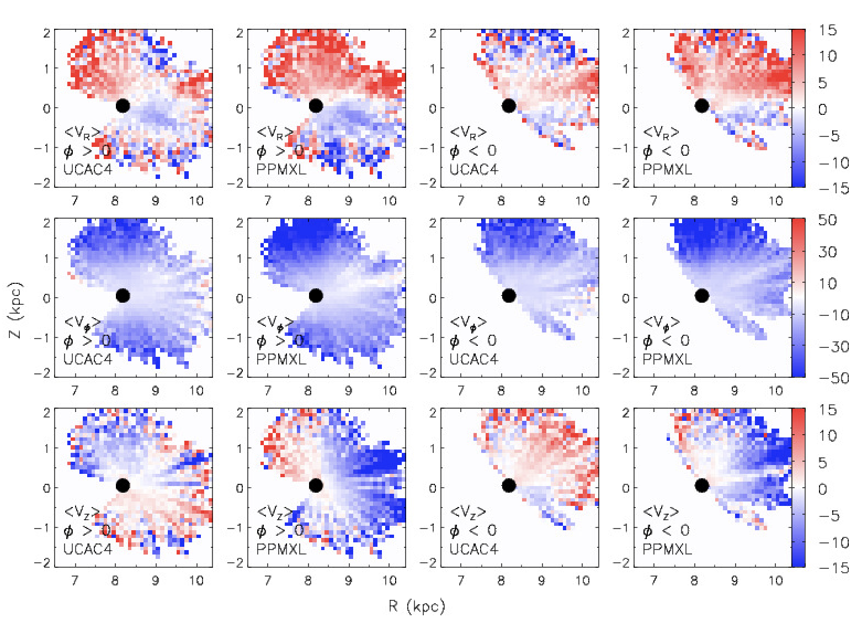
LAMOST DR3 Results
Bulk motions derived from UCAC4/PPMXL + LAMOST DR3
Sample divided at φ = 0.

Slide 12
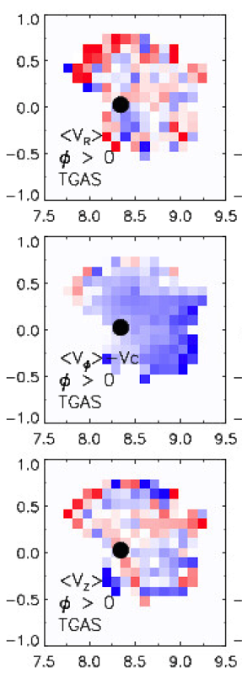
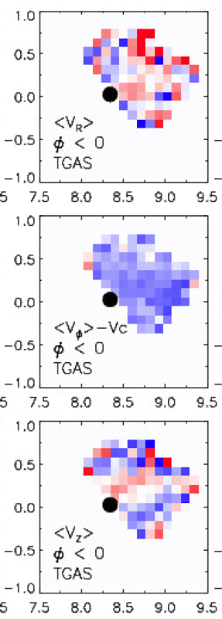
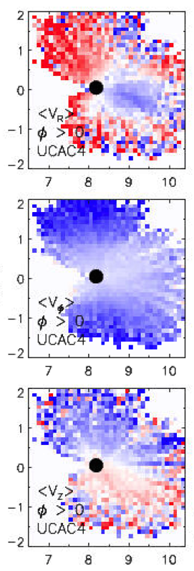
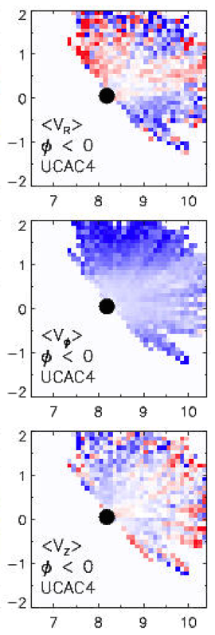
TGAS + LAMOST
UCAC4/PPMXL + LSS-GAC
(LAMOST only)
<V_{R}>: no clear pattern
<V_{φ}>: decreasing outward
<V_{Z}>: no clear pattern
<V_{R}>: inward/outward motion
<V_{φ}>: decreasing outward
<V_{Z}>: compression
Notes:
Lamost only

Slide 13
TGAS + LAMOST
UCAC4/PPMXL + LSS-GAC
<V_{R}>: no clear pattern
<V_{φ}>: decreasing outward
<V_{Z}>: no clear pattern
<V_{R}>: inward/outward motion
<V_{φ}>: decreasing outward
<V_{Z}>: compression

Slide 14
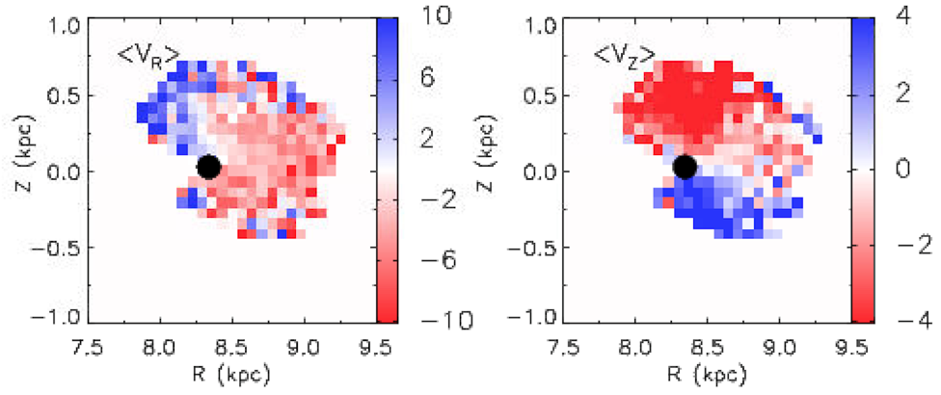
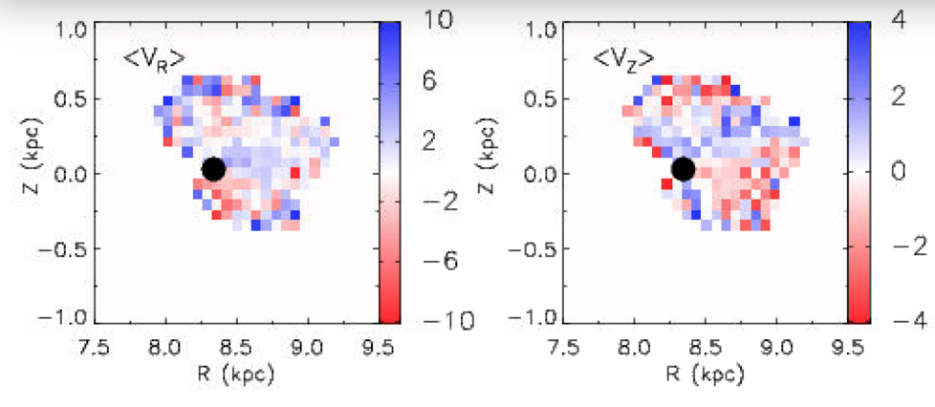
RV systematic correction?
By applying 5.7 km/s systematic correction in RV, the bulk motion patterns change significantly.
Before Correction
After Correction

Slide 15
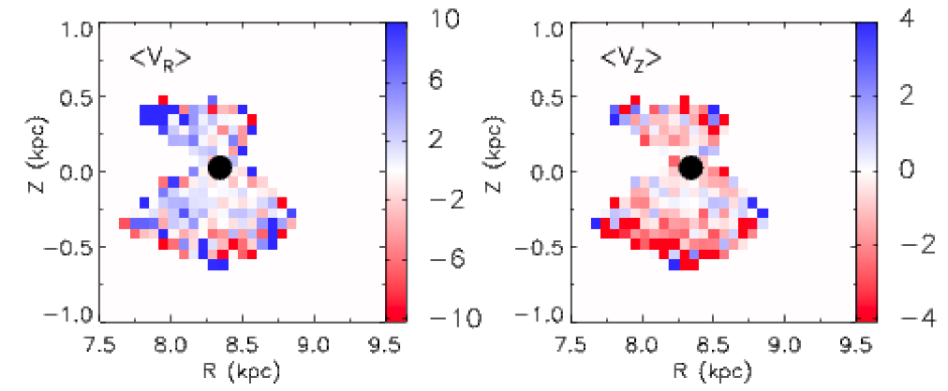
Test with RAVE DR5 + TGAS
RAVE RV agrees very well with APOGEE (no correction needed)
RAVE+TGAS
LAMOST+TGAS

Slide 16
Conclusion
Preliminary
Bulk motion maps from TGAS+LAMOST are different from the maps derived from LAMOST + UCAC4/PPMXL
TGAS results seem to indicate no clear bulk motion in the solar neighborhood (< 1 kpc) for <V_{R}> and <V_{Z}>.
Inconsistent with LSS-GAC DR3 results
No clear bulk motion patterns in RAVE + TGAS
RV systematic correction may play a role here.
The bulk motion might still exist at larger spatial ranges rather than close to the Sun (< 1 kpc) ---- to be checked with future Gaia releases.
Notes:
TGAS provides accurate proper motion (~1 mas/yr) → 6d information
LSS-GAC DR3 provides large sample to statistically study the bulk stellar motion out to 2 kpc from the Sun.

