Slide 1
Member star candidates of 10 open clusters selected from the LAMOST spectroscopic surveys
Yang Yong

Slide 2
OUTLINE
MOTIVATION
THE OBSERVATIONS
MEMBER STAR SELECTION
RESULTS AND DISCUSSION
SUMMARY

Slide 3
MOTIVATION
Importance of Open Clusters:
powerful tools for studies of the Galactic disk: structure and dynamical
star formation and evolution: cluster’s member stars have the characteristics of simple age, broad mass distribution, and uniform chemical composition

Slide 4
Advantages of LAMOST OCs study
Many spectra are collected by LAMOST
LAMOST survey covers many OCs
stellar parameter: RV、Teff、[Fe/H]、log g

Slide 5
Limitation of LAMOST OCs study
limits in the mechanical design of the focal plane
LAMOST cannot concentrate more than three fibers within a small region
we have designed to observe to open clusters of different ages utilizing test observing time of LAMOST.

Slide 6
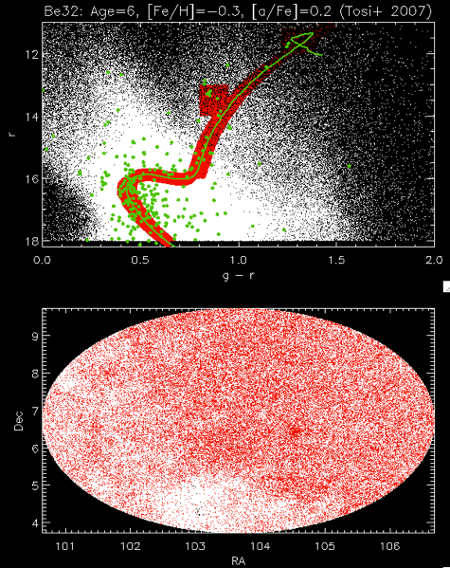
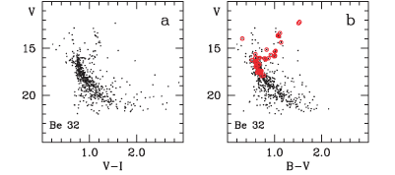
Target selection for input catalog
Selection in g – r v.s r diagram
Combine with literature member candidates

Slide 7
Target selection
Open clusters of different ages are targeted
Cluster | Age(Gyr) | RA | DEC | Angular Radius(deg)ª | Distance(pc) | E(B-V) | [Fe/H]
NGC188 | 7.0 | 011.850 | +85.255 | 0.570 | 2000 | 0.085 | -0.010
Berkeley32 | 6.0 | 104.527 | +06.435 | 0.125 | 4996 | 0.021 | -0.290
M67 | 4.0 | 132.847 | +11.815 | 1.03 | 890 | 0.050 | -0.102
NGC2420 | 2.3 | 114.595 | +21.567 | 0.305 | 2880 | 0.010 | -0.380
NGC2112 | 2.0 | 88.432 | +00.413 | 0.62 | 977 | 0.625 | 0.160
Hyades | 0.75 | 66.725 | +15.87 | 5.5 | 45 | 0.010 | 0.130
NGC2099 | 0.35 | 088.087 | +32.570 | 0.485 | 1400 | 0.350 | 0.089
NGC1912 | 0.25 | 082.215 | +35.800 | 0.390 | 1144 | 0.250 | 0.250
NGC2168 | 0.18 | 092.302 | +24.360 | 0.980 | 830 | 0.260 | -0.160
PLEIADES | 0.13 | 056.505 | +24.370 | 6.20 | 130 | 0.021 | -0.036
a: Kharchenko+, 2013
Notes:
考虑不同年龄，不同金属丰度
LAMOST 主巡天对它有较多的观测，有较丰富的光谱数据

Slide 8
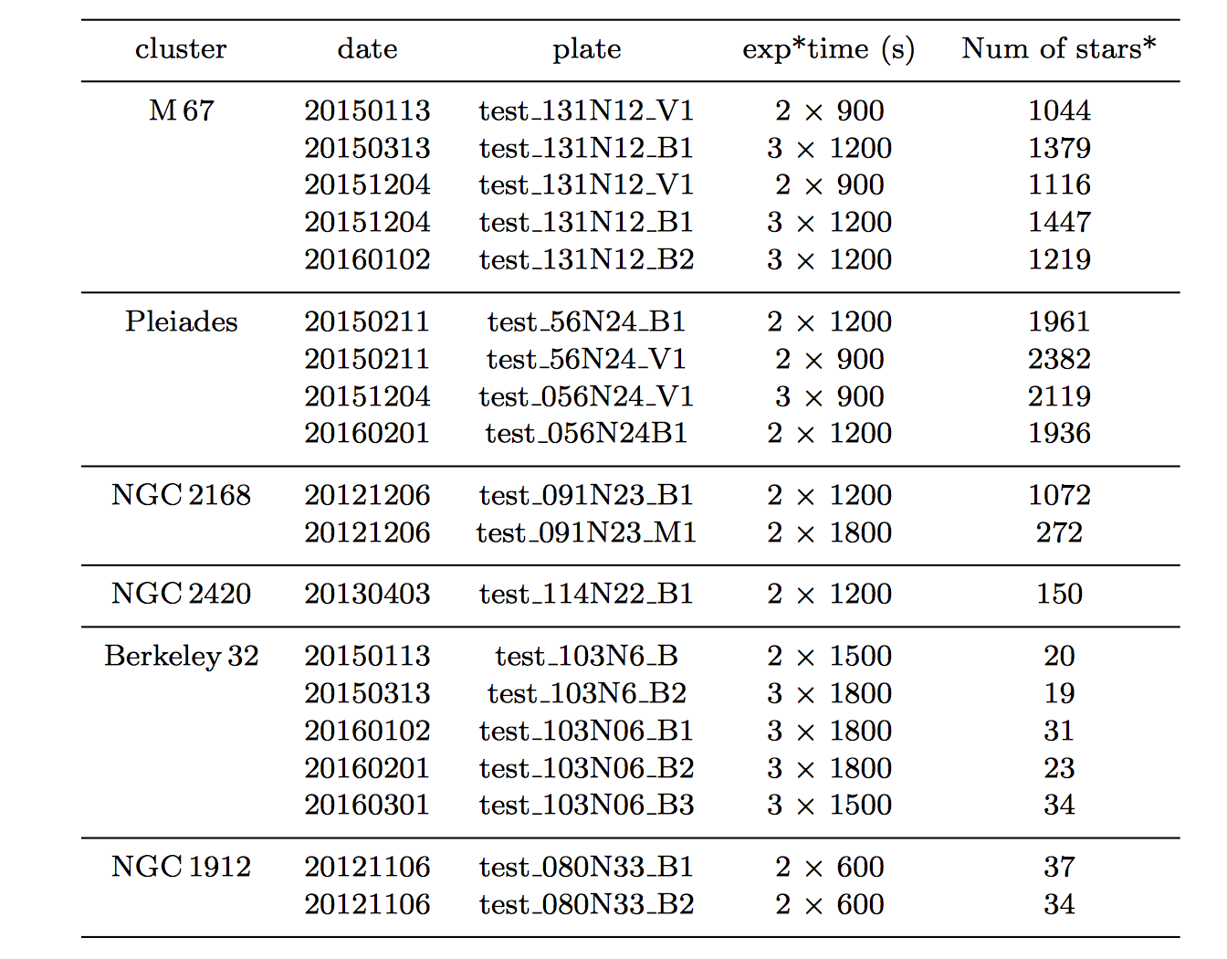

Slide 9
RV、Teff、[Fe/H]、log g：LAMOST stellar parameter pipeline at Peking University - LSP3
Accuracy of LSP3 stellar parameters, for spectra with SNR_B >10 :
5.0 km/s, 150 K, 0.25 dex, 0.15 dex for the radial velocity, effective temperature, surface gravity and metallicity, respectively .
Photometry: g r i: XSTPS-GAC + UCAC4;
Proper Motion: UCAC4

Slide 10
Method of member star selection

Slide 11
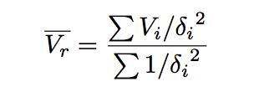
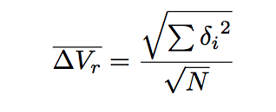
For the duplicate stars we calculated Vr (and also Teff , logg and [Fe/H] below) by taking a mean weighted by the respective errors e.g.:
We calculated a simple quadrature error in the parameter by e.g.:
(Colin A. Navin et al. 2016)

Slide 12
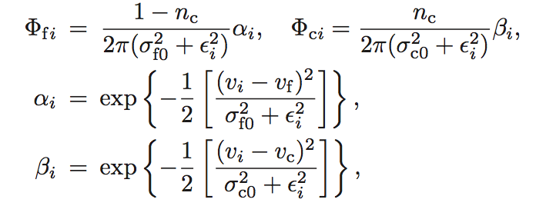
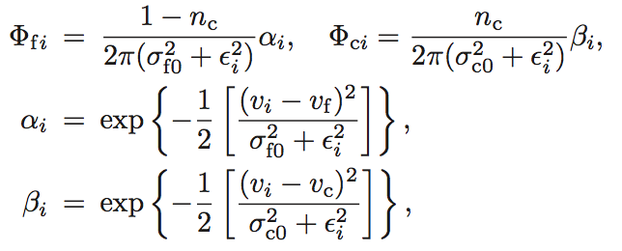
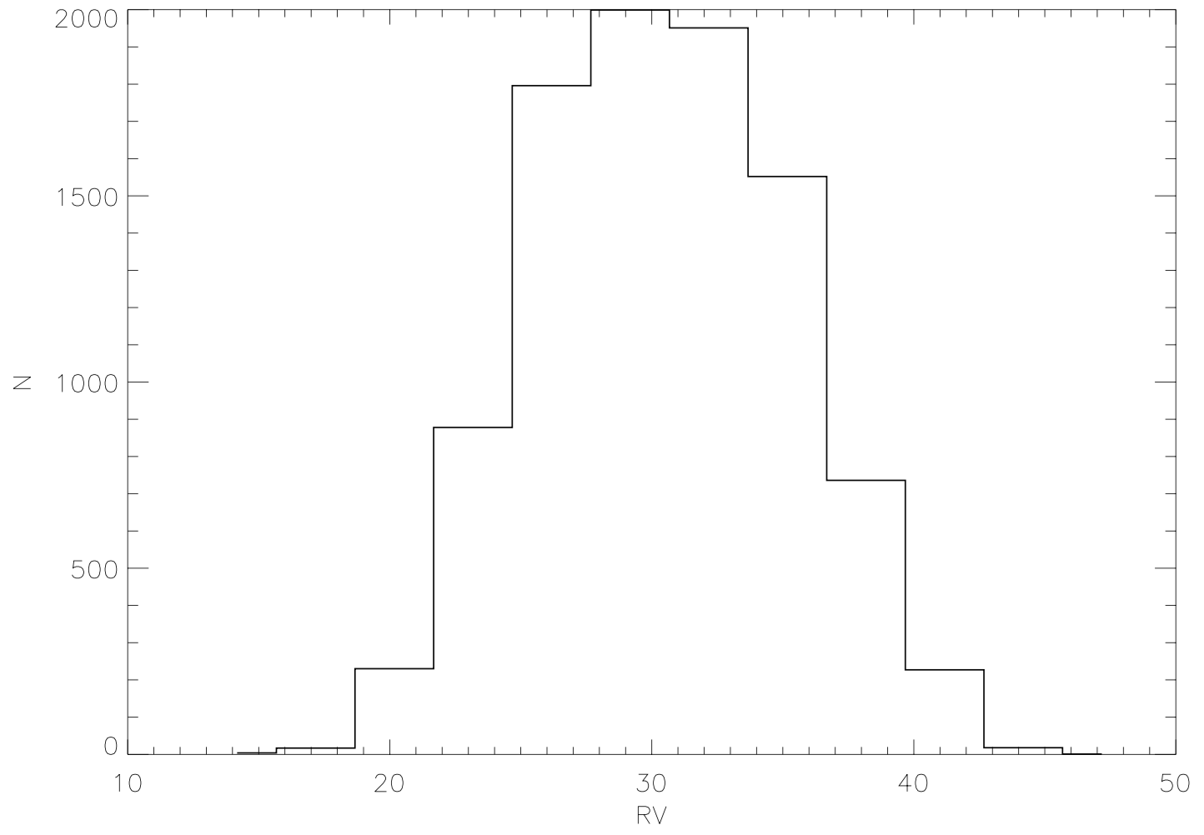
Kinematic cluster membership
RV(radial velocity):
$$n_{c},v_{c},σ_{c},v_{f},σ_{f}$$
($n_{c}$ is the normalized number of member stars)
(Tian et al. 1998, Gao et al. 2010)

Slide 13
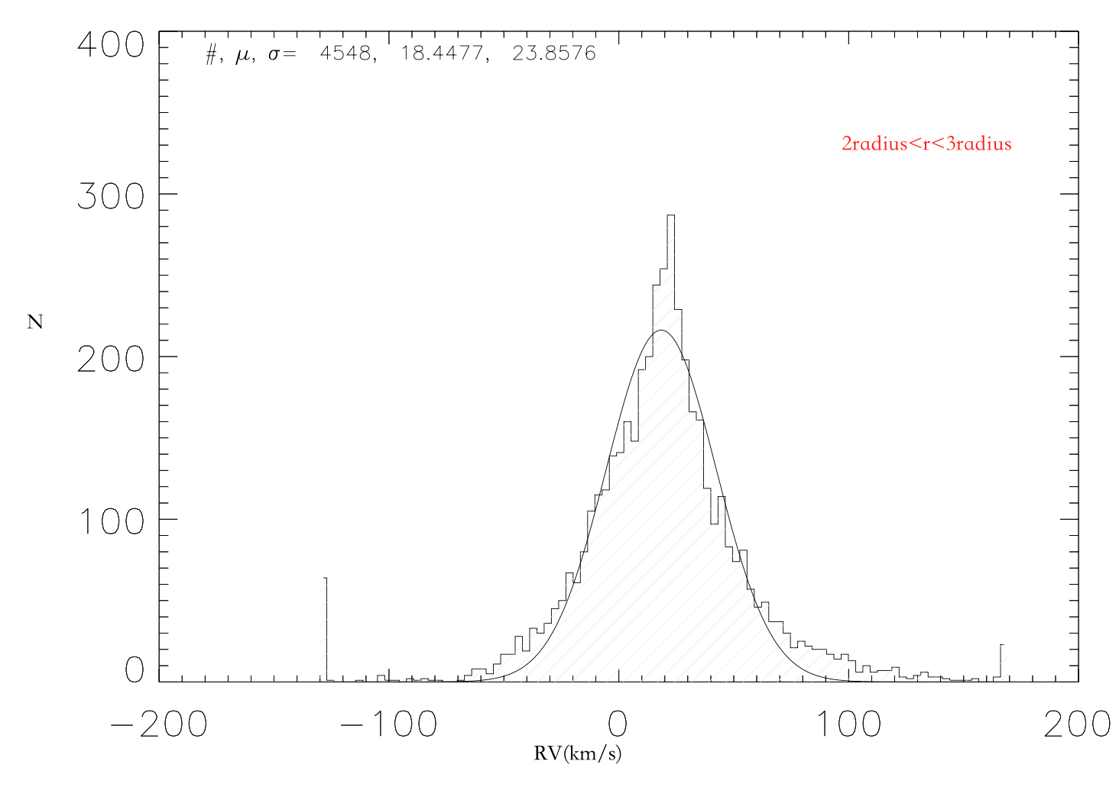
M67
Geller et al. 2015 $v_{c},σ_{c}$
$v_{f},σ_{f}$
$n_{c}$ : were estimated by a maximum likelihood method.
Cluster
(33.615 , 0.854 )
Field
(18.45,23.86)

Slide 14
Distribution Parameters of Radial Velocity for the Ten Open Clusters

Slide 15
PM(proper motion):
Cluster
field
($μ_{xc}$, $μ_{yc}$) the cluster proper motion center
$σ_{c}$ the intrinsic proper motion dispersions
($μ_{xf}$ , $μ_{yf}$ ) the field proper motion center
($σ_{xf}$, $σ_{yf}$) the field intrinsic proper motion dispersions
$γ$the correlation coefficient , $n_{c}$ is the normalized number
Balaguer-Nunez et al.1998

Slide 16
Distribution Parameters of Proper Motion for the Ten Open Clusters

Slide 17
Photometric cluster membership
Color Magnitude Diagram(CMD)
Band: g and r
Isochrone fitting
(Isochrone: PADOVA )
Distance modulus
Colour-excess: E(g-r)
g-r+E(g-r) vs r+MOD+Ar

Slide 18
Results

Slide 19
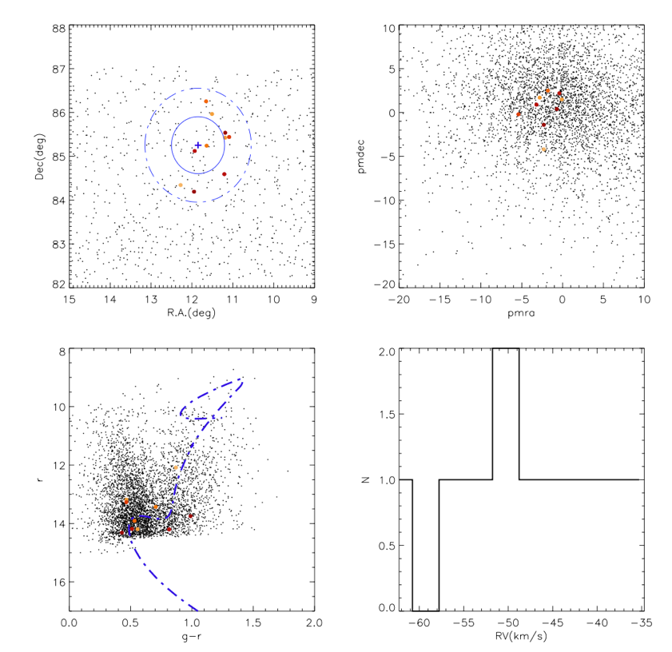
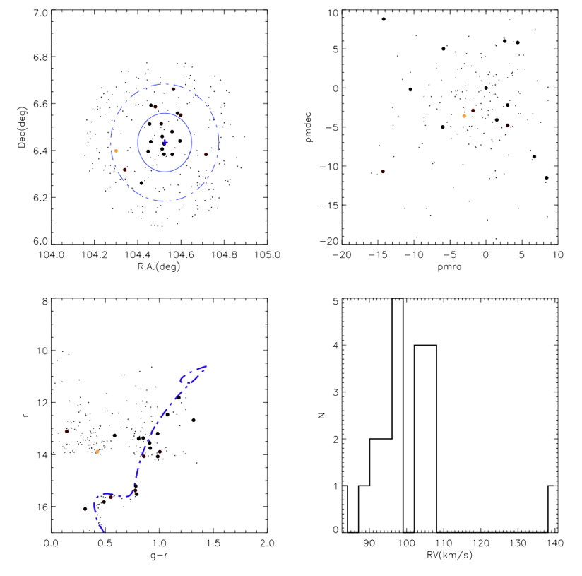
NGC 188
Berkeley 32
Member star candidates : 10
LAMOST Spectra: 11
Member star candidates : 20
LAMOST Spectra: 29
0
0.2
0.4
0.6
0.8
1

Slide 20
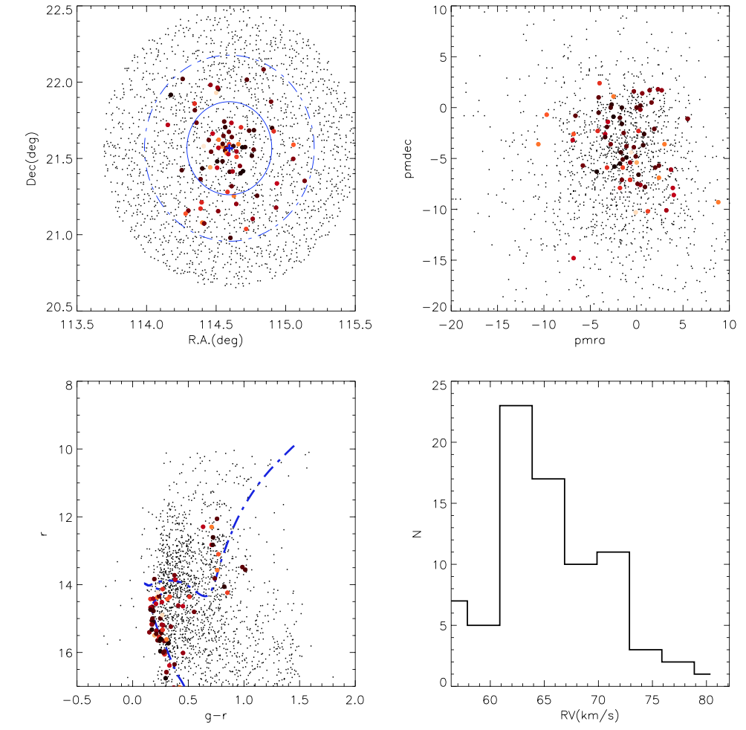
M67(NGC 2682)
NGC 2420
Member star candidates : 457
LAMOST Spectra: 3887
Member star candidates : 79
LAMOST Spectra: 159
0
0.2
0.4
0.6
0.8
1

Slide 21
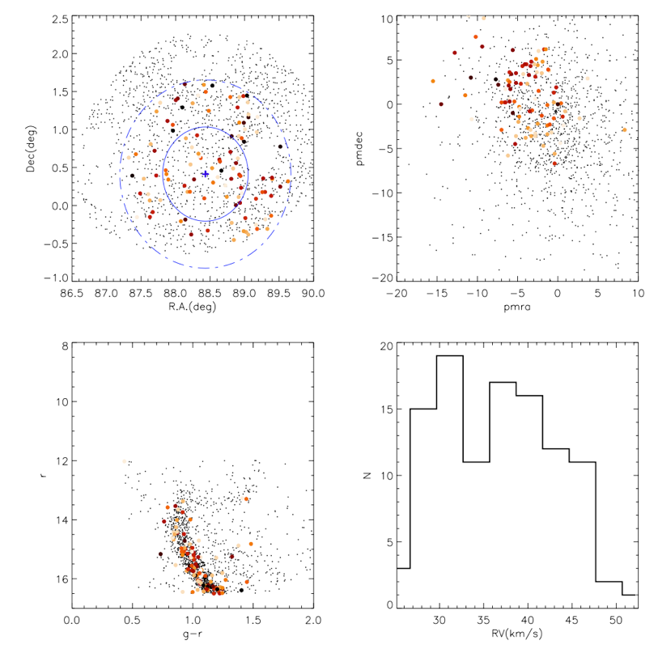
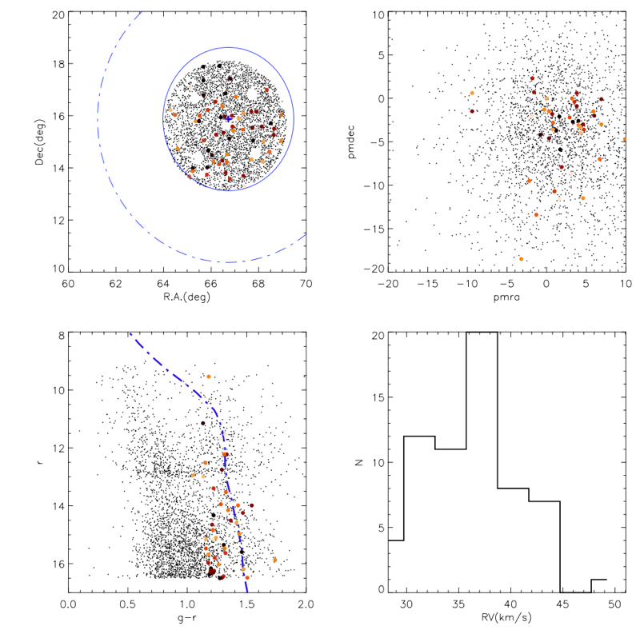
NGC 2112
Hyades
Member star candidates : 107
LAMOST Spectra: 107
Member star candidates : 63
LAMOST Spectra: 71
0
0.2
0.4
0.6
0.8
1

Slide 22
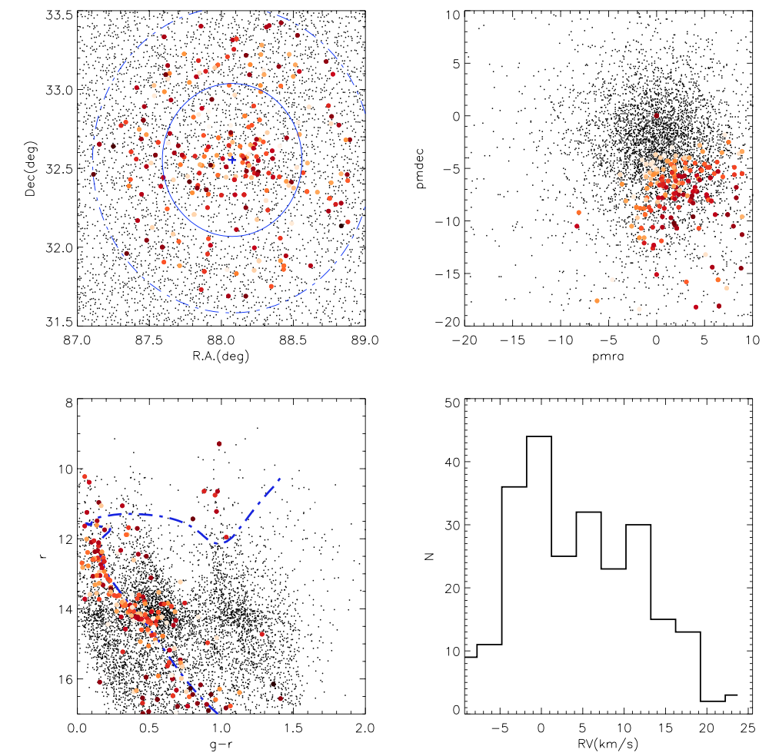
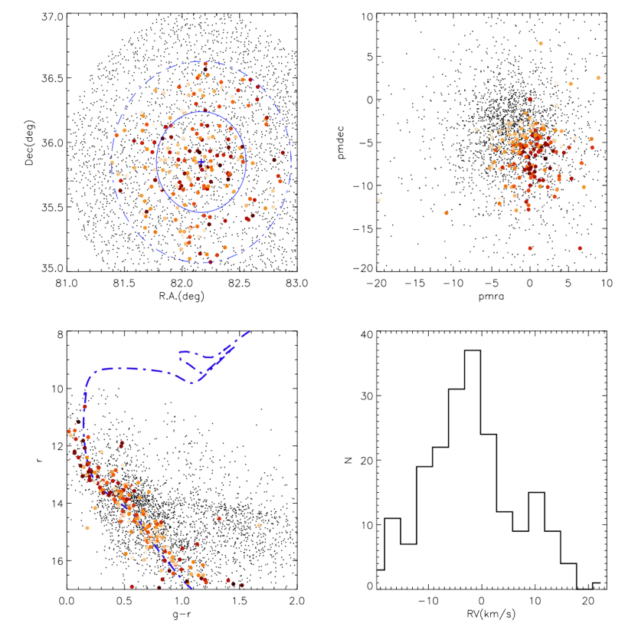
NGC 2099
NGC 1912
Member star candidates : 243
LAMOST Spectra: 376
Member star candidates : 63
LAMOST Spectra: 71
0
0.2
0.4
0.6
0.8
1

Slide 23
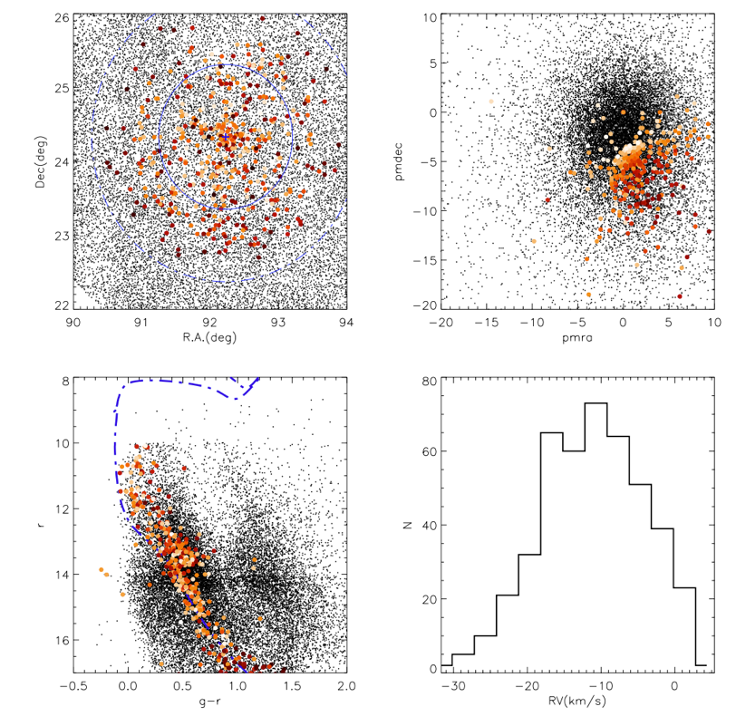
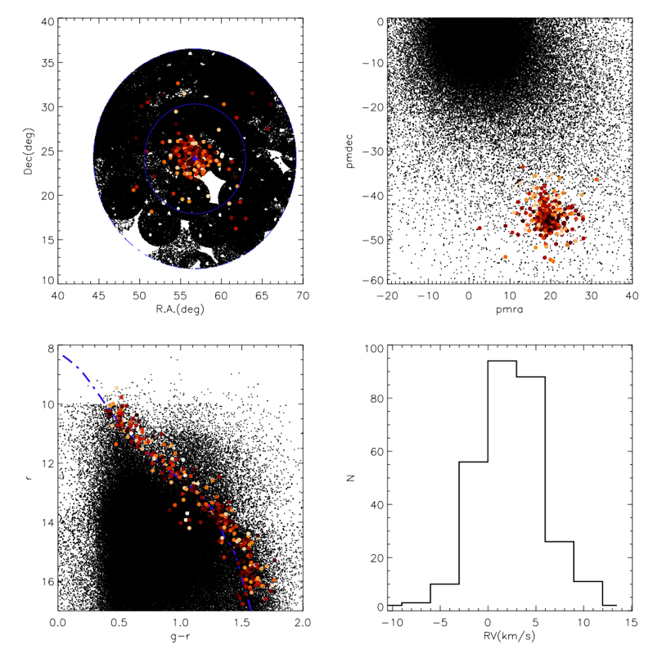
NGC 2168
PLeiades
Member star candidates : 447
LAMOST Spectra: 987
Member star candidates : 317
LAMOST Spectra: 1369
0
0.2
0.4
0.6
0.8
1

Slide 24
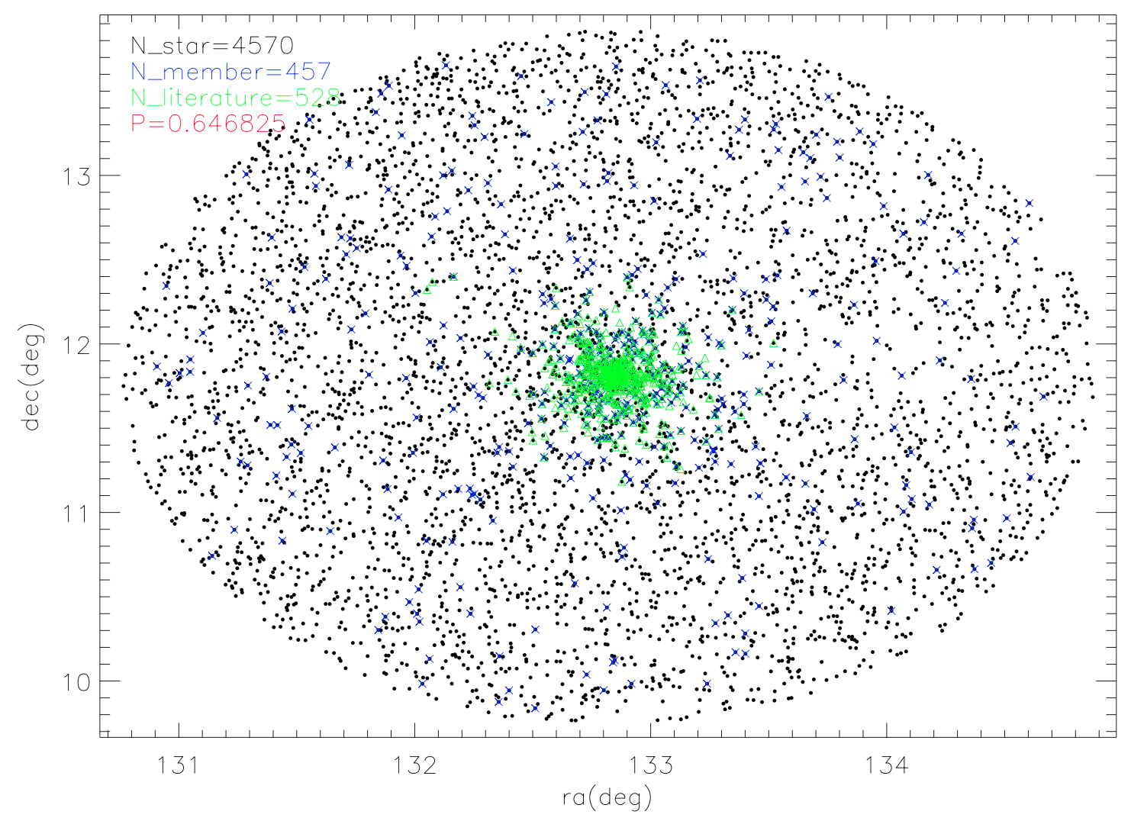
Compare with previous membership determination
P=(our members cross with members from literature)/ (whole sample stars cross with members from literature)
M67
Geller+ 2015
Pace+ 2012

Slide 25
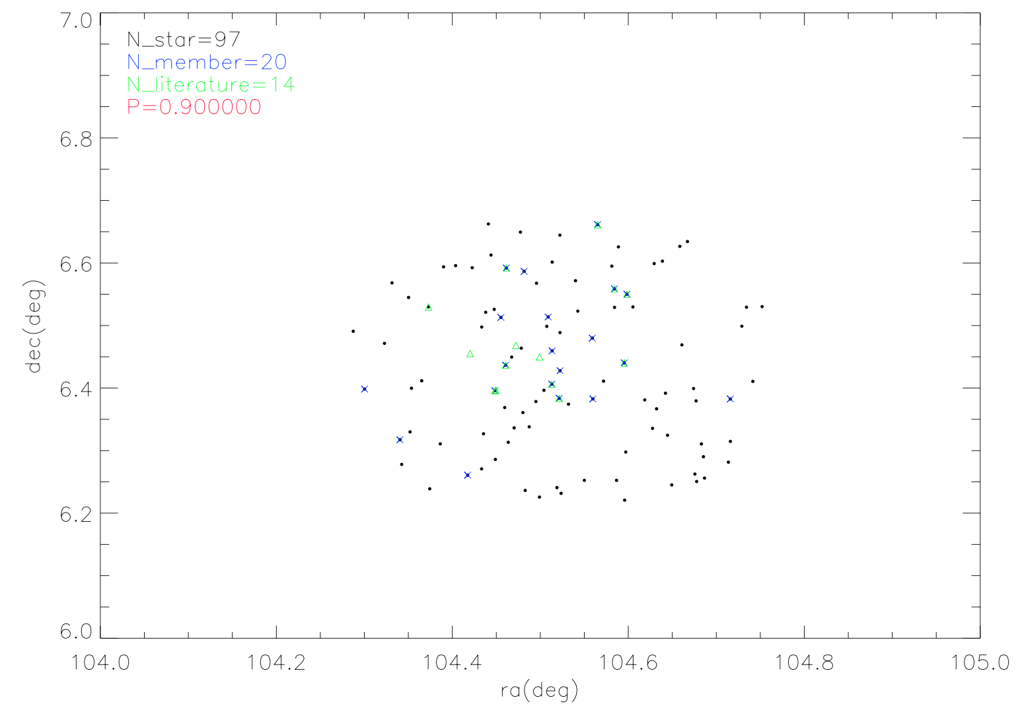
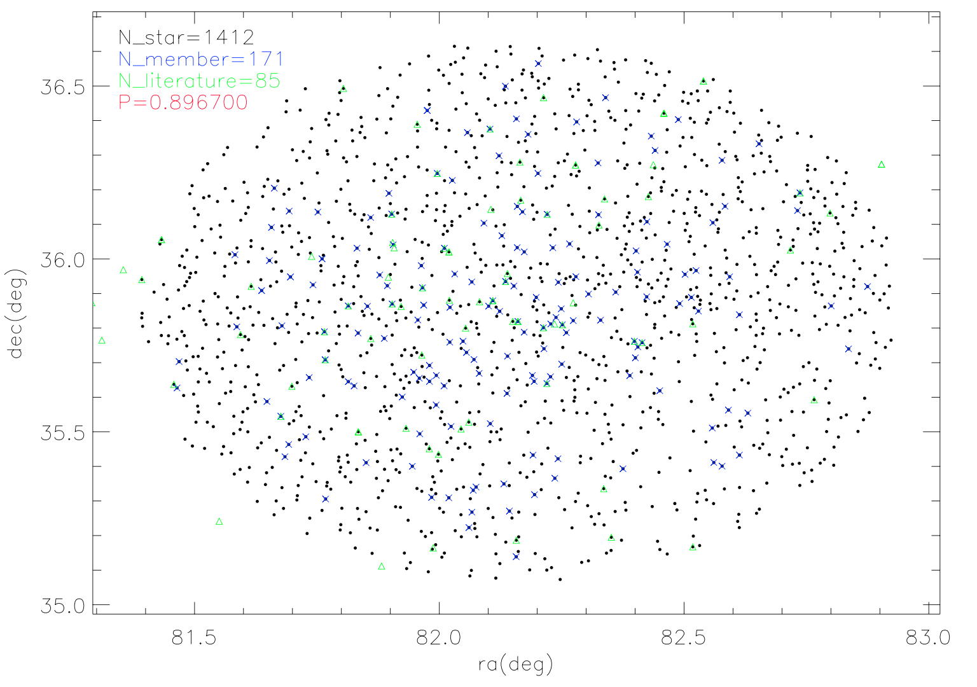
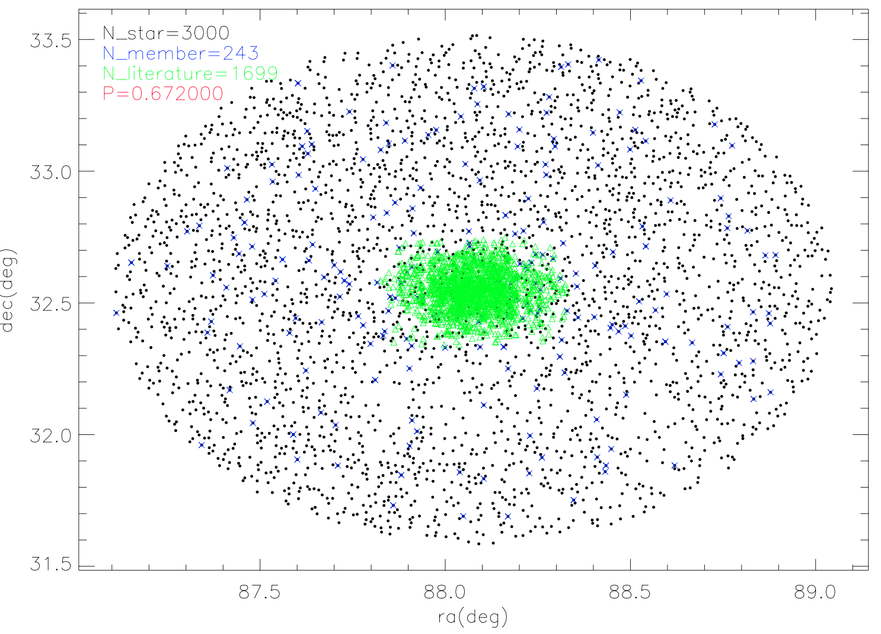
Berkeley 32
Dorazi+ 2006
Zhang+ 2015
NGC 1912
NGC 2099

Slide 26
SUMMARY
Ten Open clusters of different ages and different [Fe/H] targeted
We get a good sample of Member star candidates from ten open clusters .

